Slide 1
Reducing the carbon footprint of Heidelberg University Hospital: Preliminary results of the KLIOL-Project
Climate Change and Pandemics
Symposium 23.-25.06.2022
Dr med. Alina Herrmann
Heidelberger Institut für Global Health
Uniklinikum Heidelberg
Alina.herrmann@uni-heidelberg.de

Slide 2
Conflict of Interest Statement
I am member of the German Climate Change and Health Alliance (KLUG e.V.).
I have no other conflicts of interest to declare.
HIGH SYMPOSIUM 2022

Slide 3
Structure
Background
Setting and Aims
Preliminary Results
Conclusions
HIGH SYMPOSIUM 2022

Slide 4
Structure
Background
Aims and Procedures of the KliOL Project
Preliminary Results
Conclusions

Slide 5
Background 1
More than 2/3rd of Health Systems‘ Emissions are Scope-3 Emissions
Tennison et al 2021, Lancet Planetary Health
HIGH SYMPOSIUM 2022

Slide 6
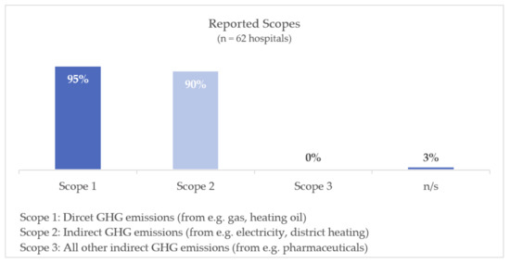
CO2-Reporting in German Hospitals
Background 2
In 2020 in Germany 232 out of 1925 hospitals reported their GHG emissions (12%).
62 hospitals reported hospital specific data (3%).
None reported Scope 3 emissions.
Source: Quitmann, C., Sauerborn, R., & Herrmann, A. (2021). Gaps in reporting greenhouse gas emissions by German Hospitals—A systematic grey literature review. Sustainability, 13(3), 1430.
HIGH SYMPOSIUM 2022

Slide 7
Climate Change Mitigation in Hospitals can have Health Co-benefits
Background 3
Active Mobility
Planetary Health Diet
Telemedicine*
Reduced Overprescription
*Miah et al 2018
HIGH SYMPOSIUM 2022

Slide 8
Structure
Background
Setting and Aims
Preliminary Results
Conclusions
HIGH SYMPOSIUM 2022

Slide 9
The KliOL-Project* - Climate Change Mitigation in Hospitals through optimization of supply chains
*Original Titel: Klimaschutz an Kliniken durch Optimierung von Lieferketten

Slide 10
Aims
To reduce 7% of the Scope 3 Emissions of UKHD (6000 tons)
To built a Carbon Footprint Calculator for hospitals and apply it to UKHD
To identify effective and feasible GHG reduction measures and implement them
To evaluate the GHG reduction measures with regard to GHG reduction and health co-benefits
To make a stakeholder analysis about the perceptions of GHG reduction measures at UKHD
HIGH SYMPOSIUM 2022

Slide 11
Structure
Background
Setting, Aims and Procedures
Preliminary Results
Conclusions
HIGH SYMPOSIUM 2022

Slide 12
Preliminary Results 2: Carbon Footprint Heidelberg
Anesthetic Gases, 1%
“Grey Emissions”, 14%
Electricity, 12%
Food Supply, 3%
Employee Transport, 5%
Patient Transport, 6%
Medical Products, 22%
Pharmaceuticals, 12%
HIGH SYMPOSIUM 2022

Slide 13
Preliminary Results 2: Carbon Footprint Heidelberg
HIGH SYMPOSIUM 2022

Slide 14
Preliminary Results 1: Stakeholder Analyse
Stakeholder perceptions of Climate change Mitigation in hospitals
(Mis-)perception that climate change mitigation comprises patient care.
Priority is on patient care
Adverse environmental impacts are accepted
Patient welfare simply has priority over climate change mitigation. That’s just how it is. This is how it should be. No one is supposed to leave the gloves on from patient to patient for environmental reasons.
(administrative staff, female).
Mitigation measures with same or improved patient care. Emphasis on Health Co-Benefits. Communication medical ethics principal of “doing no harm”.
Source: Quitmann, C., Sauerborn, R., Danquah, I., & Herrmann, A. (2022). ‘Climate change mitigation is a hot topic, but not when it comes to hospitals’: a qualitative study on hospital stakeholders’ perception and sense of responsibility for greenhouse gas emissions. Journal of Medical Ethics.
UKHD KliOL Steuerungsgruppe 23.02.2022

Slide 15
As a doctor, you are not exempt from thinking that everything is centered on the patient and that this justifies everything.(...) But actually the opposite is the case, if you are responsible for people, you should actually ensure (...) that you also act in the interests of people in other areas [e.g. climate change].
(clinical staff, male)

Slide 16
Structure
Background
Setting, Aims and Procedures
Preliminary Results
Conclusions
HIGH SYMPOSIUM 2022

Slide 17
Conclusions
Measuring Scope 3 emissions is important, more sophisticated analysis would require better life cycle assessments from industry
Stakeholder Involvement (Bottom-up and top-down) is crucial for footprinting and implementation of mitigation measures
Communicating health co-benefits and “doing no harm” seems to be crucial
HIGH SYMPOSIUM 2022

Slide 18
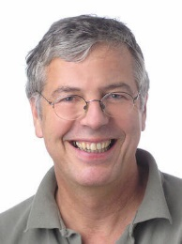
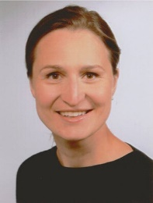
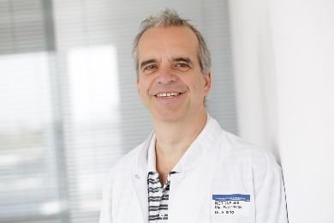
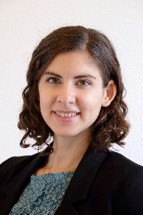
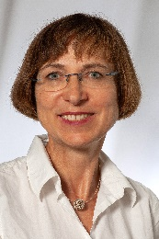
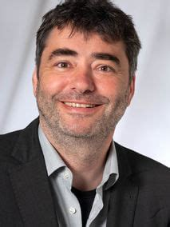
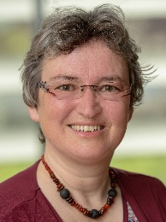
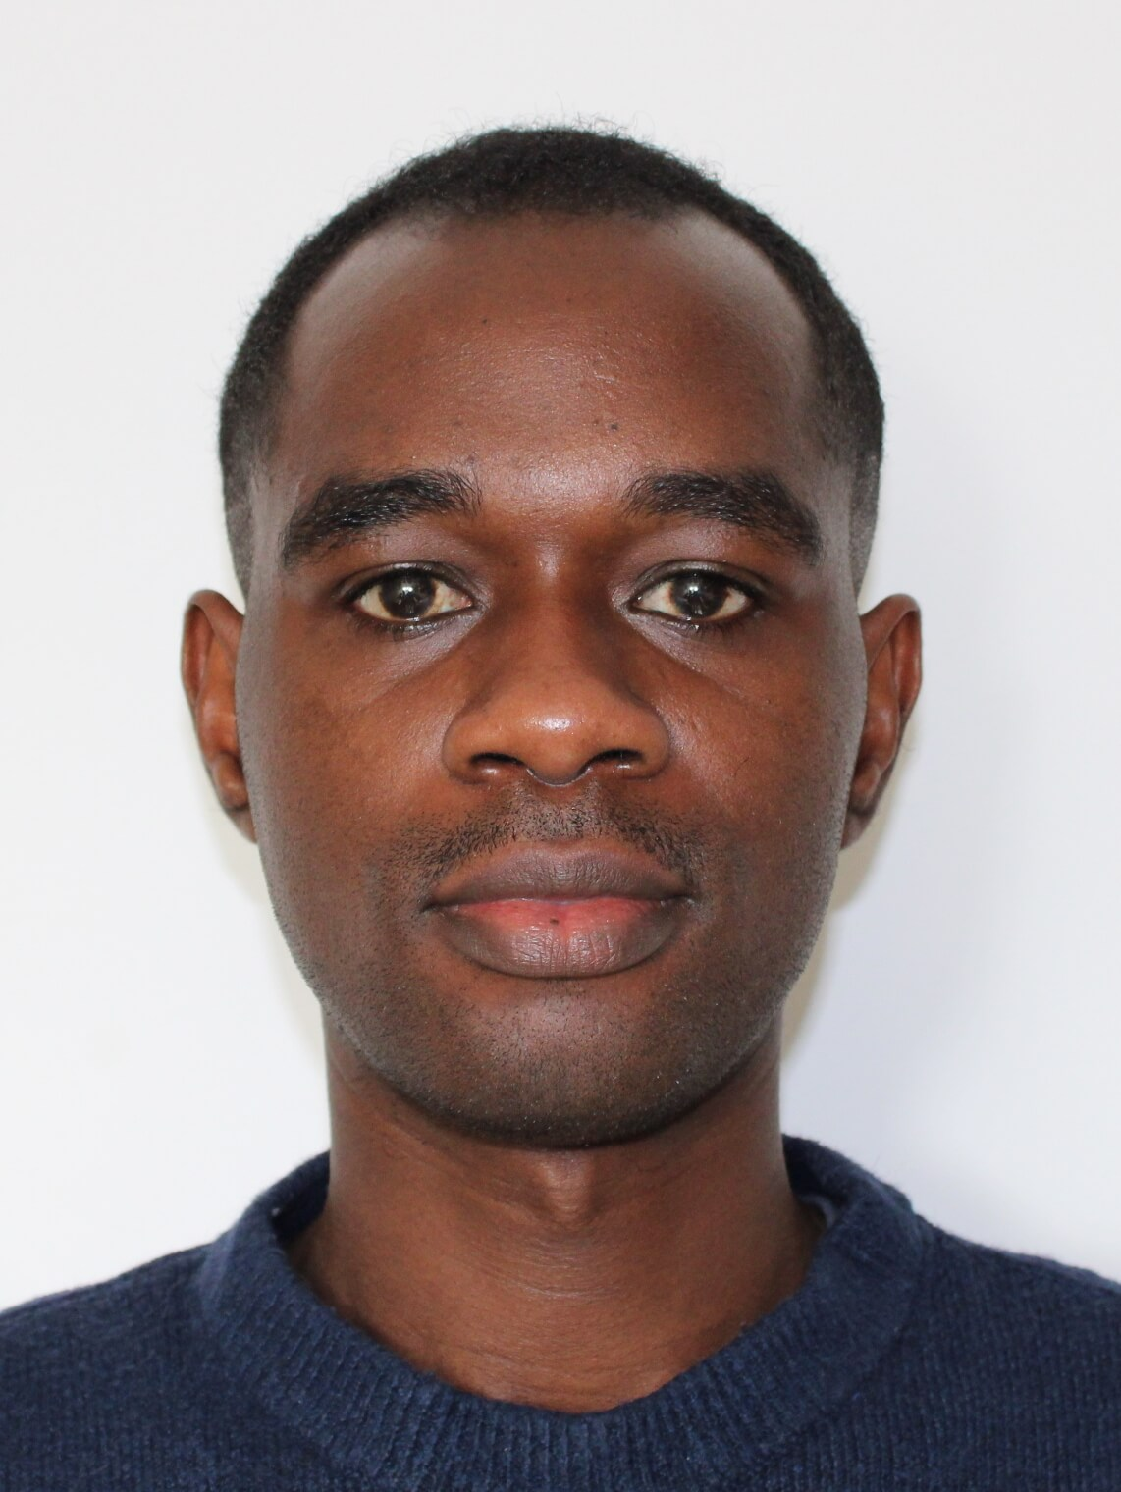
Thank you.
www.kliol-projekt.ukhd.de

Slide 19
KLiOL-Klimaschutz in Kliniken durch Optimierung von Lieferketten
UKHD KliOL Steuerungsgruppe 01.12.2021
Notes:
- Hier schon Stakeholder-Analyse erwähnen; parallel zu 1 und 2 bzw. schon erfolgt

Slide 20
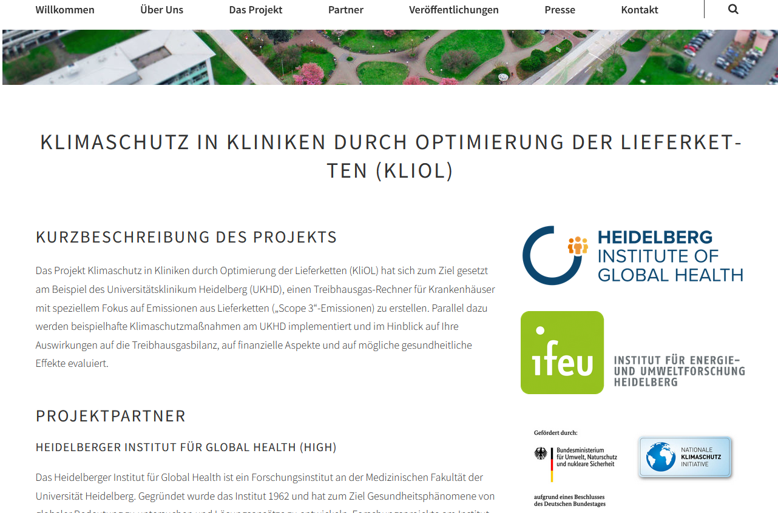
Vielen Dank für Ihre Aufmerksamkeit.
www.kliol-projekt.ukhd.de
Alina.herrmann@uni-heidelberg.de
UKHD KliOL Steuerungsgruppe 23.02.2022

