Slide 1
Public health and climate change. Has done well. Could do better
Alistair Woodward
University of Auckland
New Zealand
Symposium to celebrate 60 years of the Heidelberg Institute of Global Health, June 2022

Slide 2
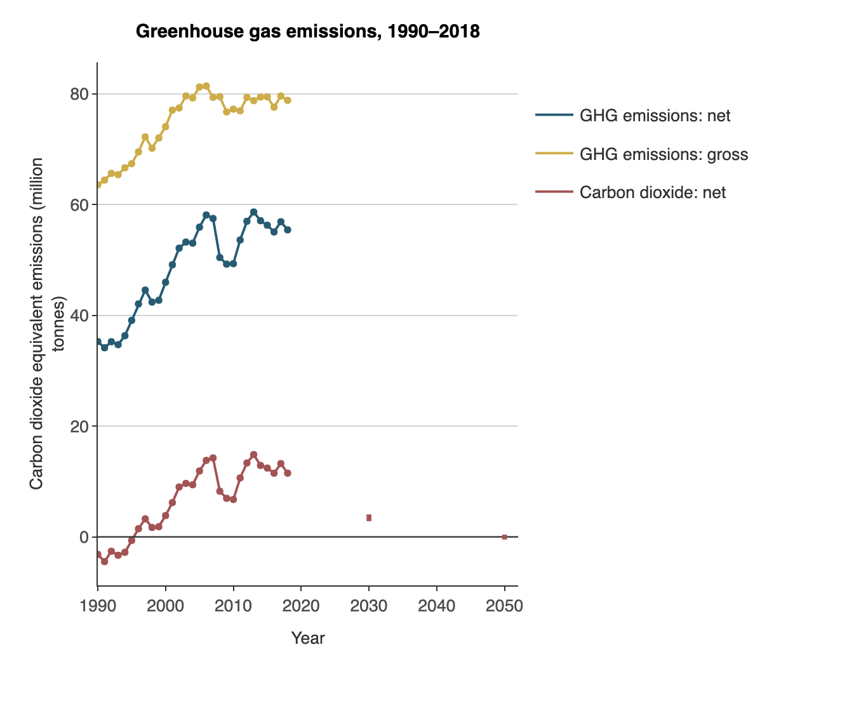
Thirty years of climate science 1990 - 2020; no sign of a fall in greenhouse emissions
In 1990 (AR1) New Zealand was close to carbon net zero.
That is now (AR6) the country’s aspirational target for 2050.
https://www.stats.govt.nz/indicators/new-zealands-greenhouse-gas-emissions

Slide 3
How public health may add value to climate policy
 | Value-adding actions | examples
1. | Provide more and better information on health impacts | Bressler 2021
2. | Health protection adds teeth to climate policy | Campbell-Lendrum 2015
3. | Make better use of openings and opportunities | Semenza 2021
4. | Engage more strongly with advocacy and activism | Rossa-Roccor 2021
Woodward, Wild & Samet. 2022

Slide 4
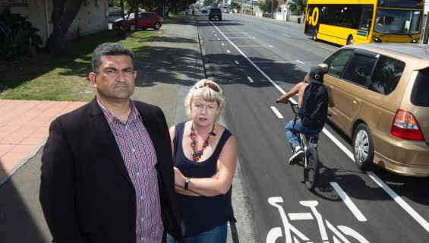
Better information may spur climate action, but often it doesn’t

Slide 5
Policy making is not a system in which rational, independent individuals have the top-down power to make decisions …. Influences include social constructs, narratives, interest coalitions and political and power dynamics.

Slide 6
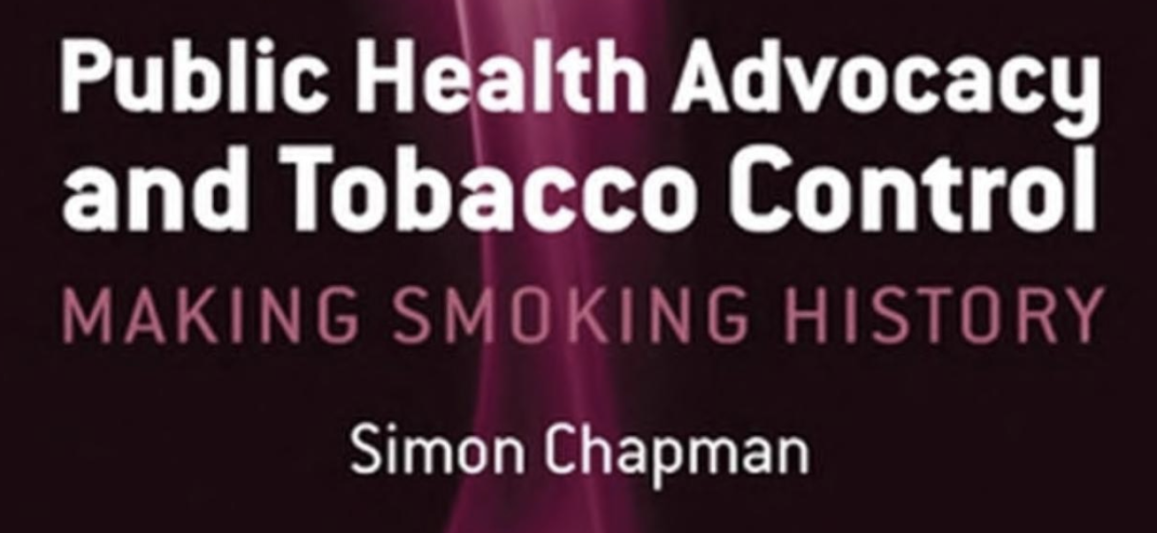
Get close to politicians
News-making is key
Vector control
Challenge norms

Slide 7
“we do not take responsibility for the future, and are unduly deferential to vested interests”
Guy Salmond
https://www.stats.govt.nz/indicators/new-zealands-greenhouse-gas-emissions

Slide 8
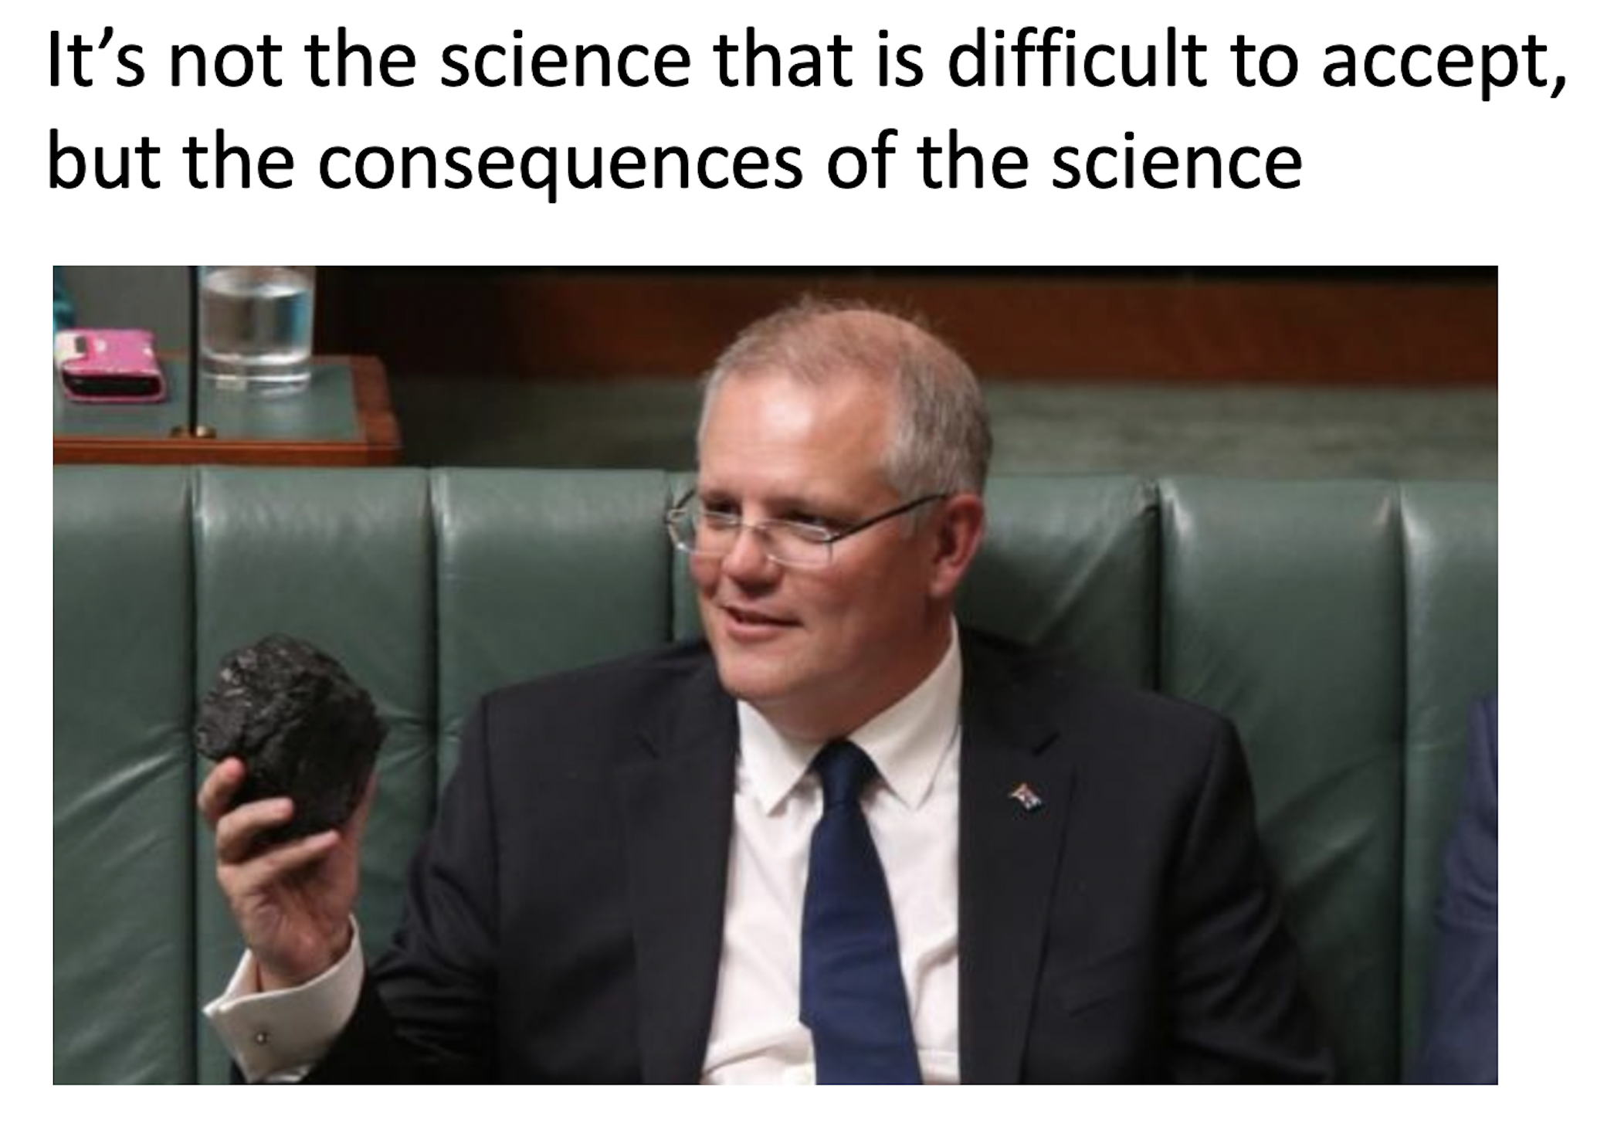
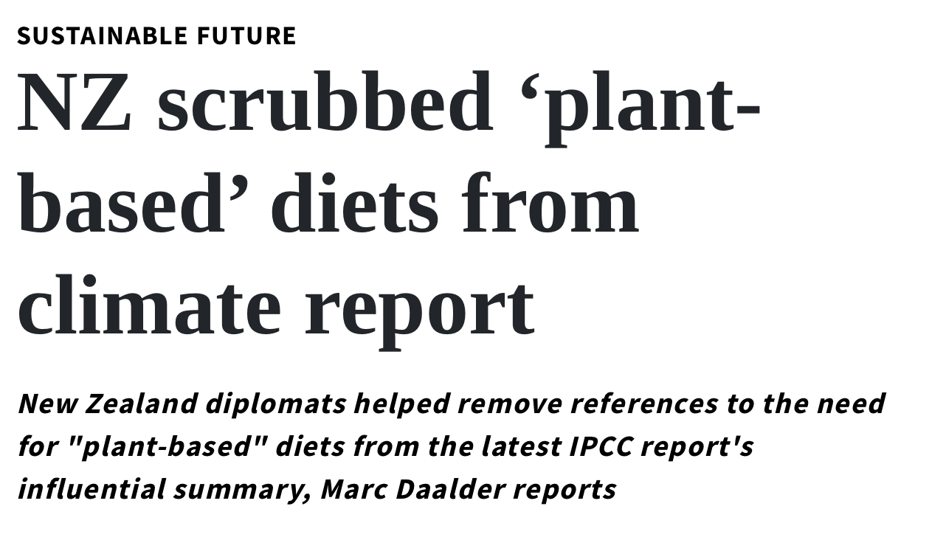

Slide 9
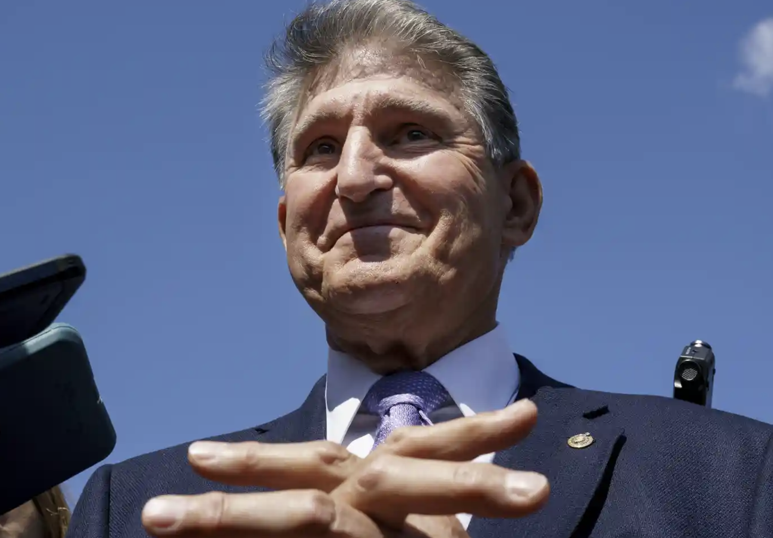
It’s not the science that is difficult to accept, but the consequences of the science
Listen to The Daily on Joe Manchin’s conflict of interests

Slide 10
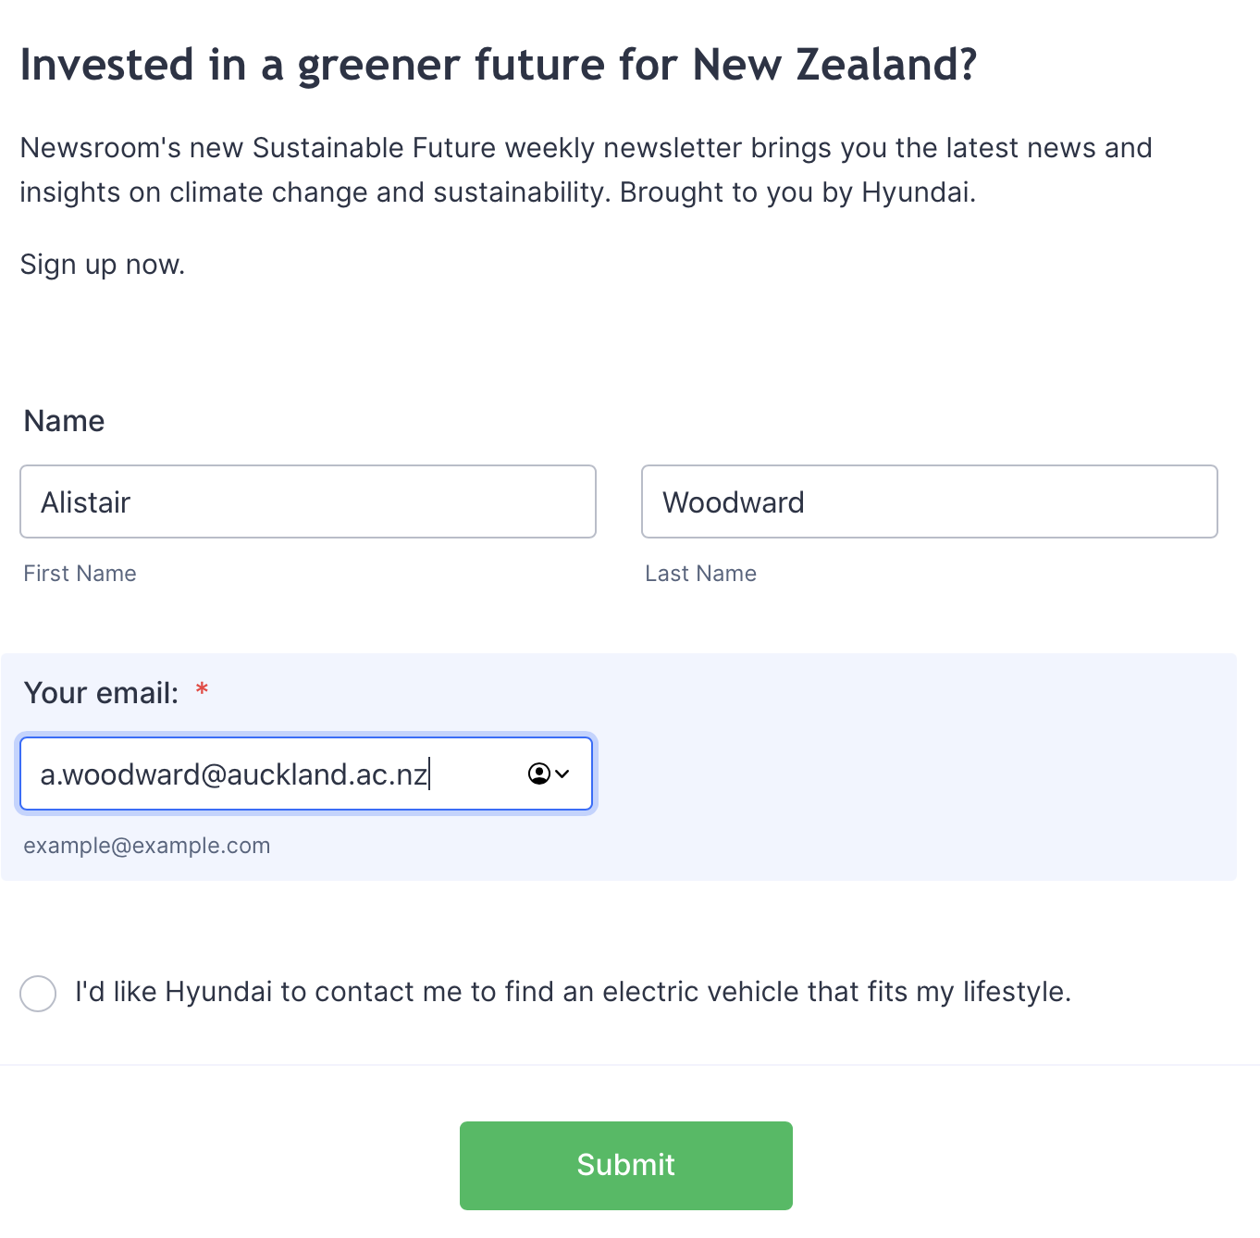

Slide 12
