Slide 1
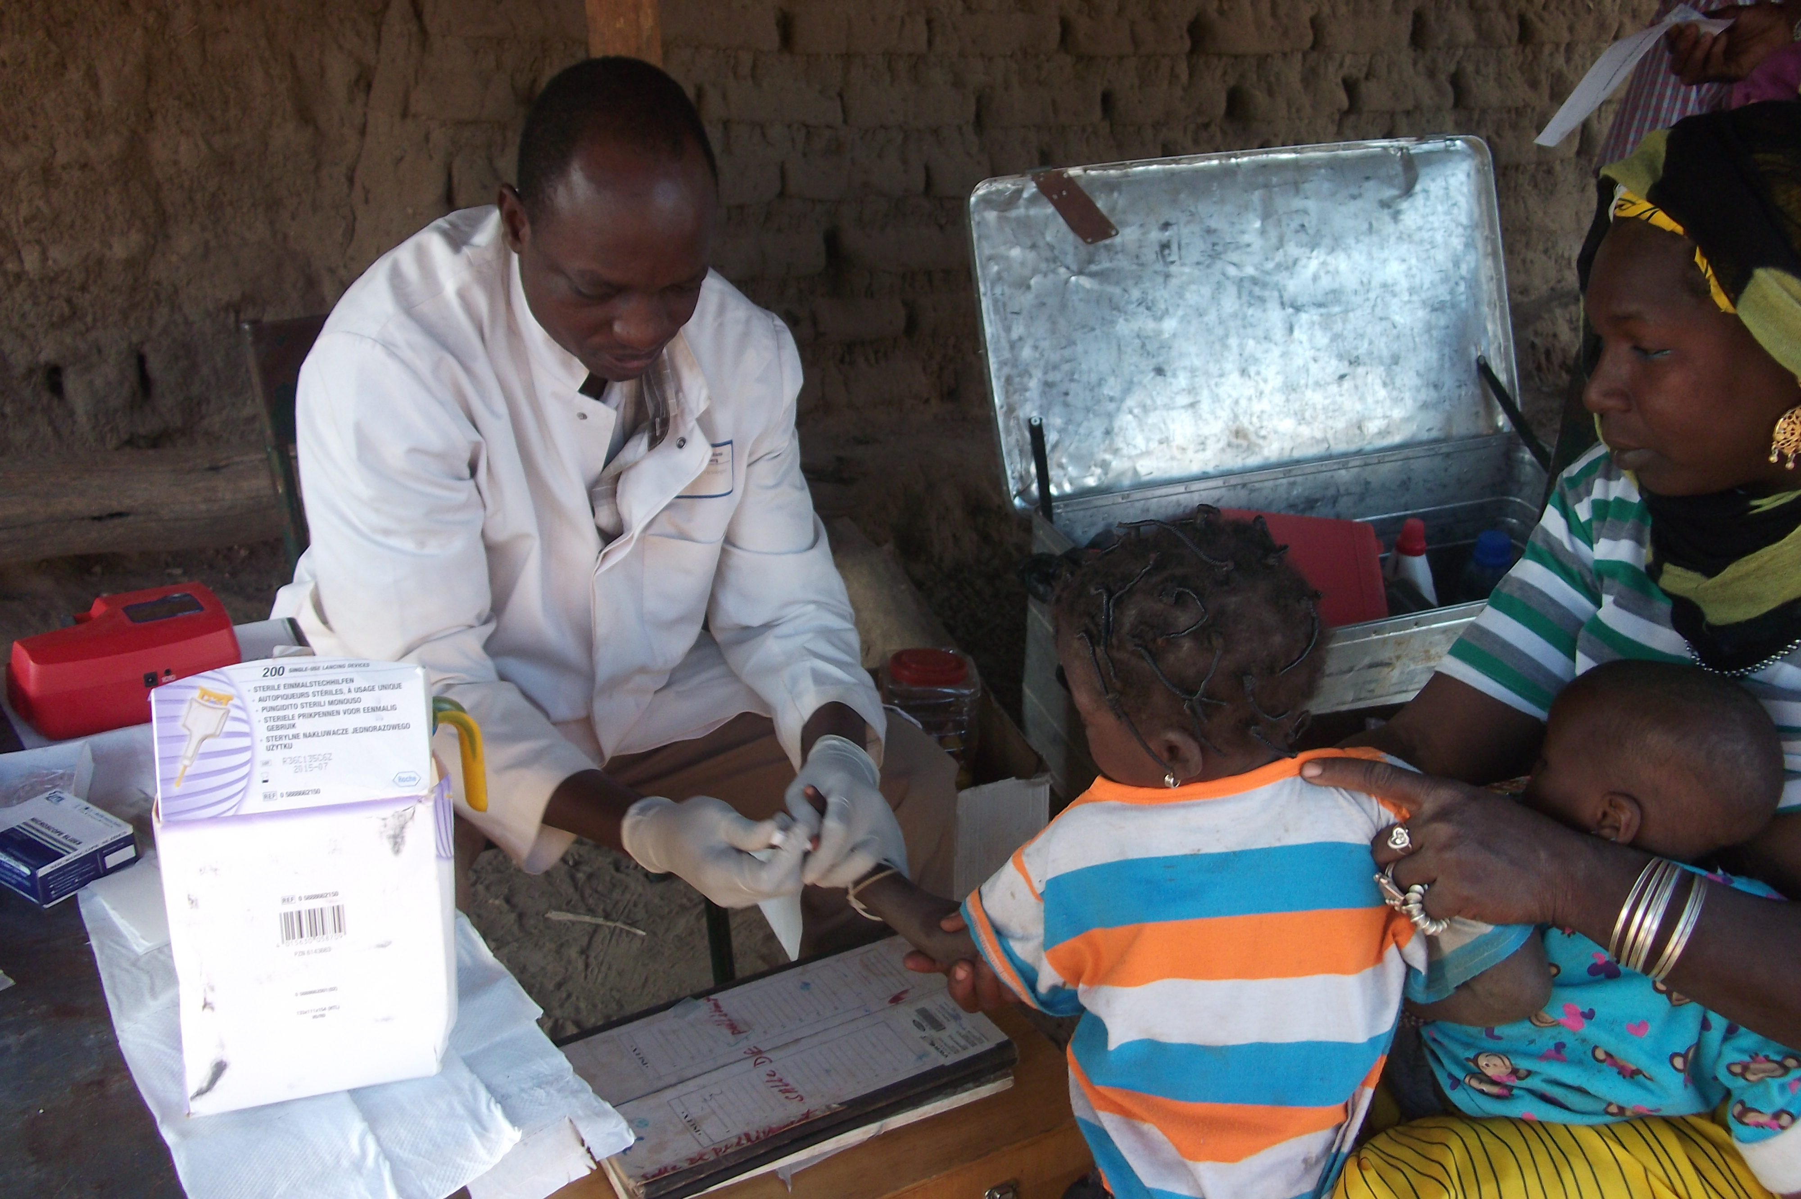
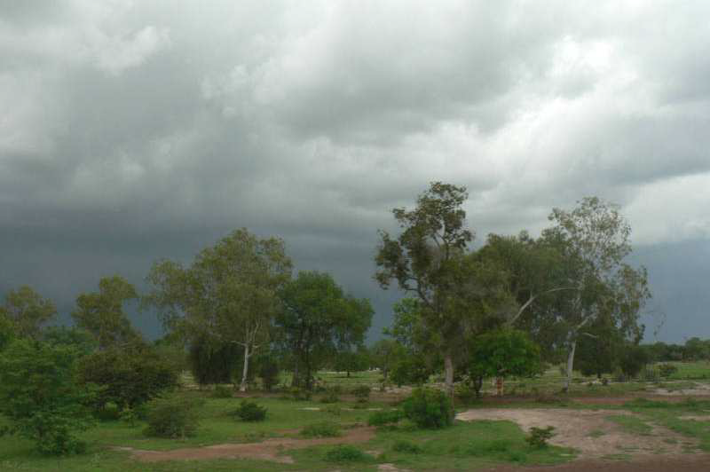
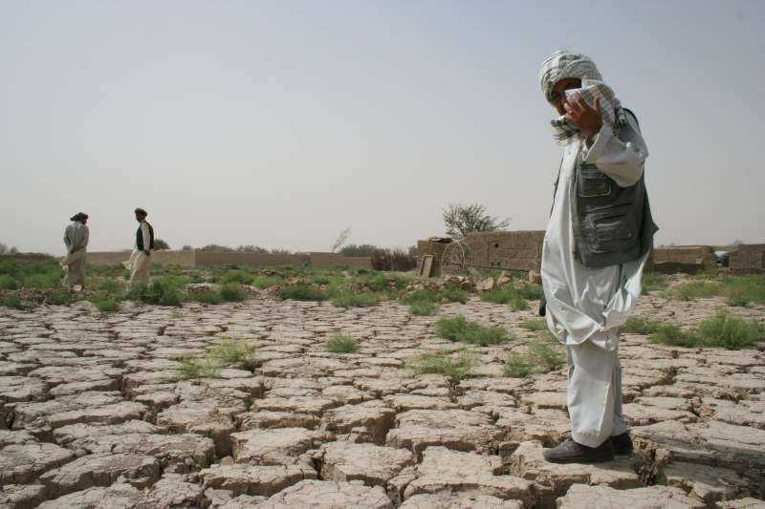
Linking climate and health-cohort data in Africa for research, early warning and policy
WG meeting at ISC 2011, Maputo
Ali Sié, Nouna Health Research Centre/National Institute of Public Health, Burkina Faso
DFG-Symposium : Climate change and pandemics
Heidelberg, June 23-25, 2022

Slide 2
Background
In many LMICs, especially in SSA, there is a lack of effective and comprehensive national civil registration and vital statistics system
This is also true for health systems, incapacitated to provide good & accurate data
HDSS meant to fill this data gap in responding to contextualise interventions to improve health and well-being
HDSS strengths:
Monitors births, deaths, causes of death, migration, and other health and socio-economic indicators within a defined population over time.
Temporal coverage, detail, dense linkage in LMICs

Slide 3
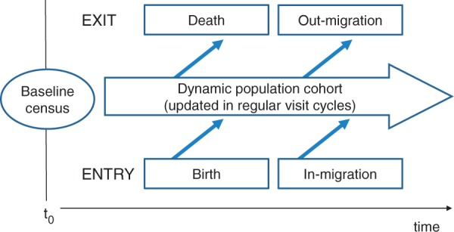
Background
Adaptation to CC impact on health requires:
Improve EWARS to CC phenomena
Strengthen research in CC
HDSS = good environment for both EWARS & research
Need to fill some limitation:
Collect more health data
Link with climate data
This is how HDSS could be more policy relevant despite geographic limitation

Slide 4
EWAR Conceptual Framework
Indicator-based surveillance (IBS)
IBS = systematic collection, monitoring, analysis, and interpretation of structured data, i.e. health-based but not limited.
IBS data are not only employed for EWAR
Event-Based Surveillance (EBS)
EBS = organized collection, monitoring, assessment and interpretation of mainly unstructured information regarding health events or risks, which may represent an acute risk to human health.
EBS is a functional component of EWAR
Epidemic Intelligence (EI)
EI = systematic collection, analysis and communication of any information to detect, verify, assess, and investigate events and health risks with an early warning objective
EI integrates both sources of information (IBS and EBS) in order to detect acute public health events and/or risks.

Slide 5
How do HDSS best contribute to EWARS
Continue assessment of demographic dynamics – births, deaths, migrations, fertility, etc.
Adding climate/weather data
Daily meteorological data on site
Nearest national weather stations
Online Climate Data
Environmental contexts, risks, exposures
Food security
Capturing morbidity
Make morbidity surveillance routine
Avoiding seasonal bias
Establish burden of diseases for study population
Introduce direct health measurement

Slide 6
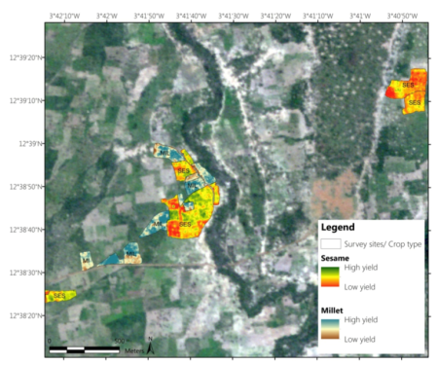
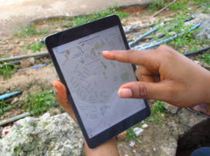
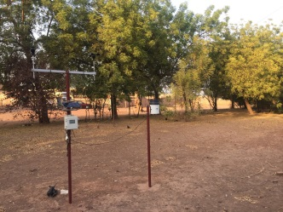
Linking climate data to HDSS
DFG RU Climate Change and Health
Seafile Cloud
Local Server/DFG RU
DFG RU
MOOC
Remote sensing
local servers / African partners
Sensors
Weather stations
Nouna & Kisumu/HDSS
Bärnighausen, Sié, Barteit 2019
Notes:
Entweder dieses Dia als Finale Zusammenfassung, auch eine Verbeugung in Richtung Till und CP1!

Slide 7
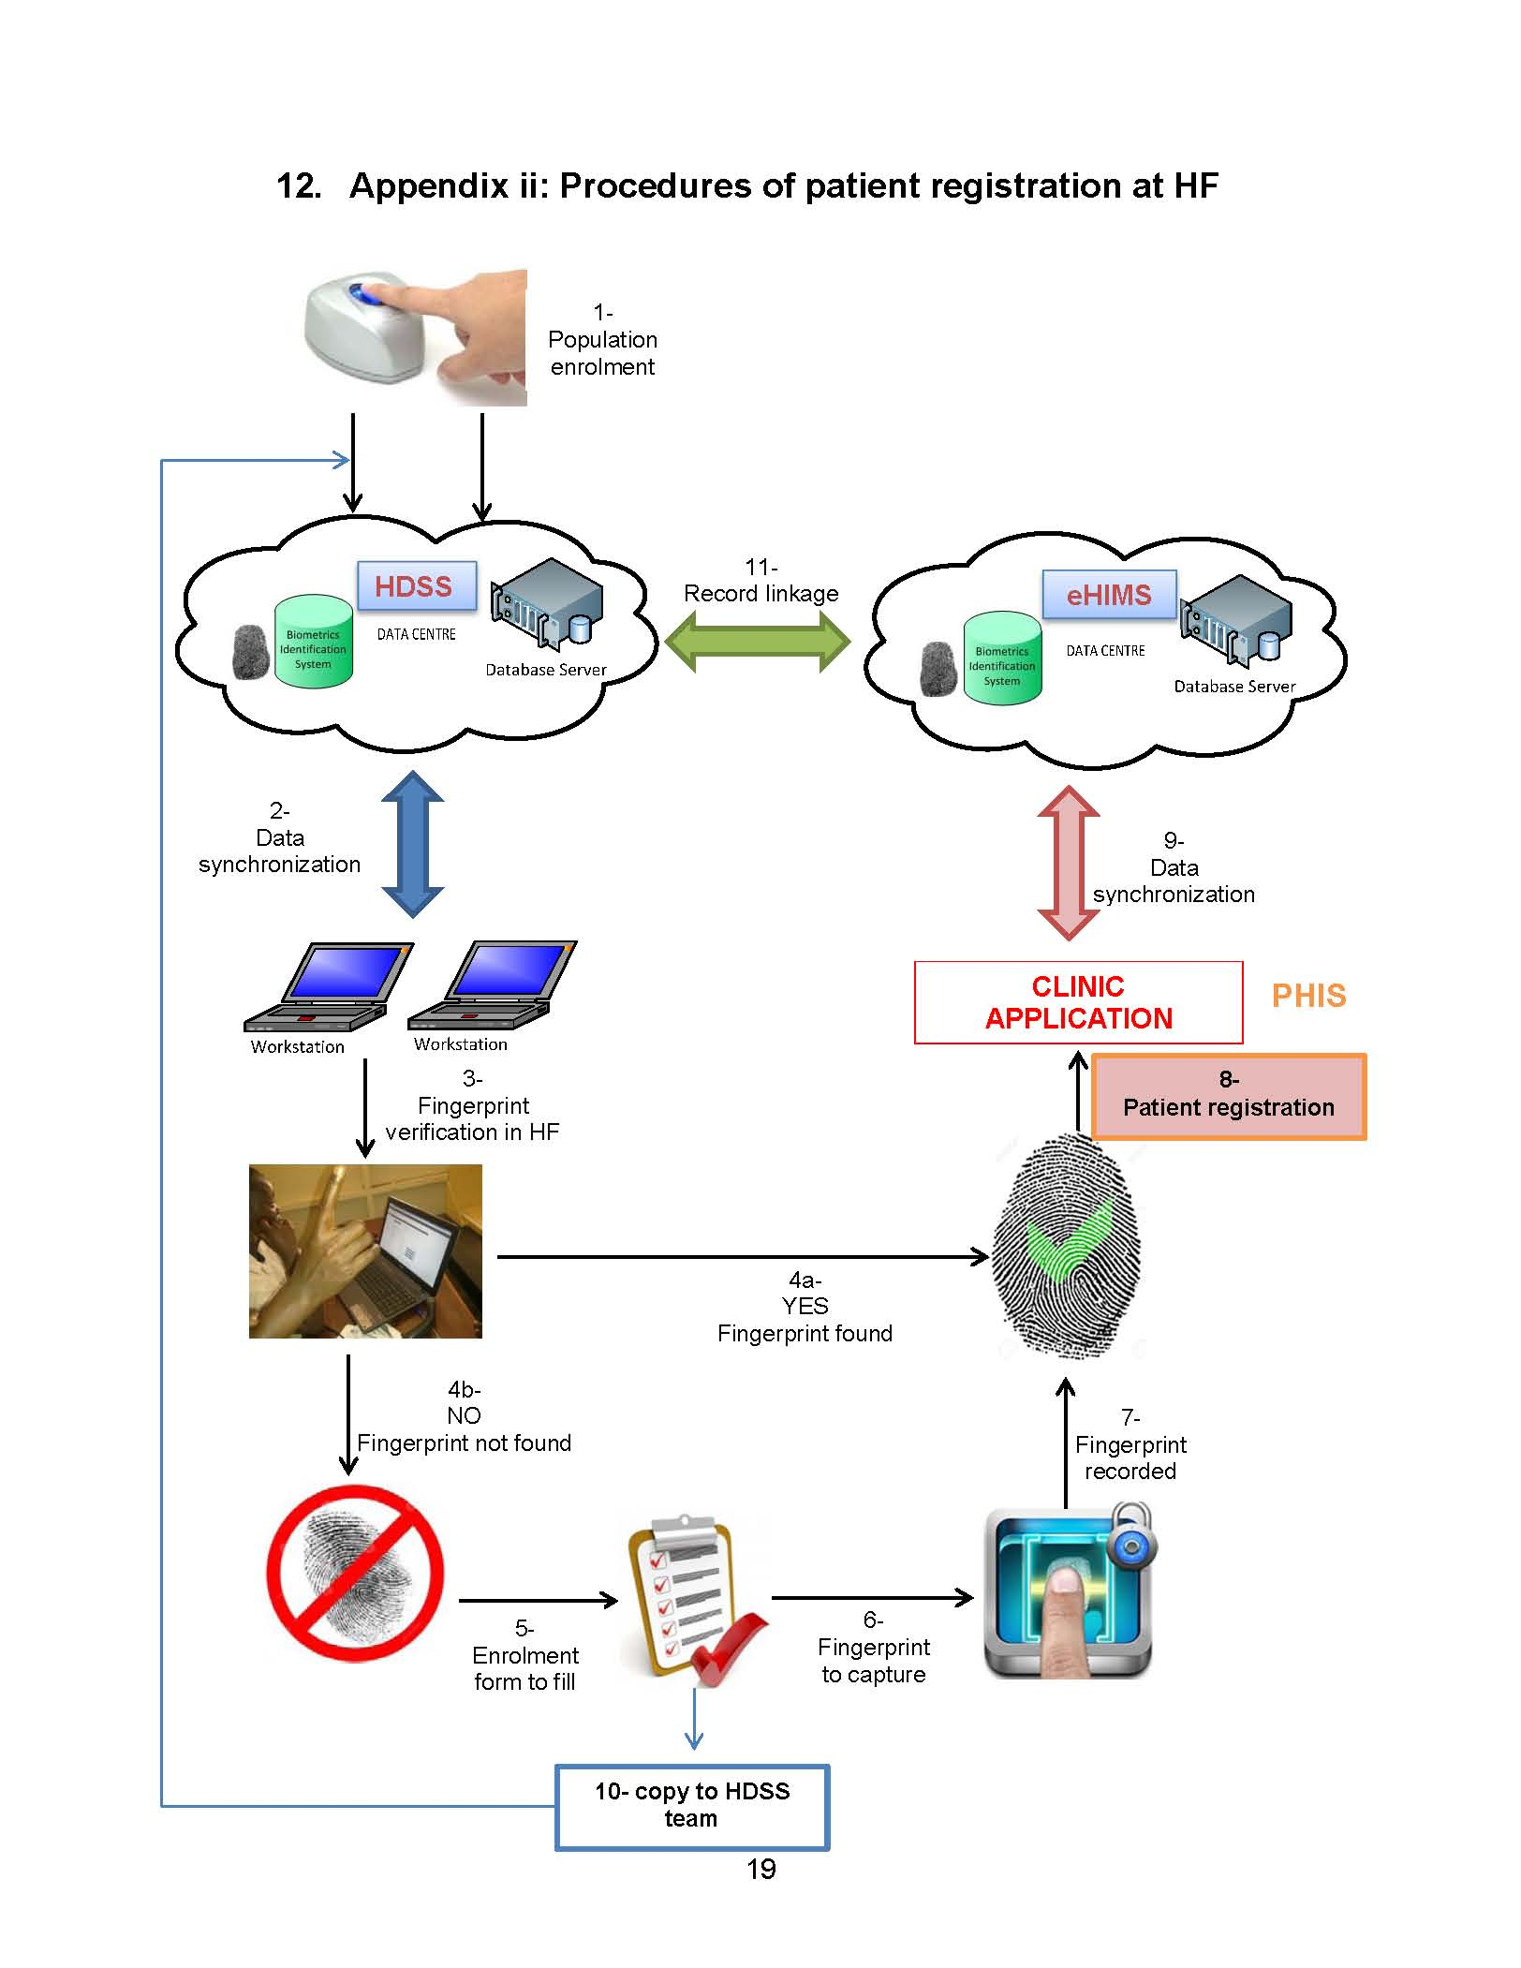
Linking Morbidity data to HDSS
CDA: Comprehensive disease Assessment
CHESS: Comprehensive Health and Epidemiological Surveillance System
Integration in HDSS (sample of HDSS)
Capturing all episodes and their duration
acute illnesses
chronic illnesses
Assigning type of illness
Continuous time-space data collection
Over 365 days to measure morbidity and and demand for care and avoid seasonal bias

Slide 8
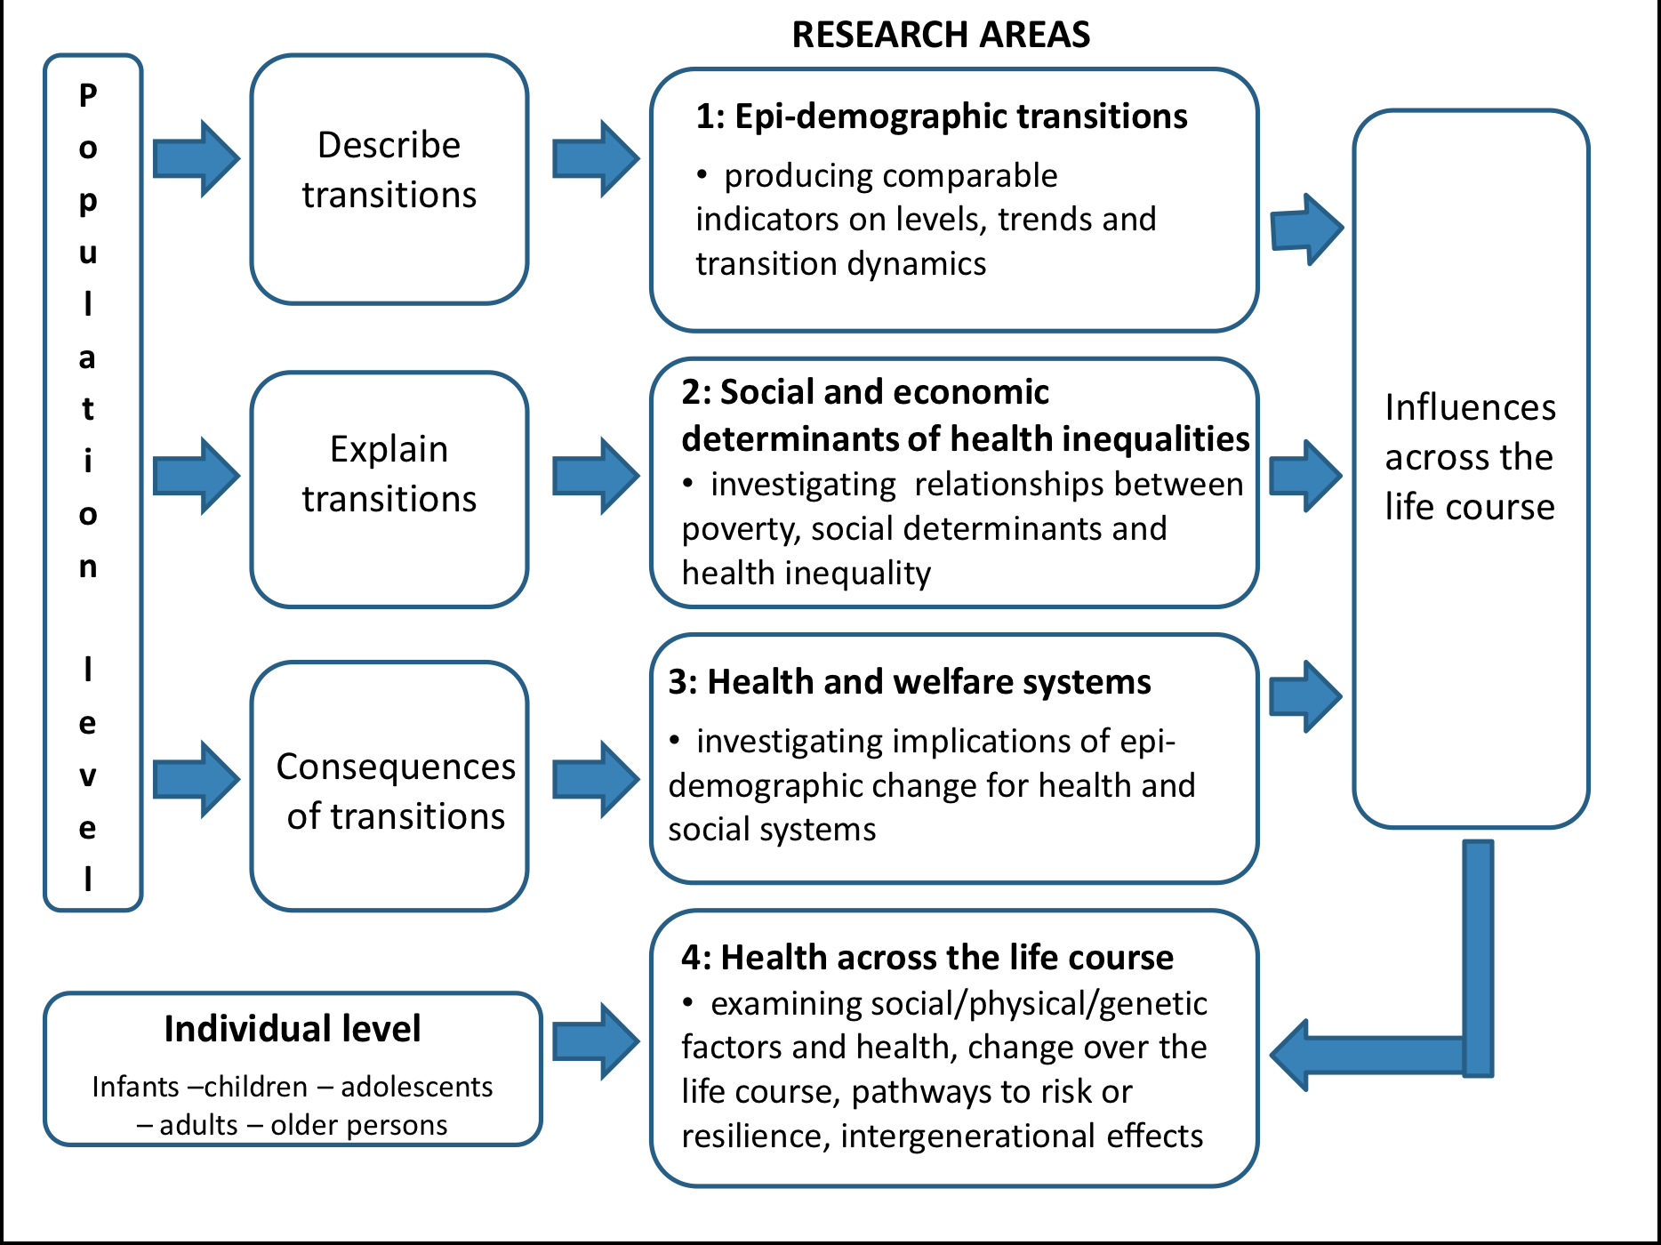
Research Framework
Osman and al.

Slide 9
Conclusion
Linking climate and health-cohort data in Africa for research, early warning and policy is possible and relevant
HDSS are in a better position to fill the data gap in LMICs
HDSS data harmonisation and accessibility are key
A strong collaboration between the in-country HDSS sites, the national statistics office and HMIS is critical
Make the HDSS climate-research ready for policy relevance.
How a locally defined HDSS could efficiently contribute to national EWARS?
How to build a reliable Epidemic Intelligence for an effective EWARS?

Slide 10
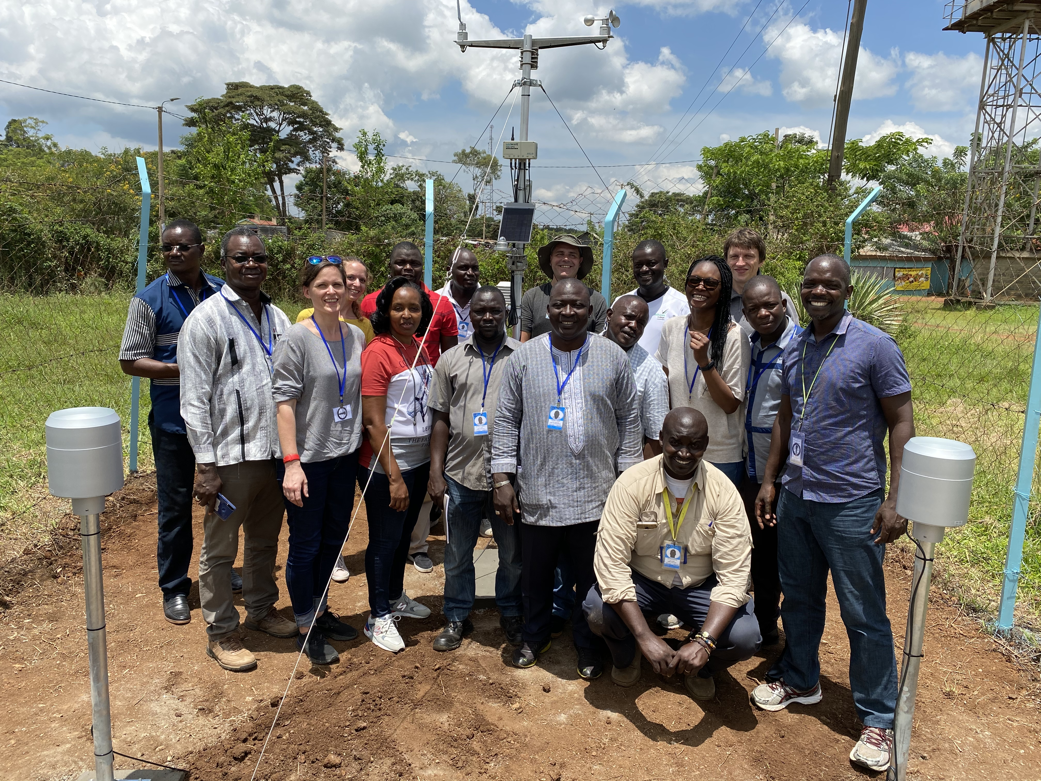
THANK YOU

