Slide 1
Can index-based weather insurance stabilize farmers’ livelihood among African smallholder households?
Prof. Dr. Manuela De Allegri,
With contributions from Edmund Yeboah, Dr. Moubassira Kagoné, and Dr Valérie Louis

Slide 2
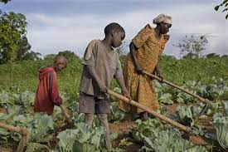
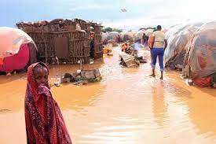
The problem as we know it
High dependence on subsistence farming in Africa
Subsistence farming exposes farmers to high risks induced by weather variability
Weather variability is enhanced by climate change – high temperature, alternance of too much vs too little rain

Slide 3
From weather variability to impoverishment and poor health status
Weather variability
Poor agricultural production
Food insecurity
Asset depletion
Impoverishment & poor health status

Slide 4
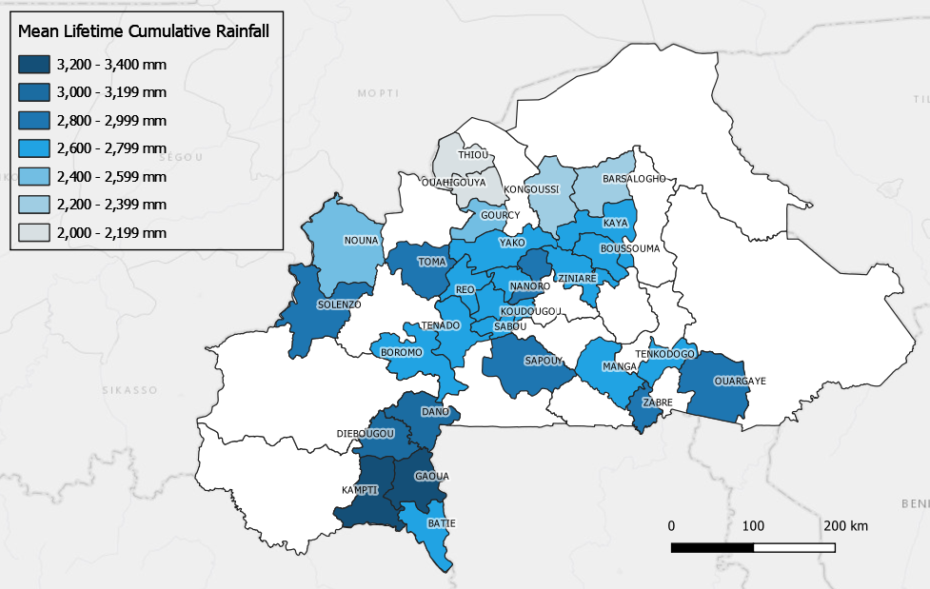
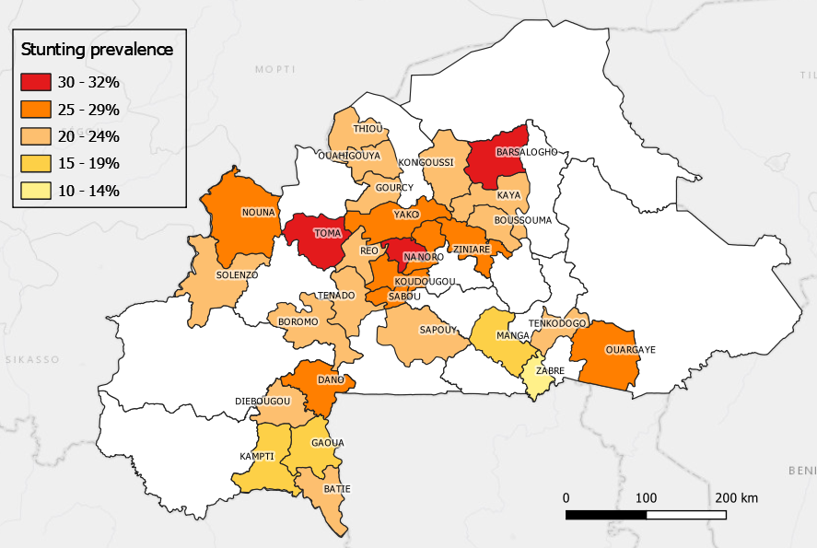
Cumulative rainfall exposure increases children’s poor nutritional status
Lifetime Cumulative Rainfall by study district
Stunting prevalence by study district

Slide 5
Crop Insurance as adaptation strategy to break this vicious cycle
Rainfall variabilty
Index-based weather insurance
Compensation for lost agricultural production
Food security
Assets protection
Less impoverishment
Better health status
Challenge of crop insurance is loss verification

Slide 6
Index-based Weather Insurance (IBWI) as preferred alternative to Crop Insurance
Rainfall variabilty
Index-based weather insurance
Compensation for lost agricultural production
Food security
Assets protection
Less impoverishment
Better health status
Index-based weather insurance (IBWI) links insurance payout to a weather index over an area instead of verifying individual-level crop losses
A POLICY SOLUTION TO BREAK VICIOUS CYCLE

Slide 7
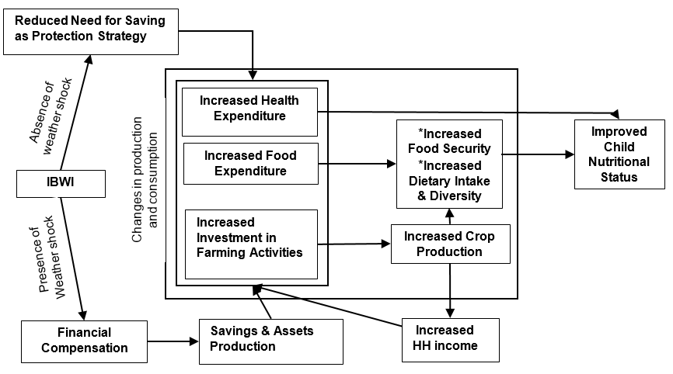
How do we expect IBWI to work?

Slide 8
What we know on IBWI
In Mali, IBWI had a positive effect on size of land use and expenditure on seeds (Elabed & Carter 2014).
In Ethiopia, insurance influenced farmers risk behavior by boosting uptake of fertilizers (Vargas et al. 2012).
Two studies in Kenya found that IBWI guarded against precarious income and asset smoothing strategies (Janzen & Carter 2018) , and insured households enjoyed greater and better food availability (Isaboke et al. 2016).
In Rwanda, insured households were observed to enjoy larger income due to crop sales than non-insured ones (Mwe 2016).

Slide 9
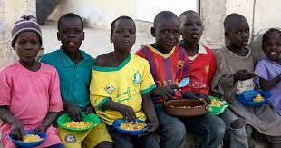
What we still need to know on IBWI
Limited evidence on impact of IBWI on dimensions of welfare related to health.
No study has systematically explored the link between insurance coverage, crop production, food security, dietary diversity, nutritional status, and health status.
No study has assessed the impact of IBWI on other health-relevant dimensions, such as health service utilization and expenditure.
No study assessing its value for money.

Slide 10
The way forward
Further investments needed in the development and implementation of IBWI for agricultural production
Further investments needed in research to generate evidence base on welfare impact of IBWI …
… expanding current research trends to include impacts on health

Slide 11
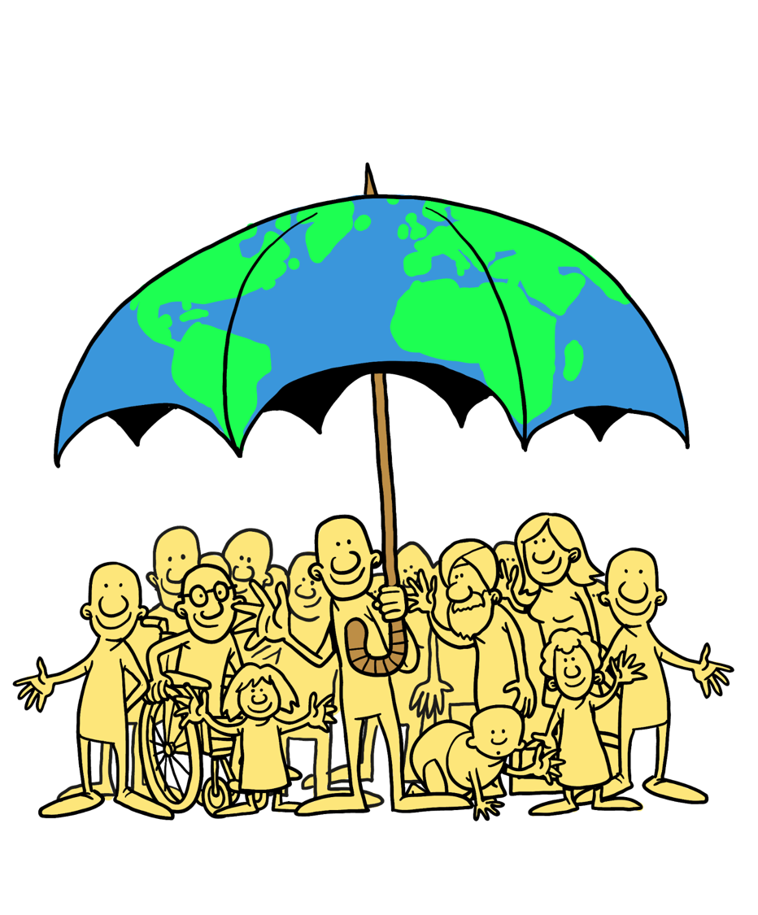
Thank You manuela.deallegri@uni-heidelberg.de

