Slide 1
Climate migration as a stressor for health systems?
Dr. Kira Vinke
German Council on Foreign Relations (DGAP)
Potsdam-Institute for Climate Impact Research
Co-Chair of the Advisory Board to the German Federal Government for Civilian Crisis Prevention and Peacebuilding
Climate Change and Pandemics
Heidelberg Institute of Global Health
June 23, 2022

Slide 2
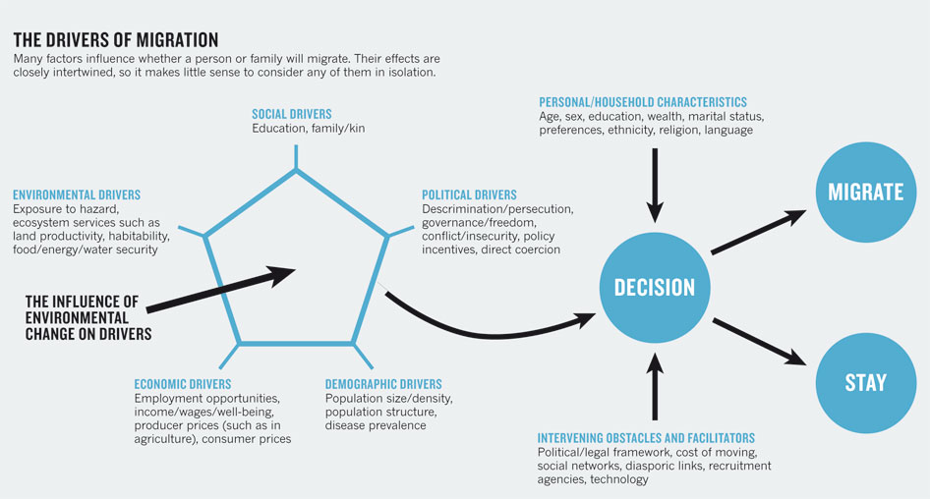
The Climate Change and Migration Nexus
Source: Nature 478, 447–449(27 October 2011)

Slide 3
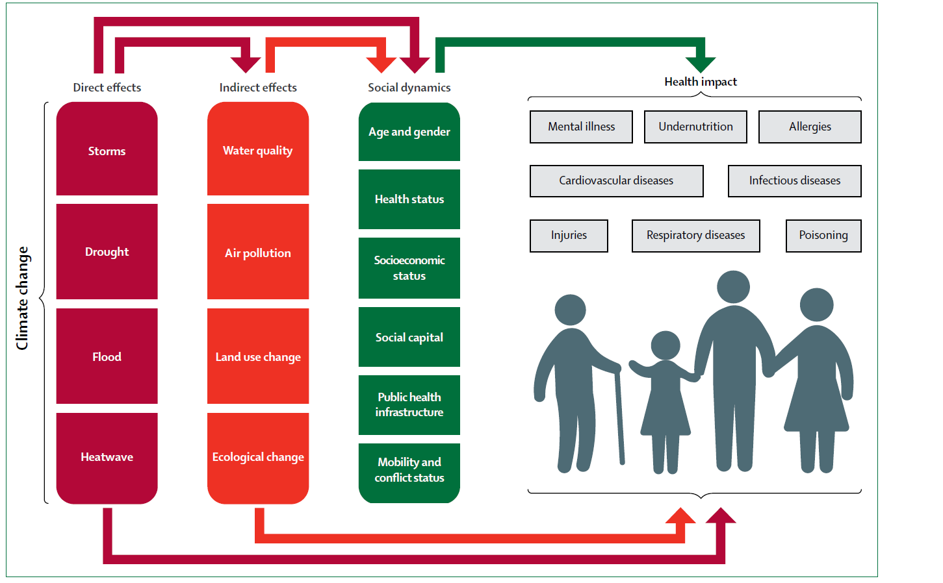
The Climate, Health and Migration Nexus: The Lancet
Source: The 2015 Lancet Comission on Health and Climate Change

Slide 4
The Climate, Migration and Health Nexus: 3 Angles
Health risks as push factors of migration
Extreme event hazards for physical safety
Food shortages after climate impacts
Health opportunities as pull factors of migration
Better access to healthcare and saniation
Better access to income
Health outcomes as risks of migration
Injuries during migration
Exposure to different diseases

Slide 5
Potential Health Effects for Migrants,
Receiving and Sending Communities
 | Short Term | Long Term
Migrants | Wounding / direct physical injuries / death during migration process Malnutrition Shock Insecurity during migration Violence & crime Waterborne & infectious diseases, e.g. tuberculosis Cultural shock, anxiety and stress upon arrival | Malnutrition Risk of infectious diseases Mental health & stress Premature birth Development of chronic diseases Decreased capacities for managing chronic diseases Loss of traditional health practices. Changes in the diet Hopelessness leading to informal forms of employment such as prostitution, housework etc. Health risks associated with unregulated labor Improved access to health care in cities compared to rural areas

Slide 6
Potential Health Effects, Part II
 | Short Term | Long Term
Receiving Communities | Risk of introduction of infectious or waterborne diseases Reduced quality of care for receiving communities because health systems are under pressure Sanitary settlement problems Societal friction and competition for resources | Introduction of communicable diseases Changing local demographics Stress on the educational system Decreased availability of resources Competition for jobs: migrants would work for less, stress associated with job loss Overall economic effects, for instance decreased availability of adequate housing Formation of an informal economy, black markets Availability of informal labor could benefit receiving communities Increase in GDP as migrants add to the economy
Sending Community | Labour drain: increased workload for women & children who stay & do agricultural labor Remaining locked- in population such as the elderly may receive less care | + Improved acess to medicine because of remittances + Improved nutrition because of remittances Decrease in population pressure in exposed areas, potentially more resources for those who stay

Slide 7
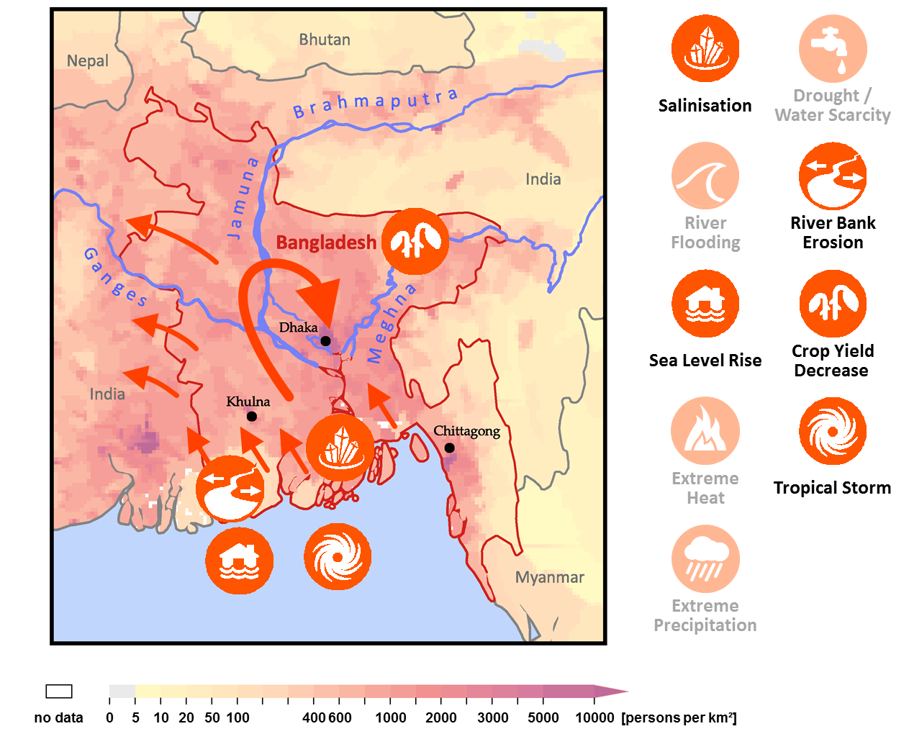
Case Study Bangladesh
With modification from:
Vinke, Schellnhuber,
Laplante et al. (2017)
Notes:
In orange are the most significant climate impacts which can be drivers for outmigration.
Cascadal Migration
Migration into already densely populated areas
Interview Excerpt

Slide 8
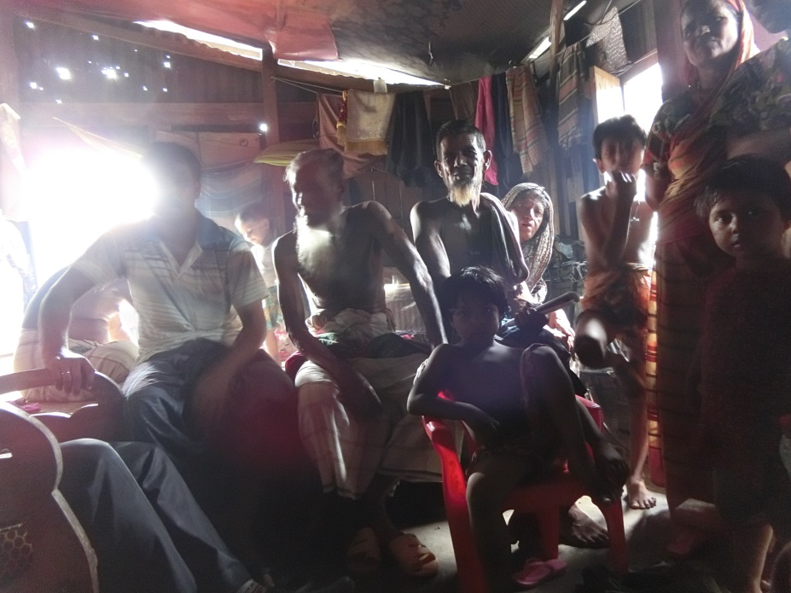
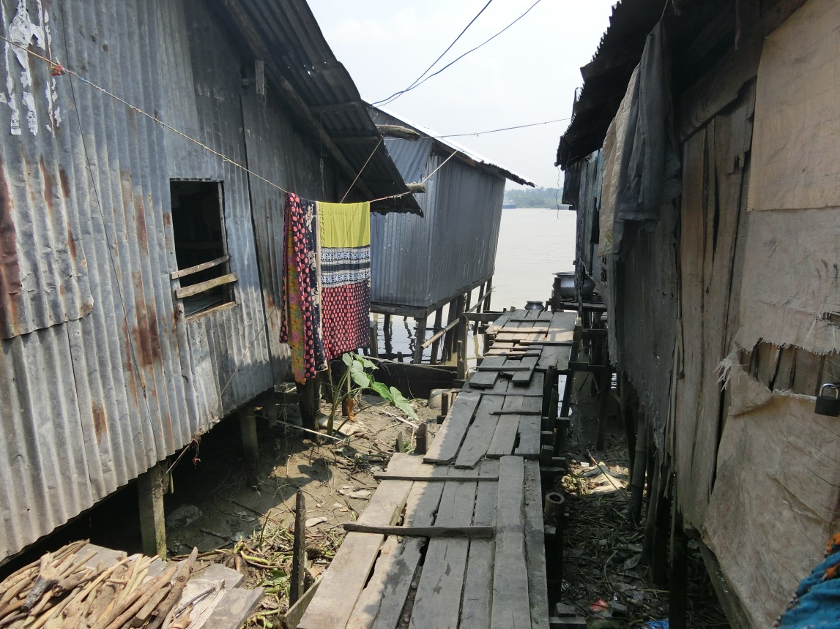
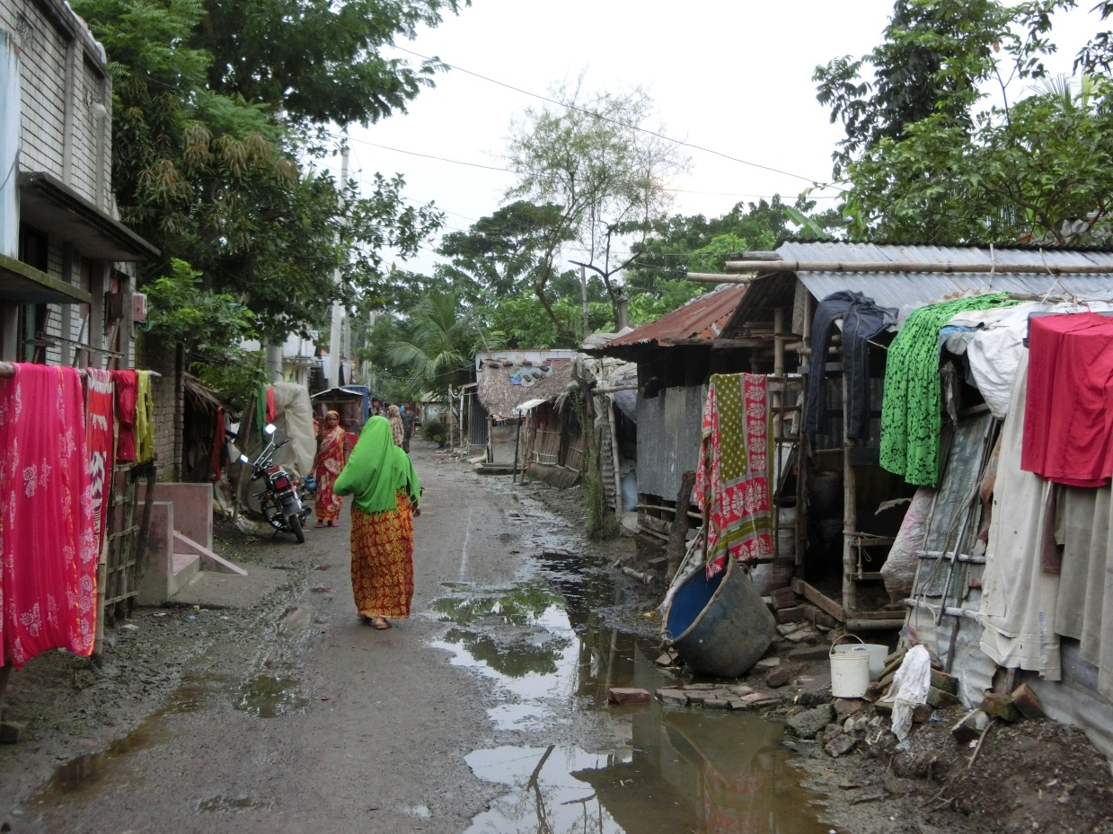
Climate Migration as a Poverty Trap?
“In summer season it is difficult to live” (Interview 11, Khulna)
“Frankly, sometimes during monsoon we are used to starve” (Interview 21, Barisal).
“Due to excessive temperature, I sometimes lose my senses” (Interview 3, Khulna).
Source: Vinke, Unsettling Settlements, 2019.

Slide 9
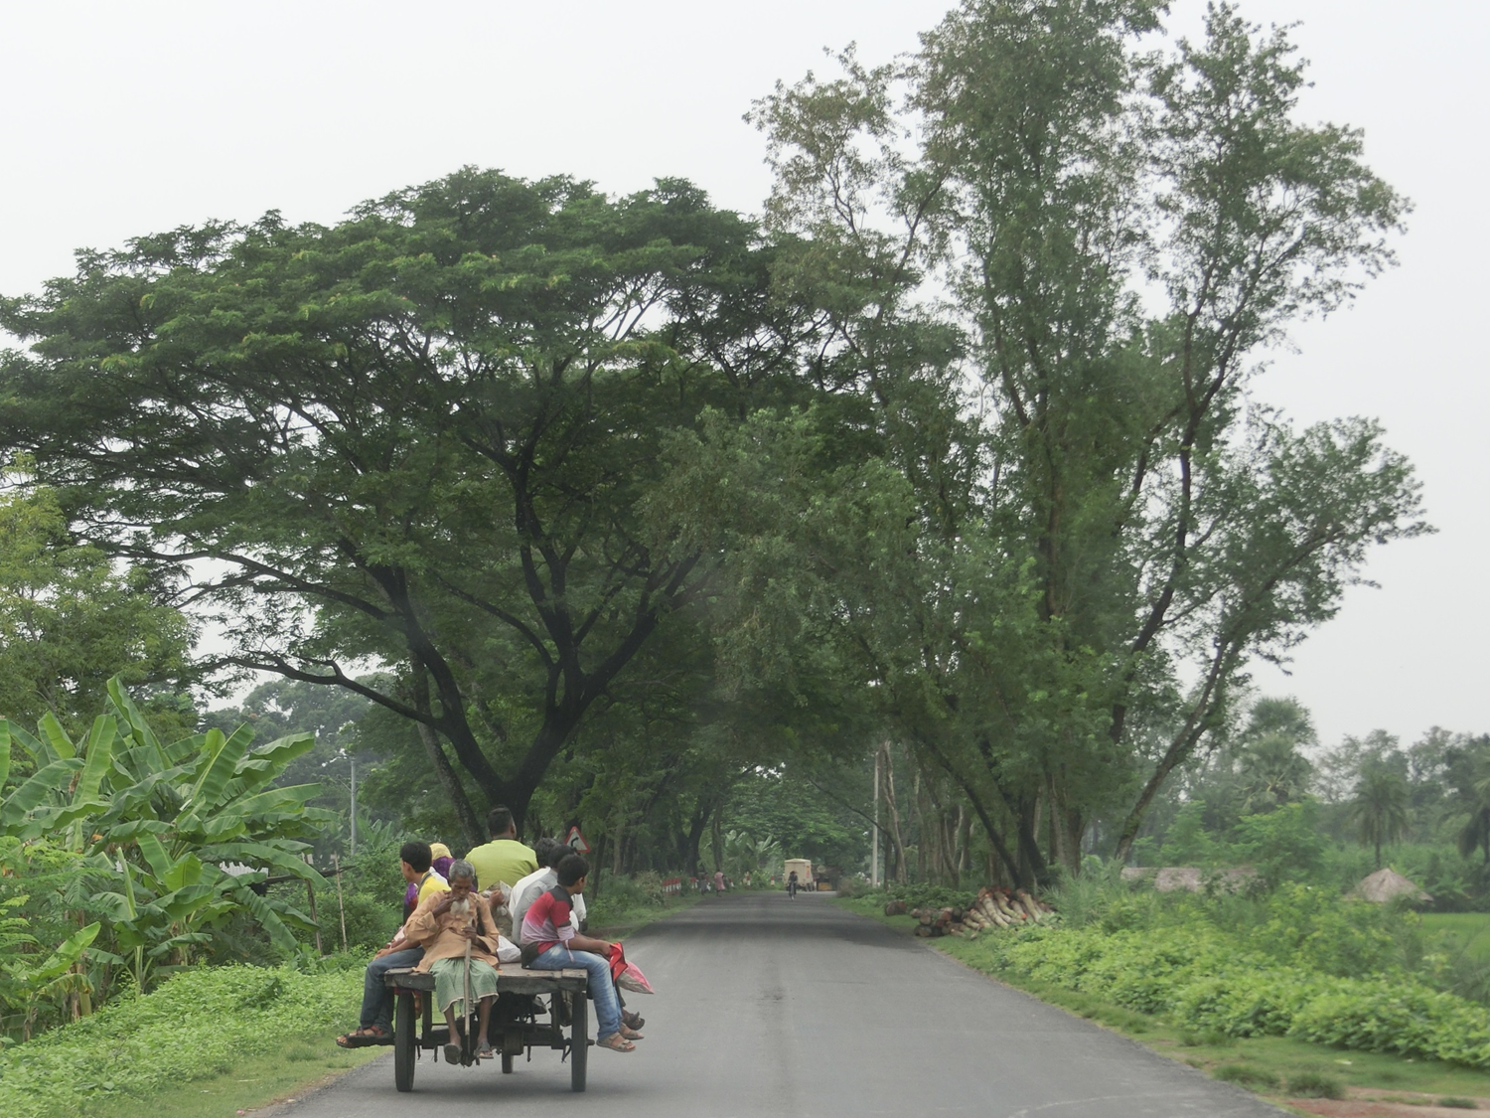
Climate Migration and Mental Health
“We were well in the village because the environment was good. We now feel psychological depression because living here meant to leave our own home. The urban areas are more chaotic than the rural regions. Here, income is less than in my village” (Interview 19, Satkhira).

Slide 10
Climate Migration from the Marshall Islands
“When the sea level rises sometimes we have dead children who were playing in the ocean where they used to play. They are taken away by the sea. It happened nearby at the ocean side. Two children. 3 and 1 year old”, Interview Ailuk.
”Food crops are decreasing. The water lenses are salinized. People have to rely on imported food” (Maloelap Interview 2)”
Salinization
Drought
King Tides
SLR
Crop yield decrease
Source: Vinke 2019
Notes:
Impacts
Quote

Slide 11
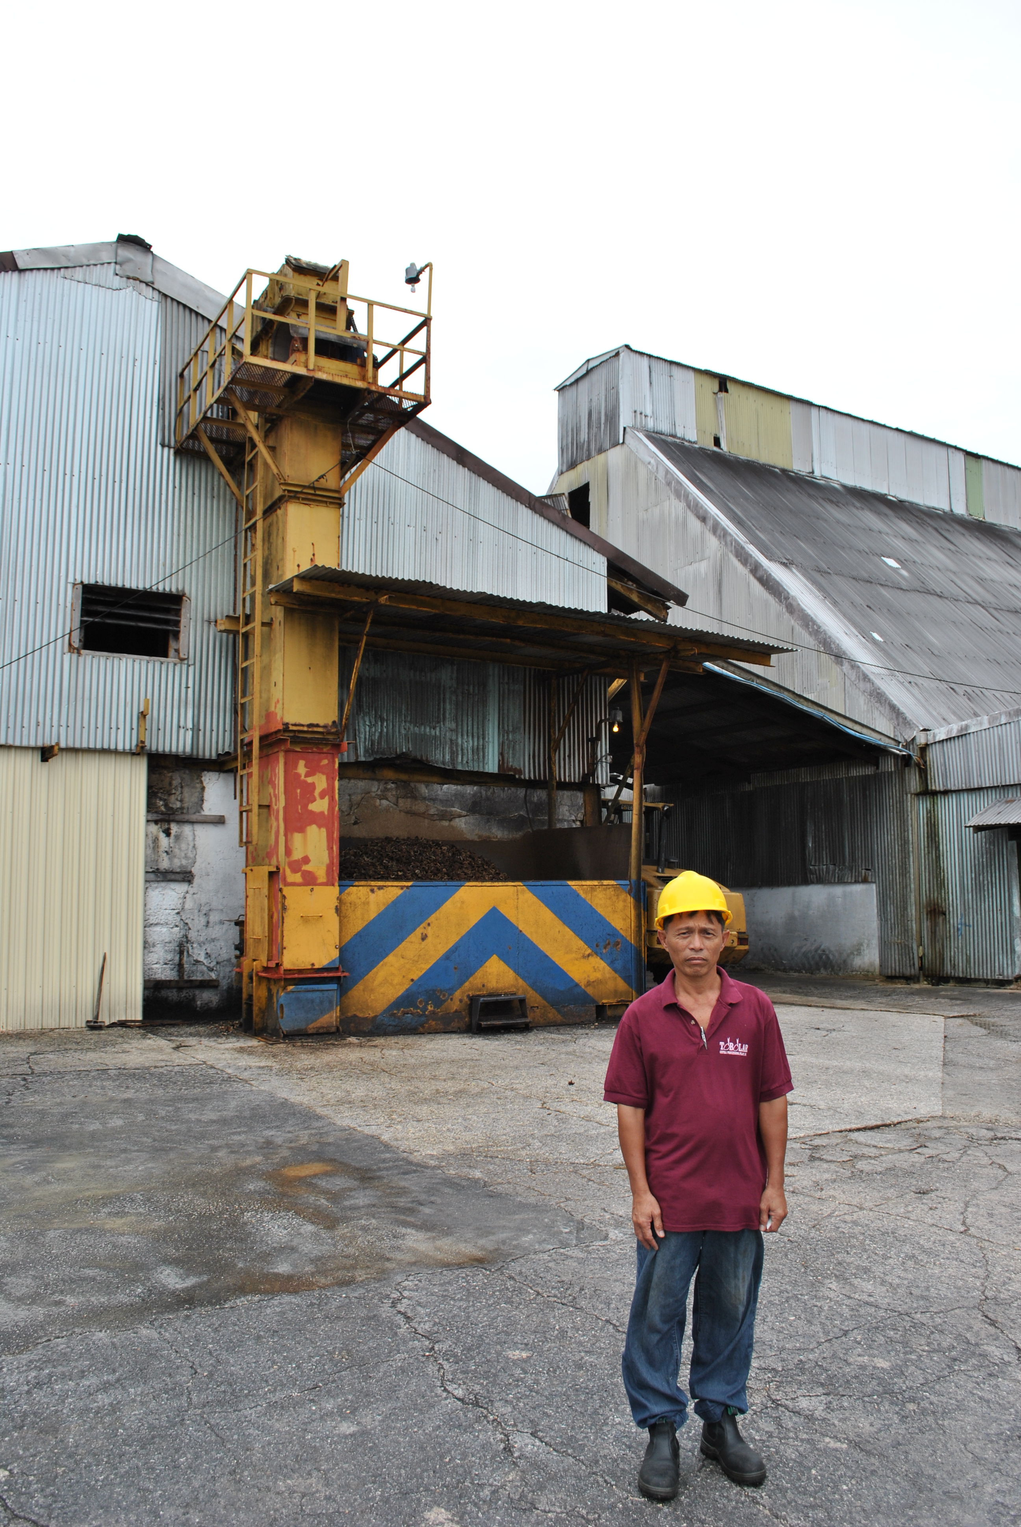
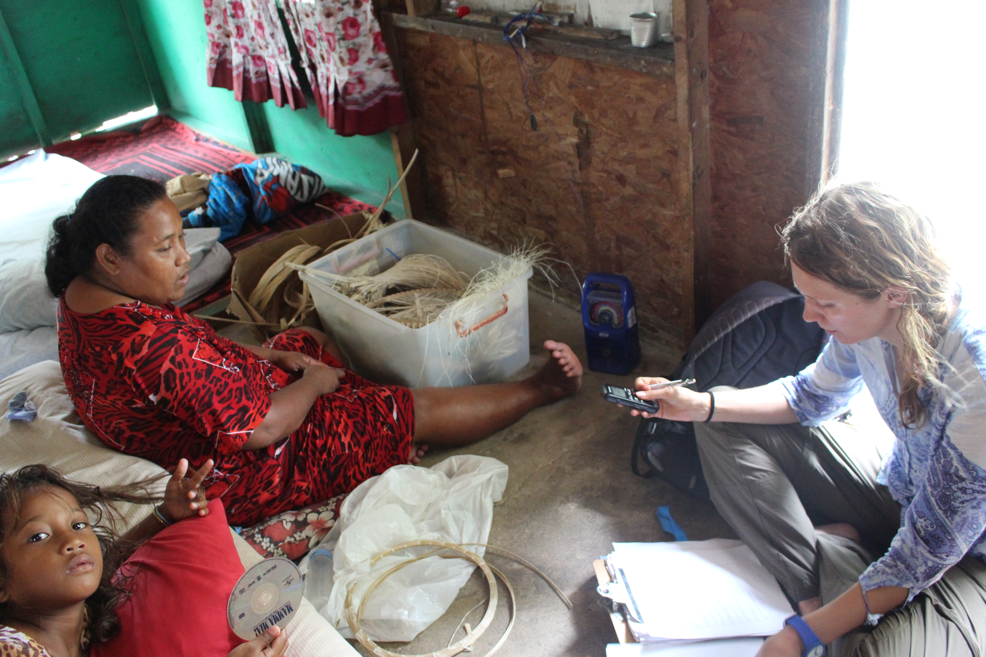
Loss of Culture and Identity
“[…] people are losing their culture out there. Their own culture and the custom of togetherness” (Expert Interview Majuro, Community Expert 1).
“Food crops are decreasing. The water lenses are salinized. People have to rely on imported food” (Maloelap Interview 2).
“I am not scared to go down the sea. I am scared to move there and be nobody” (Expert reports a woman’s story on the outer islands. Expert Interview Majuro, Policy Maker).

Slide 12
Vulnerable Groups and Intersectionality

Slide 13
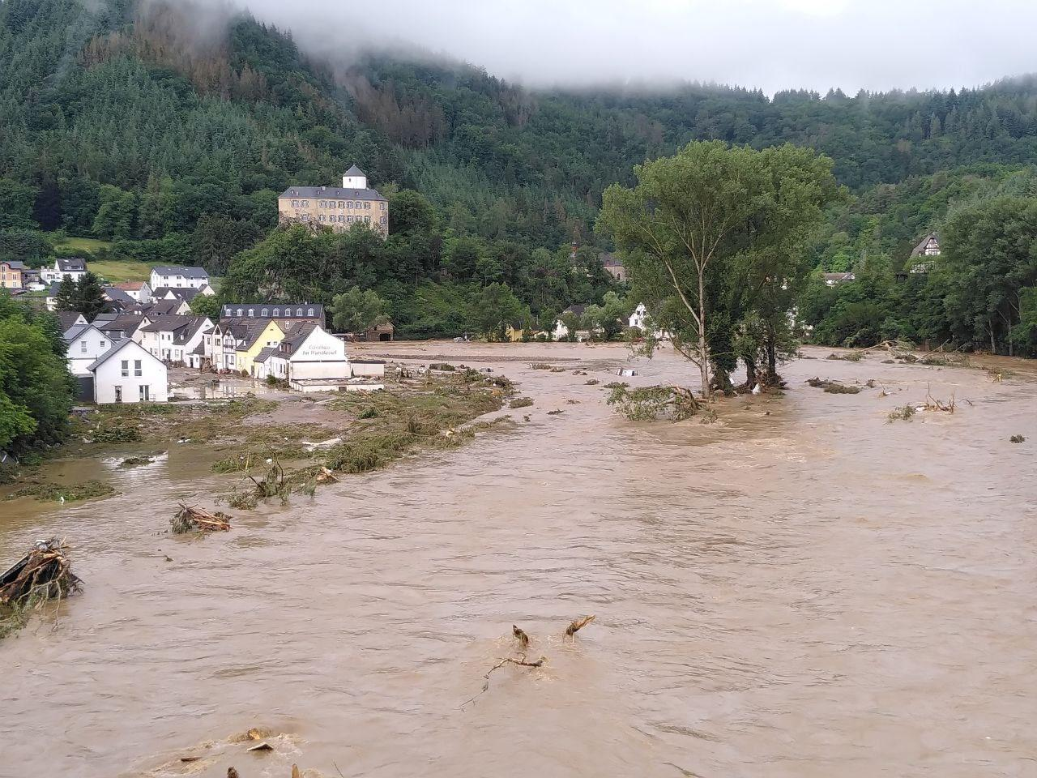
Germany (Ahrtal) Floods 2021
180 casualties
12 people with disabilities passed away in Sinzig because they could not self-evacuate

Slide 14
Limits of Habitability:
Health Stressors
New Delhi Construtction Workers
Source: Dominique Faget/AFP/Getty Images

Slide 15
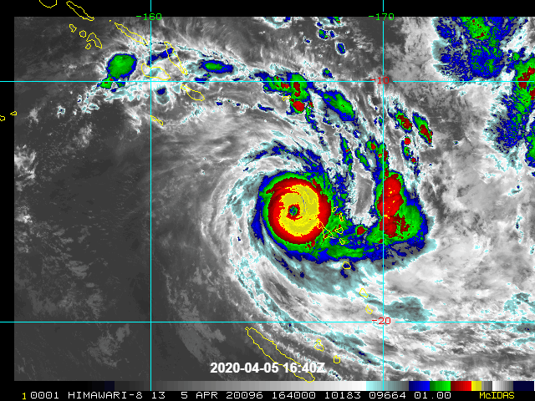
Battling on Many Fronts
In the midst of the pandemic, cyclone Harold hit several Pacific Island Countries in April 2020
→ New risk landscape requires new cooperation and capacities
See also Vinke et al (2020)
Corona and the Climate
– A Comparison of two Emergencies
Picture Source:
https://www.jma.go.jp/jma/en/copyright.html / wikimedia

Slide 18
access to hospitals and healthcare
access to sanitation
access to food
access to drinking water
health risks associated with the migration itself
Mental health impacts of migration and climate impacts

