Slide 1
Positive framing works – in the communication of COVID and climate change -
Trust can be earned and build!
Dr. Katharina von Knop
(Founder & CEO)
Digital Trust Analytics GmbH
www.digitaltrust.de
© Dr. Katharina von Knop

Slide 2
Building Digital Trust in Digital Health Care solutions
Abbreviated general representation
5. Trust
Real Life trust experience
4. Deep Connection
Multiple mutual benefits
etc.
Significance
Belonging & Affiliation
Reputation of the user
3. Bonding
Reciprocity
Context
Selfeffiancy
Consitency
Decision-Architectures
Relationships
etc.
Experienceable: Cyber, GDPR, Privacy, Ethics and Data Policy
Controllability
Reliability
etc.
2. Fundamentals of trust
1. License to make Business
Cyber
GDPR
Regulations
Ethics & Data Policy
Accessibility
Transparency
Predictability & Accountability
Correct non biased Data
Efficient and effective processes
© Dr. Katharina von Knop

Slide 3
To influence human health and climate behaviour effective communication needs to be done.
© Dr. Katharina von Knop

Slide 4
Authentic information can only generate the expected effects if the primary data is easy understandable
Intergovernmental Panel on Climate Change (IPCC)
The scientists work out three iterations of the Assessment Reports, which are rigorously evaluated—
by experts and then
by the public as the
pre-final drafts are made available on the internet.
Everybody is allowed to comment, and review editors ensure that all comments are addressed.
Language: highly scientific style
Defogging Climate Change Communication: How Cognitive Research Can Promote Effective Climate Communication, Dorothee Amelung, Helen Fischer, Lenelis Kruse, Rainer Sauerborn
https://www.ipcc.ch/report/ar6/wg2/downloads/report/IPCC_AR6_WGII_FinalDraft_FullReport.pdf
© Dr. Katharina von Knop

Slide 5
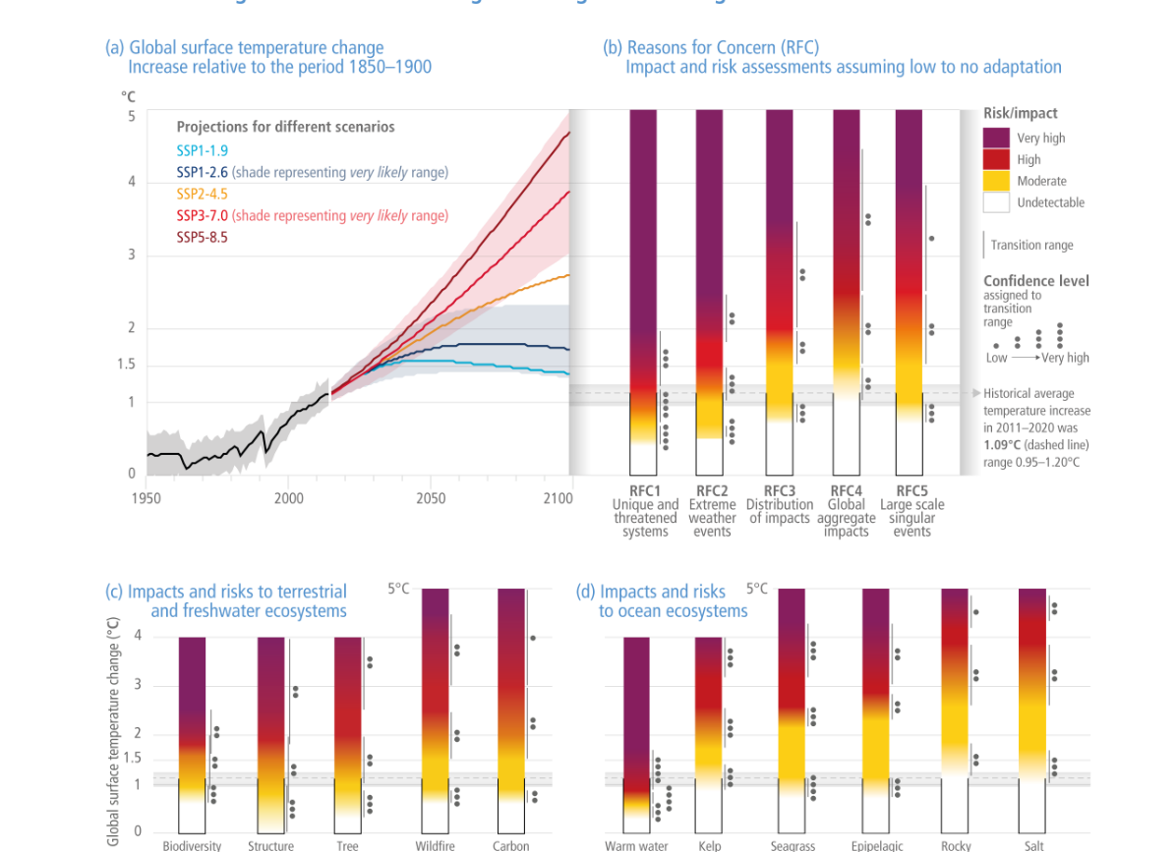
Intergovernmental Panel on Climate Change (IPCC) Report 2022
https://www.ipcc.ch/report/ar6/wg2/downloads/report/IPCC_AR6_WGII_FinalDraft_FullReport.pdf

Slide 6
Summaries for Policy Makers – Make them Brain Friendly
“The SPMs' main principles include being “audience-appropriate”
“Because SPMs should not be policy-prescriptive, however, they should enable informed decision-making without promoting specific response strategies or unintentionally and prematurely narrowing down public debates.”
“Accessible presentation formats can increase understanding of the dynamically complex determinants of climate change (Fischer et al., 2015).”
Today's decision-makers will not be personally affected by the outcomes of their climate action—or inaction—, and they will not be held accountable for them
Defogging Climate Change Communication: How Cognitive Research Can Promote Effective Climate Communication, Dorothee Amelung, Helen Fischer, Lenelis Kruse, Rainer Sauerborn
https://www.ipcc.ch/report/ar6/wg2/downloads/report/IPCC_AR6_WGII_FinalDraft_FullReport.pdf Human health as a motivator for climate change mitigation: results from four European high-income countries; Dorothee Amelung, Helen Fischer, , Alina Herrmann , Carlo Aall, Valerie R. Louis, Heiko Bechere , Paul Wilkinson, Rainer Sauerborn, Global Environmental Change Volume 57, July 2019, 101918
© Dr. Katharina von Knop

Slide 7
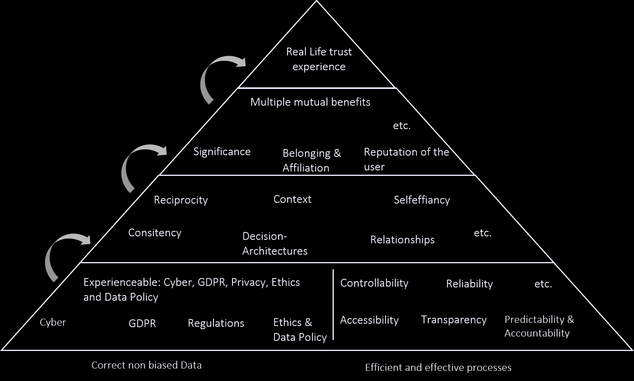
Cognitive Controllability
A large body of research within the cognitive sciences shows that the way information is presented affects both understanding and the credibility of the information. Specifically, analytical processing of all factual details is not sufficient or sometimes even counterproductive for comprehension of uncertain and complex information (Kahnemann)
© Dr. Katharina von Knop

Slide 8
Example Airplane Cockpit
© Dr. Katharina von Knop

Slide 9
Use the whole and very target group specific tailored media
Mass media
in combination with other programs
Interactive Websites with multi- format Information and useful tools
Internet
News Pages, Blogs
Social media
Target Group specific Influencers
Micro-Influencer
Physical life opinion leaders
The Effectiveness of Mass Communication to Change, Public Behavior, Lorien C. Abroms and Edward W. Maibach, Annu. Rev. Public Health 2008. 29:219–34, 10.1146/annurev.publhealth.29.020907.090824
© Dr. Katharina von Knop

Slide 10
Well-designed messages, and those messages are delivered to their intended audience with sufficient reach and frequency to be seen or heard and remembered
One of the most successful Covid-19 Insta. Postings
Authentic communication with useful tools
The Effectiveness of Mass Communication to Change, Public Behavior, Lorien C. Abroms and Edward W. Maibach, Annu. Rev. Public Health 2008. 29:219–34, 10.1146/annurev.publhealth.29.020907.090824
© Dr. Katharina von Knop

Slide 11
© Dr. Katharina von Knop

Slide 12
Why use Research on Health Communication as a Guide for Research on Climate Communication?
Complexicty
Probabilistic information (Hoffrage et al., 2000).
Human / organisational behavioral change needs a lot effort
Human health as a motivator for climate change mitigation: results from four European high-income countries; Dorothee Amelung, , Helen Fischer , Alina Herrmann , Carlo Aall, Valerie R. Louis, Heiko Bechere , Paul Wilkinson, Rainer Sauerborn, Global Environmental Change Volume 57, July 2019, 101918
© Dr. Katharina von Knop

Slide 13
What makes behavioral change difficult?
Health
Climate Change
Effort to change the behavior affecting personal health
Reduction of dopamine release
Decisions by large amounts of scientific uncertainty.
The effects of climate change will only show decades or centuries later (Wigley, 2005)
Affecting future generations
Decision-makers will not be personally affected by the outcomes of their climate action—or inaction—, and they will not be held accountable for them.
Human health as a motivator for climate change mitigation: results from four European high-income countries; Dorothee Amelung, Helen Fischer, , Alina Herrmann , Carlo Aall, Valerie R. Louis, Heiko Bechere , Paul Wilkinson, Rainer Sauerborn, Global Environmental Change Volume 57, July 2019, 101918
© Dr. Katharina von Knop

Slide 14
Several methodologies and strategies exist to enable us Humans to change behavior we are profiting directly
Health Science already provides a set of proven concepts to change our decisions and behavior.
The combination of two vital issues would make a difference
Evidence-based climate communication, and that cognitive psychology can deliver such evidence. (Sauerborn, Fisher et al)
Human health as a motivator for climate change mitigation: results from four European high-income countries; Dorothee Amelung, Helen Fischer, , Alina Herrmann , Carlo Aall, Valerie R. Louis, Heiko Bechere , Paul Wilkinson, Rainer Sauerborn, Global Environmental Change Volume 57, July 2019, 101918
© Dr. Katharina von Knop

Slide 15
This study is the first to show that providing information on strictly unconditional, individual health co-benefits can motivate households in highincome countries to adopt climate mitigation actions
“(i) health co-benefits accrue directly to the acting individual, they are "private goods" rather than public ones;
(ii) the evidence base for, and magnitude of health co-benefits is well-established; and
(iii) the idea of a healthy life-style is well-engrained in public discourse, much more so than that of a climate-friendly life-style.”
Human health as a motivator for climate change mitigation: results from four European high-income countries. Dorothee Amelung , Helen Fischer , Alina Herrmann, Carlo Aall , Valerie R. Louis , Heiko Bechere , Paul Wilkinson , Rainer Sauerborn, https://doi.org/10.1016/j.gloenvcha.2019.05.002 Received 21 May 2018; Received in revised form 25 April 2019; Accepted 7 May 2019 0959-3780/ © 2019 Elsevier Ltd.
© Dr. Katharina von Knop

Slide 16
“….households who were given information on direct health co-benefits reported a higher willingness to implement these measures”
“Private households have been identified as key actors in global climate change mitigation (Aall and Hille, 2010; Dubois and Ceron, 2015; Sovacool, 2014), and households in high-income countries influence up to 72% of global greenhouse gas emissions (Hertwich and Peters, 2009).”
Human health as a motivator for climate change mitigation: results from four European high-income countries. Dorothee Amelung , Helen Fischer , Alina Herrmann, Carlo Aall , Valerie R. Louis , Heiko Bechere , Paul Wilkinson , Rainer Sauerborn, https://doi.org/10.1016/j.gloenvcha.2019.05.002 Received 21 May 2018; Received in revised form 25 April 2019; Accepted 7 May 2019 0959-3780/ © 2019 Elsevier Ltd.
© Dr. Katharina von Knop

Slide 18
Positive Framing excurse Denmark
Reasons for the high vaccination rates and the low protests
90 percent of Danes trust health care system, according to Hope Project
Danish authorities promoted adherence to testing and other Covid 19 guidelines as a moral obligation - simply put, the right thing to do for each other, building on the collective approach to the pandemic.
University of Copenhagen – Department of Political Science - The Hope Project –
Denmark’s largest behavioral covid-19 research project
https://politicalscience.ku.dk/research/projects/hop
e/
The successful COVID-19 vaccine rollout in Chile: Factors and challenges Claudio Castillo; Pablo Villalobos Dintrans; MatildeMaddaleno
https://www.sciencedirect.com/science/article/pii/S2590136221000310
© Dr. Katharina von Knop

Slide 19
Digital Trust Matters!
Digital Trust Analytics GmbH
Dr. Katharina von Knop
Founder & CEO
Kurfürstendamm 137 10711 Berlin, Germany
www.digitaltrust.de
Mobile: +49 (0)176 – 4144 9040
Phone: +49 (0)30 250 58 328
Email: Katharina@digitaltrust.de
© Dr. Katharina von Knop

