Slide 1
Communicating facts to policy-makers & the public:
2 years of leadership experience with COVID-19
Lothar H. Wieler
24th June 2022

Slide 2
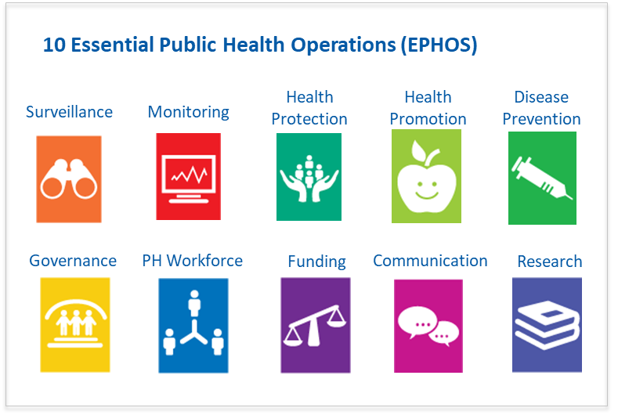
RKI – Germany‘s National Public Health Institute
Public Health – Beyond just infectious diseases
Central requirements for expertise and tasks of a National Public Health Institute:
Collection and analysis of health-related data (ongoing monitoring and assessment of the health status of the population);
Planning (and implementation) of measures (prevention or mitigation of health risks and threats);
Communication with relevant target groups on public health aspects (evidence-based and credible; policy, science, (professional) public, press);
Basic and applied research (entire thematic spectrum of public health).

Slide 3
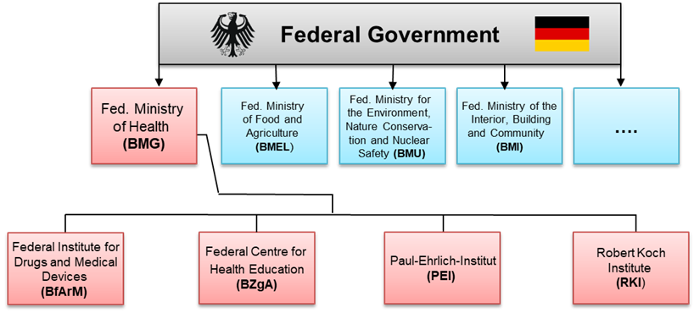
The health sector in Germany and the legal mandate of the RKI
RKI Mandate: to protect and improve the health of the population
RKI (Robert Koch Institute) is Germany’s national public health institute and is responsible for identifying, preventing and combating diseases. Its core tasks are in the fields of surveillance, detection, control and prevention of diseases as well as health monitoring (legal mandate).
BZgA (Federal Centre for Health Education) is specialised in promoting health by developing and disseminating health education materials on, for example, unhealthy behaviour or risks of contracting infectious diseases (legal mandate).
Develops guidelines behavioral recommendations for the general public
Develops policy and medical expert guidelines based on scientific evidence

Slide 4








The RKIs professional expertise and competence at a glance
Department 1: Infectious diseases
On a pathogen trail
Centre for artificial intelligence – public health research
Department 2: Epidemiology and health monitoring
Excellence in research and research support
Health trends under a magnifying glass
Centre for international health protection
Department 3: Infectious disease epidemiology
The world is changing, we change with it
Reducing the burden of infectious diseases
Methods development, research infrastructure and information technology
Centre for biological threats and special pathogens
Digital innovation and automation as the basis for knowledge generation and evidence-based action
Bioterrorism under scrutiny

Slide 5
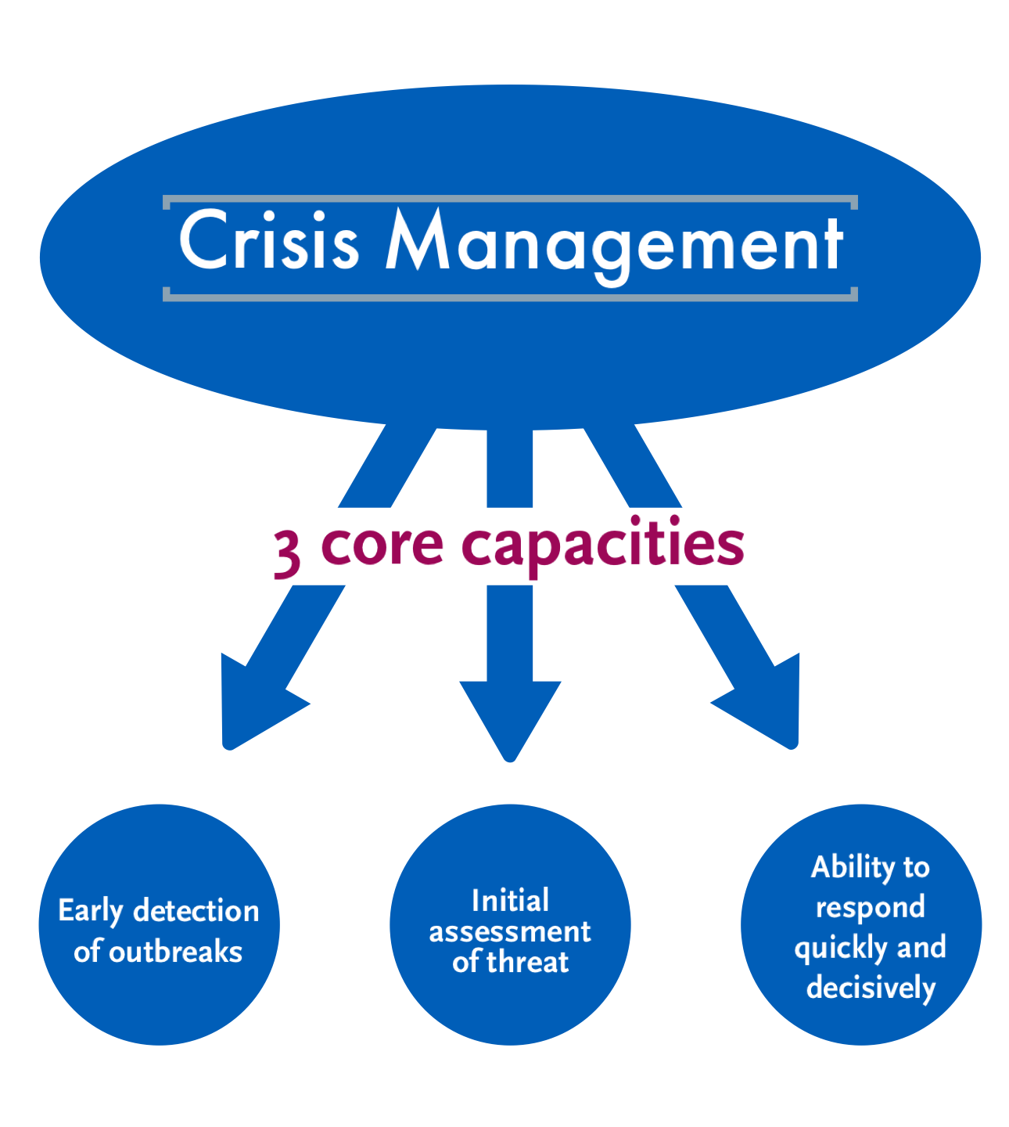
RKI‘s ability to respond to and manage a crisis
We are tasked with crisis management and coordination of a crisis at hand
Intensive preparation before the pandemic (pandemic preparedness)
3 core capacities
Professional competencies (excellent scientific quality)
Scientific quality and excellence forms the basis for scientific independence

Slide 6
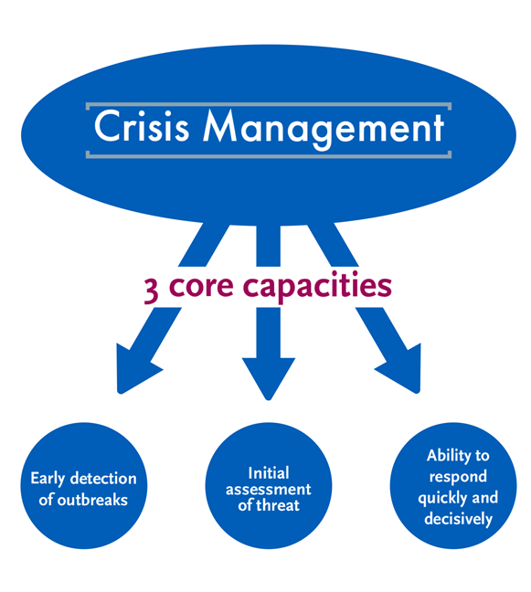
RKIs specific role in national epidemiological crises
Information processing
  Collect, collate, analyse & evaluate data (e.g. situation reports)
  Develop recommendations
  Conduct outbreak investigations upon request
Communication & coordination
  Horizontal & vertical
  National & international
  Public health actors in Germany (BMG, state authorities, institutes)
  Supranational institutions (WHO, ECDC)
  Public health stakeholders worldwide (IANPHI)
  Professional public
  Public
Responsibility for implementing measures lies locally (federalism)
Notes:
Das RKI hat bei nationalen gesundheitlichen Krisen 2 Hauptaufgaben: Informationsverarbeitung sowie die Kommunikation/Koordination. Für die Umsetzung der Maßnahmen ist die lokale Ebene zuständig.

Slide 7
Principles of scientific policy advice
[...] Four principles [...] that form the ideal-typical framework to which the organisation and practice of policy advice should be oriented: Distance, plurality, transparency and publicity.
Distance ensures the independence of science from politics and prevents the mixing of interests and scientific judgements.
Plurality requires the appropriate involvement of disciplines and advisors.
Transparency of advisory and decision-making processes ensures trust in them.
Publicity means access to relevant information and is the prerequisite for trust.
Peter Weingart für: Aus Politik und Zeitgeschichte/bpb.de; Creative Commons Lizenz CC BY-NC-ND 3.0 DE

Slide 8
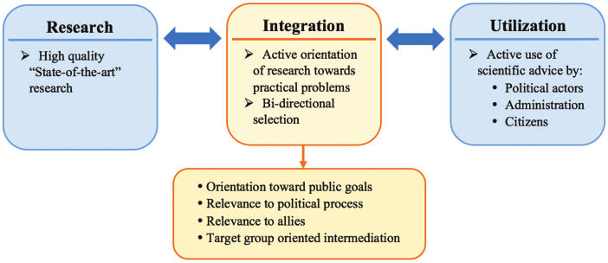
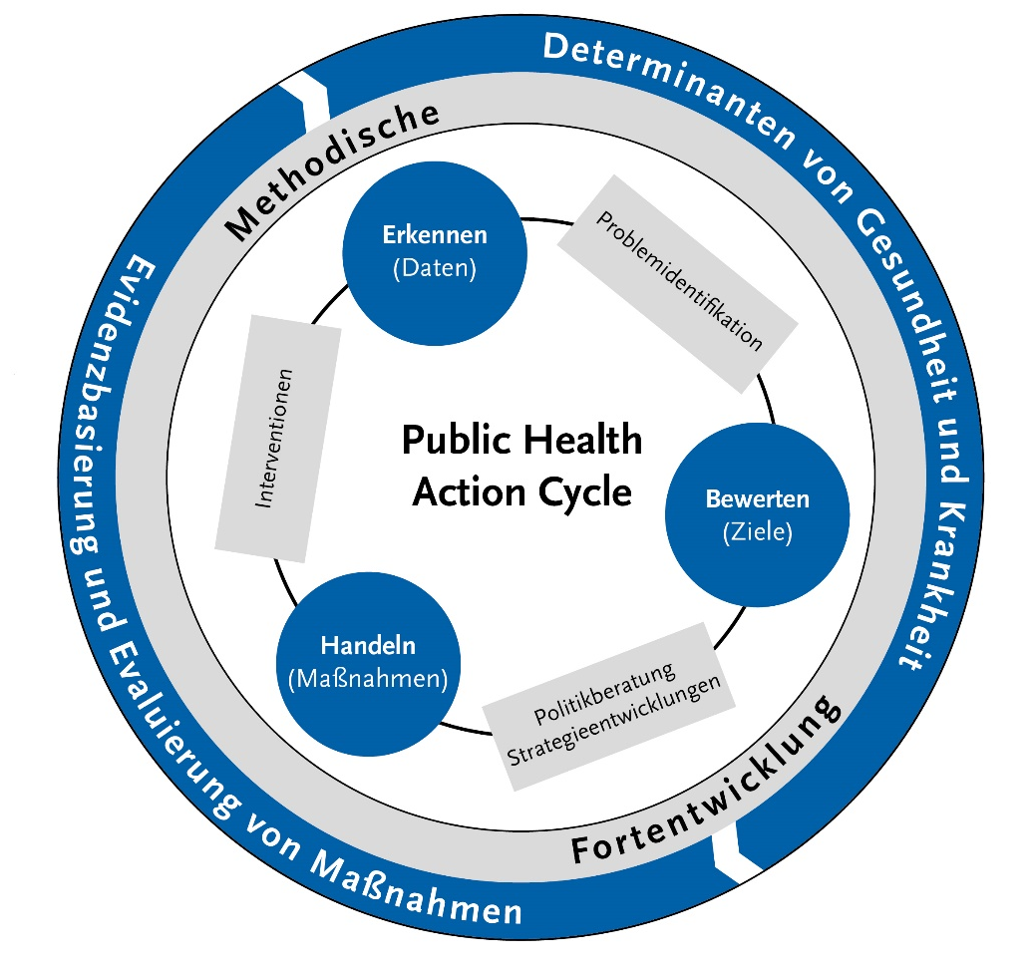
Model of scientific policy advice
RIU-Modell
Public-Health-Cycle
Do H, Juerges N; Krott M, Böcher M (2019). Can landscape planning solve scale mismatches in environmental governance? A case study from Vietnam. Environment and Planning E: Nature and Space. 2. 251484861882251. 10.1177/2514848618822510.
Robert Koch Institute 2018

Slide 9

Model: R - Research: Pandemic preparedness
2020:
2012:
2016:
Intensive preparations long before the crisis
2020:

Slide 10
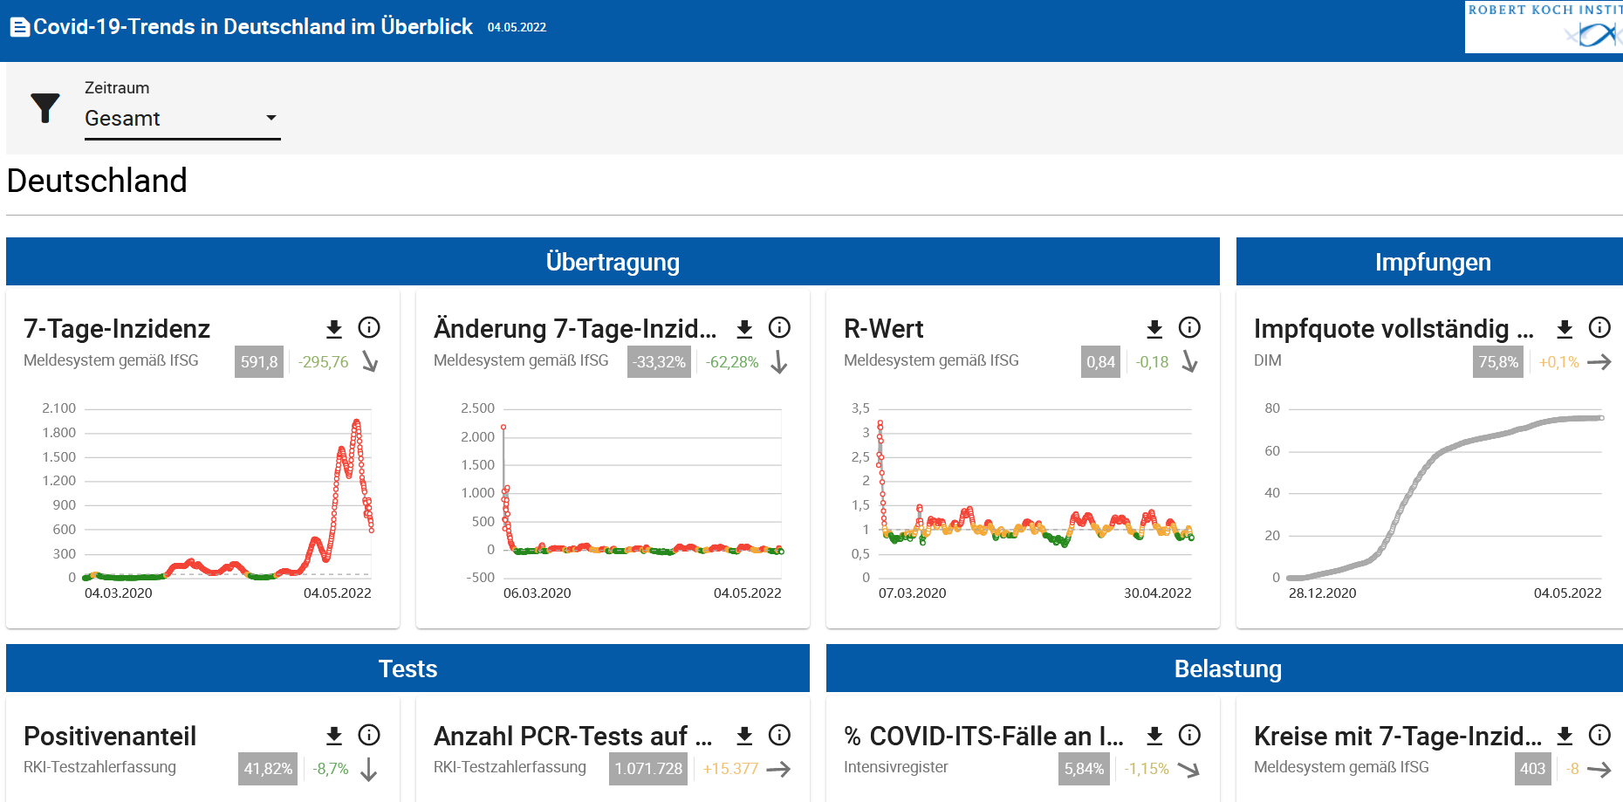
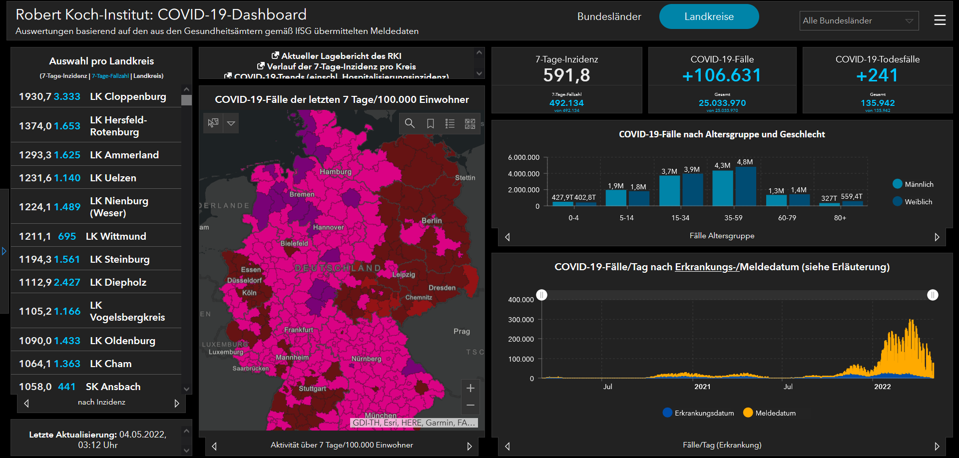
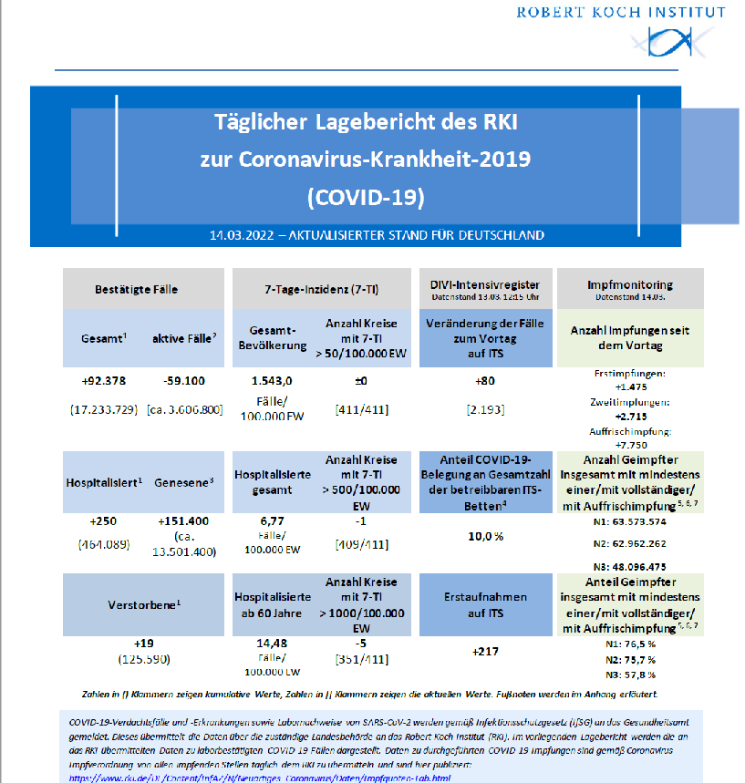
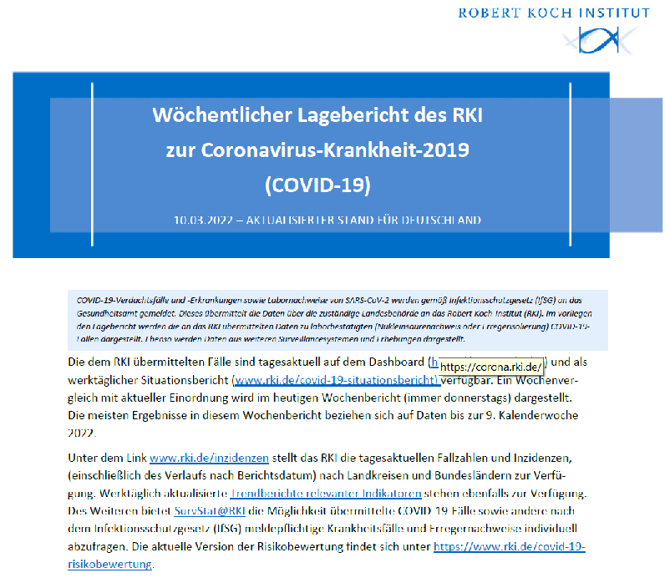
Model: I – Integration: Reporting and advice
Daily dashboard updates
Daily and weekly situation reports
Strategy papers
Technical guidelines
Scientific publications
Communication (Press, Science)

Slide 11
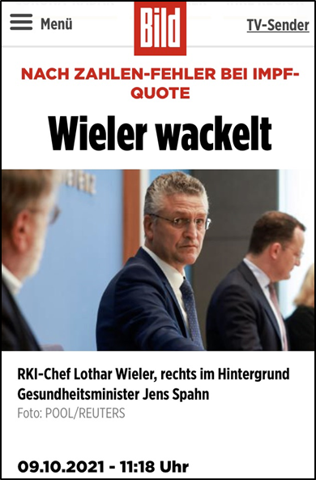
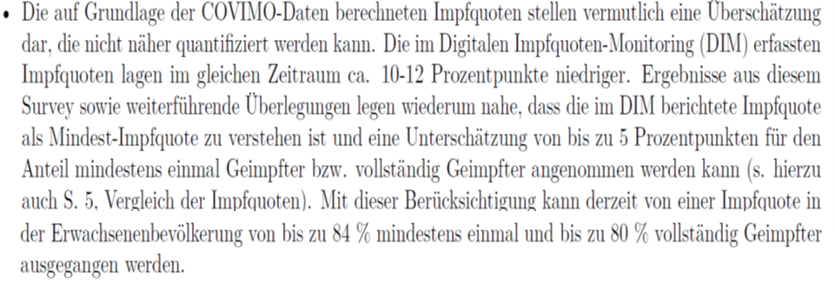
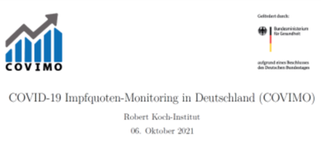
Model: U – Utilization: Scientific policy advice during the pandemic
Objective
"Scientific policy advice enjoyed [...] so much attention that some even complained about a "technocratisation" of politics [...]. The article analyses the question of whether the scientific policy advice of the Robert Koch Institute (RKI) actually gained so much weight. [...] It becomes clear that the RKI, as the responsible departmental research institution, provided different integration services for a policy in crisis mode. Nevertheless, politics was the dominant actor. It is shown that existing independent scientific expertise, the networking of scientific institutions, close exchange of information with political actors and the media increase the chance that scientific information is taken up by politics in the basis for action."
Aus: Michael Böcher, Max Krott, Ulrike Zeigermann: Wissenschaftsbasierte Politikberatung in der Corona-Krise: Die Ressortforschung des Robert-Koch-Instituts zwischen wissenschaftlichem Standard und politischem Handlungsdruck. dms – der moderne staat – Zeitschrift für Public Policy, Recht und Management, 14. Jg., Heft 2/2021, S. 351-372
Example
Initial tendency towards idealisation of scientific policy advice
Instrumentalisation of science + shirking of responsibility by politics
Disproportion between political expectations and scientific possibilities
Ignoring of facts
Discrediting of advisory services in interaction with the media
Subjective

Slide 12

Lessons learned: Effective communication during a pandemic
Why:
Inform
Trust-building measure
Prevent and fight „Infodemics“
Promote dialogue
Arouse understanding
How:
Current assessment of the situation (situation reports, press, social media).
Answer questions, practice self-criticism, self-evaluation/optimisation of processes/methods
Proactive dissemination of information on specific topics (e.g. vaccination/STIKO)
Interviews, talks, panel discussions
Science communication/risk communication

Slide 13
Lessons learned: Communicative challenges during the pandemic
Striking the right balance between scientific evidence, legal framework and implementability of recommendations (factual reports vs. opinions):
Producing evidence-based / knowledge based recommendations. Implementation of recommendations in laws / regulations is the responsibility of policy makers.
Dynamic data situation and limited resources
Expectations of the press, data journalists, experts and, last but not least, the general public
Power dynamics in the scientific community: "Expert" without technical expertise
Infodemics
Communication triad (Often a lack of coherence)

Slide 14
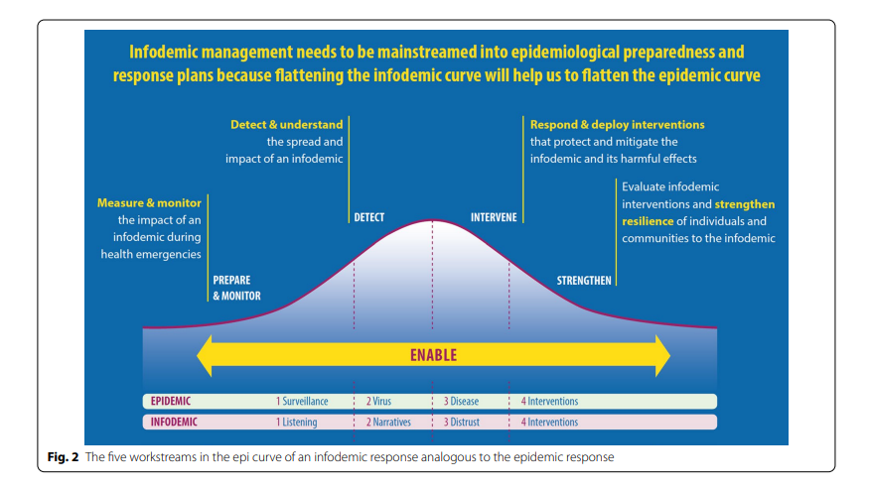
Lessons learned: Infodemic Management
COVID-19 is the first pandemic in history where various technologies and social media have been at the heart of communications
But the same technology has amplified infodemics
The term "infodemic" refers to the overabundance of information - including misinformation and false information.
In September 2021, WHO published a competency framework for infodemic management
https://doi.org/10.1186/s12960-022-00733-0

Slide 15
Lessons learned: Suboptimal Information vs. Misinformation
Suboptimal information undermines public health response to
Pandemic, which negatively affects people's physical and mental health and hinders countries' responses to the pandemic
Suboptimal Information
False- /Misinformation
Disinformation can
polarize public debate and promote hate speech, threatening human rights and social cohesion
https://doi.org/10.1186/s12960-022-00733-0

Slide 16
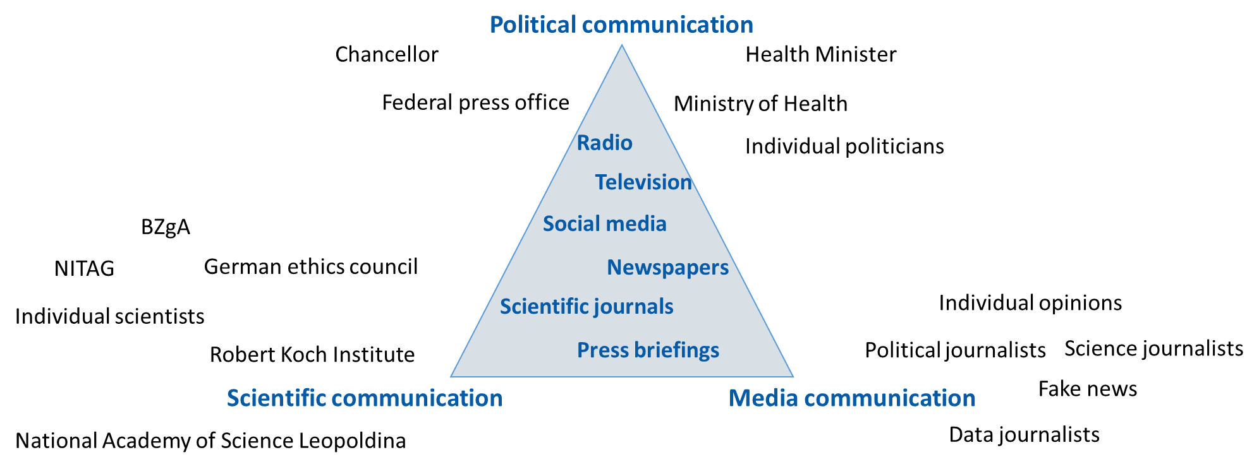
Lessons learned: The communication triad
If not coherent, this can be challenging for society

Slide 17
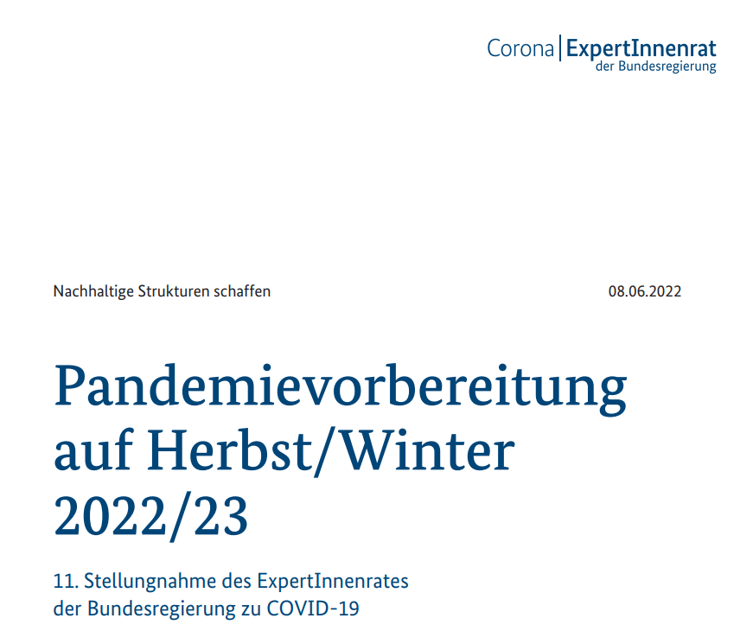
Lessons learned: Other players in scientific policy advice
Until December 2022:
Leopoldina – National Academy of Science: 10 Ad-hoc-position papers
acatech – Germany academy of technical science: 8 position papers about the COVID-19 pandemic, crises and resilience
German Ethics Council : 7 Ad-hoc-recommendations and position papers
Medical-scientific societies: various statements on individual topics in the context of the pandemic
Informal advisory bodies of the Federal Minister of Health and the Federal Chancellor with changing, occasion-related composition: no public statements
Since December 2022:
19 experts appointed by the Federal Chancellor
from various disciplines: 11 position papers so far
Medical-scientific societies:
further statements about individual issues

Slide 18
Take home message
The RIU model describes how advising politics works
Responsibility of each stakeholder has to be clarified
Scientific independence goes hand in hand with scientific excellence and quality
Communication can be challenging if not coherent when coming from different sources (Communication triad)
Promoting dialogue with society (public engagement) and transparently communicating scientific evidence / scientific knowledge clearly and coherently (even if it isn’t always good news) will increase the trust of the public

