Slide 1
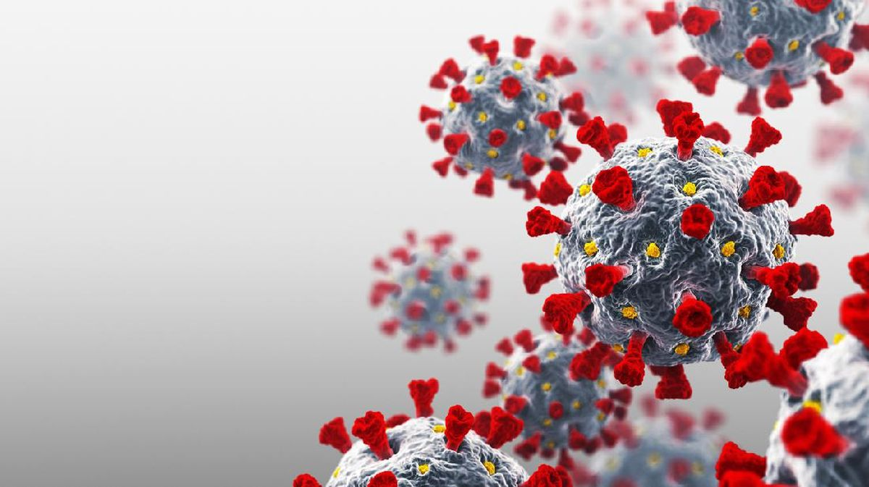
Health system strengthening for pandemic preparedness and response
Yodi Mahendradhata

Slide 2
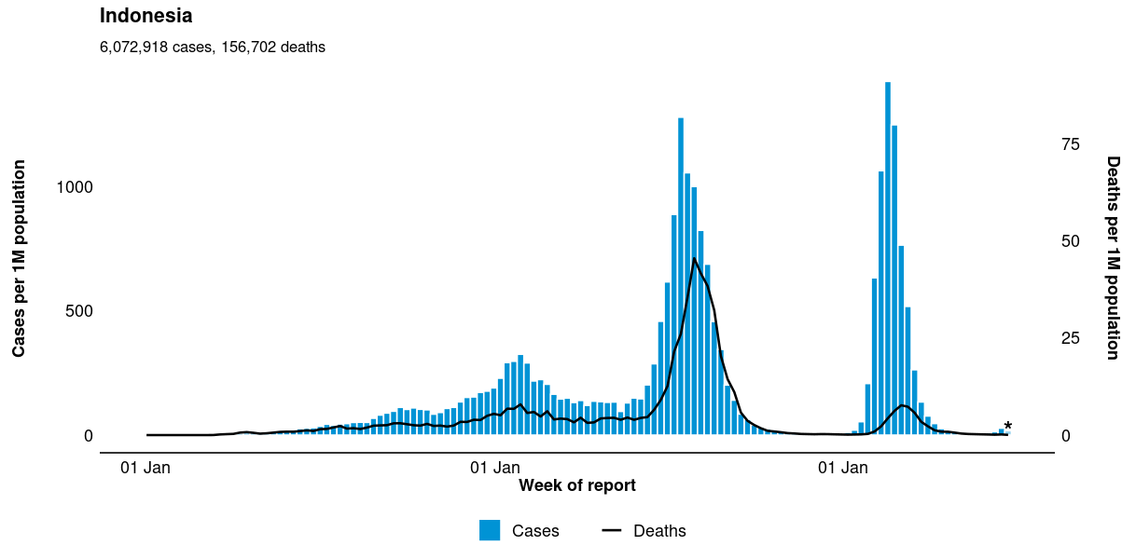
*Ref: https://worldhealthorg.shinyapps.io/covid/

Slide 3
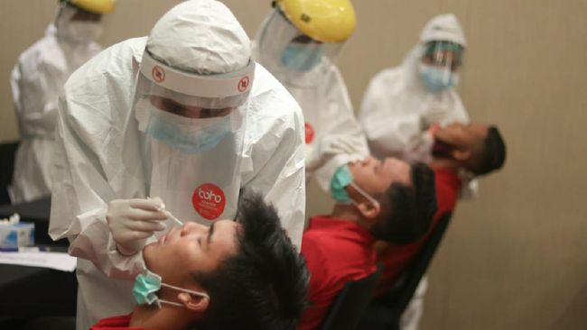
“Everything starts with smarter surveillance. If you don’t look, you don’t see. If you don’t see, you will always respond too late”
Jeremy Farrar (2021)

Slide 4
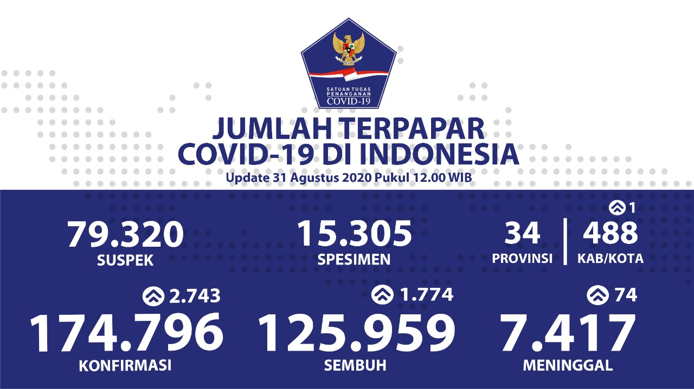
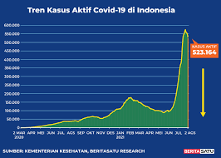
“We were doing elegant math on crappy data”
Jennifer Nuzzo (2021)

Slide 5
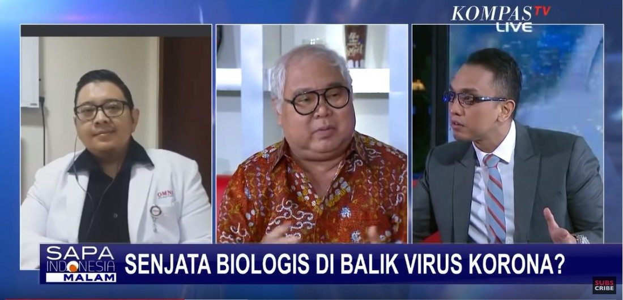
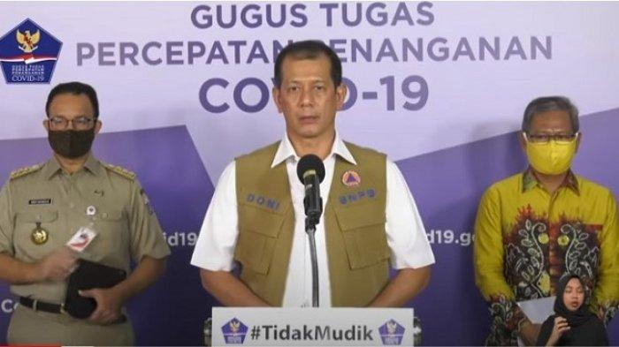
“The pseudo-academization of conspiracy theories is at its nascency - and that is only going to get worse in the next pandemic,”
Nahid Bhadelia (2021)

Slide 7
“People acknowledge this is important, but see it as too hard to fix. We can’t come out of COVID-19 and not have equity be front and centre.”
Jennifer Nuzzo (2021)

Slide 8
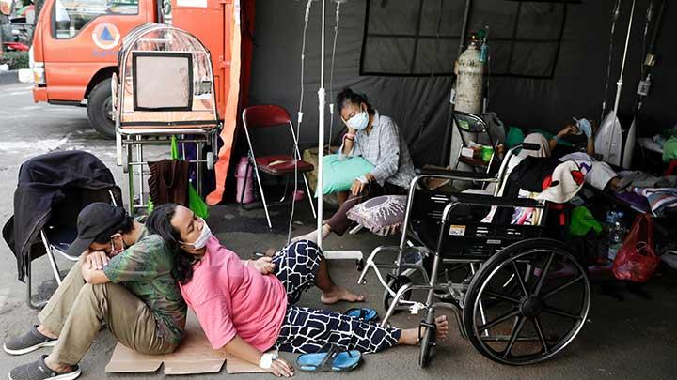
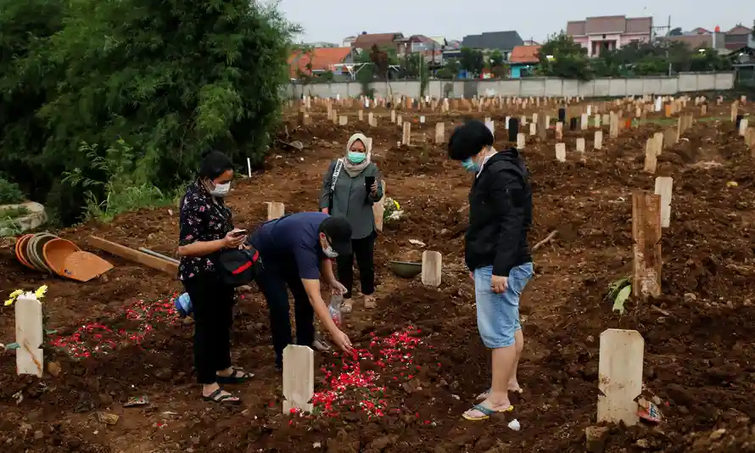
“The pandemic highlighted the human resources challenges the healthcare system has been struggling with. The pandemic has exposed the fragility of medical supply chains….The existing healthcare infrastructure is still inadequate to deal with the rise of COVID-19 cases.”
Mahendradhata et al (2021)

Slide 9
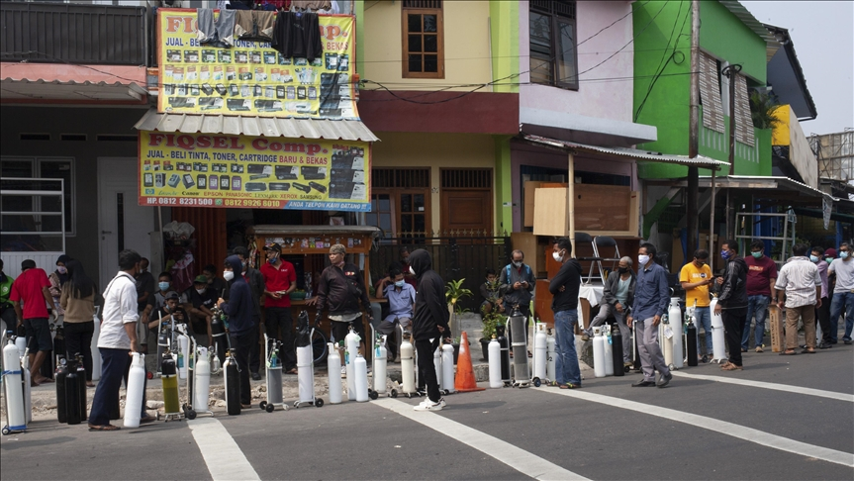
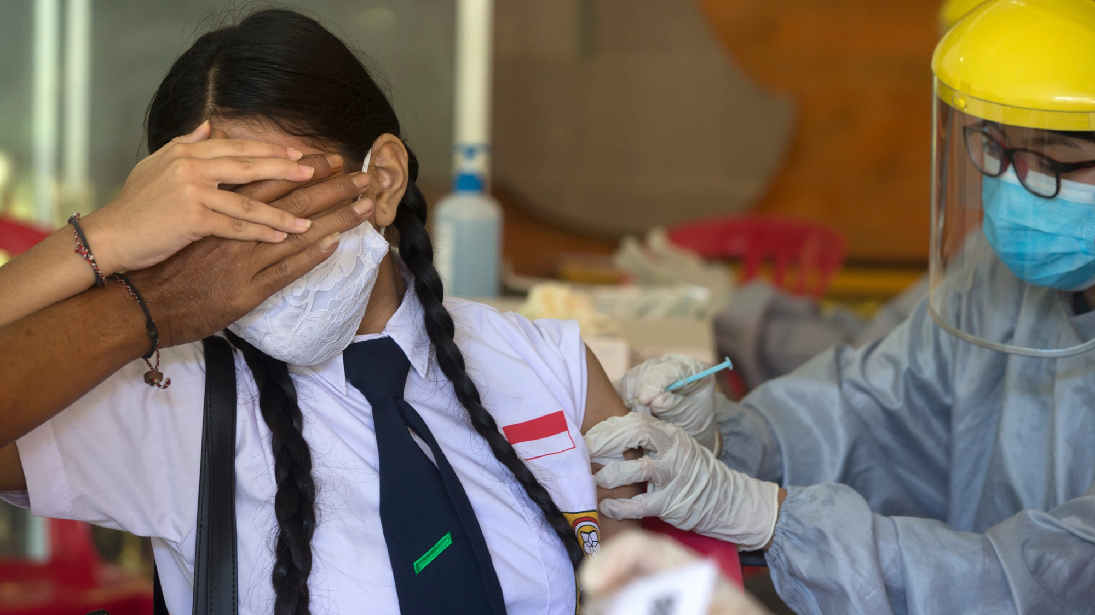
“With the COVID-19 pandemic, globally, we now face unprecedented challenges to access essential medicines and other health commodities. Drug shortages, hoarding of medicines and supplies, and the circulation of falsified health products have already exacerbated this once in a century global health challenge.”
Kohler & Mackey (2020)

Slide 10
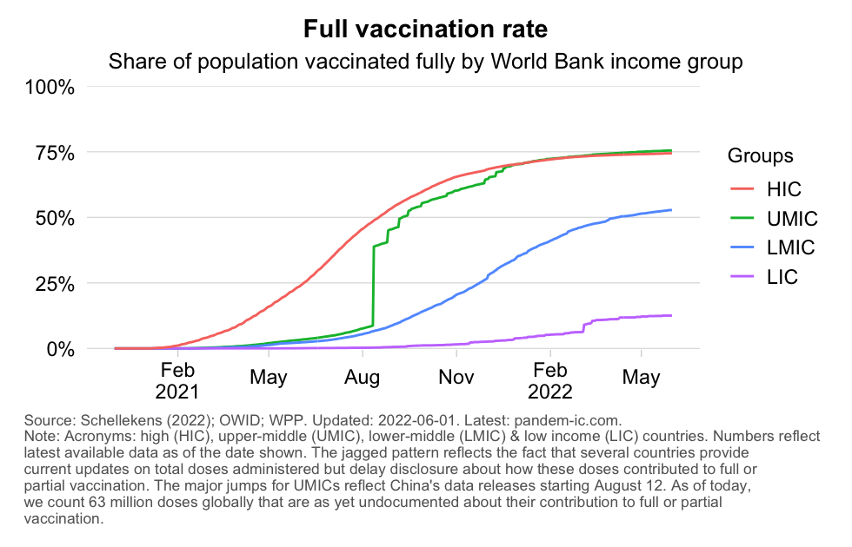

Slide 11
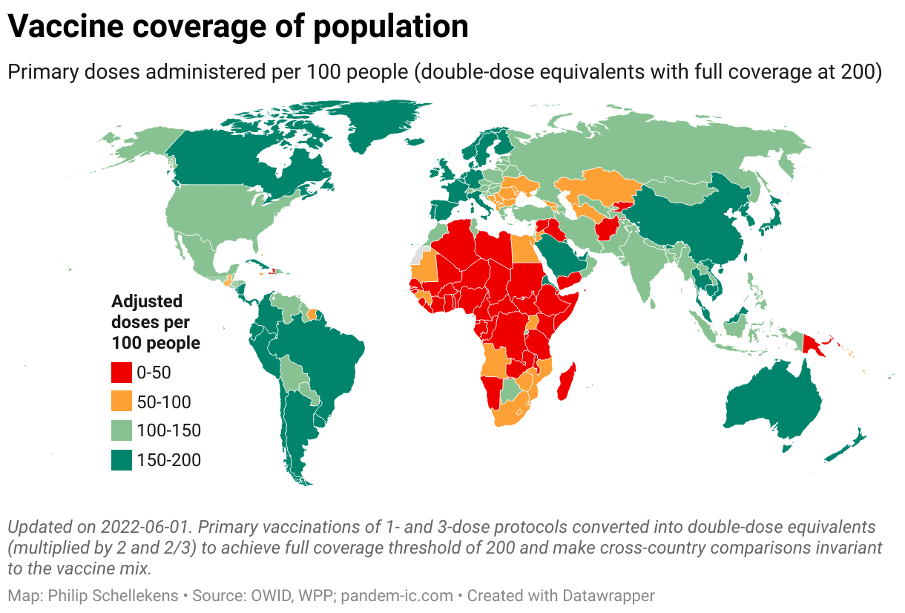

Slide 12
Lessons from covid-19 pandemic*
How to advance warning systems?
How can better data drive smarter decision?
How to enhance communication and trust?
How to improve health equity?
How to ensure access to vaccines, medicines & commodities?
How strengthen healthcare capacity?
*Ref: Maxmen (2021)

Slide 13
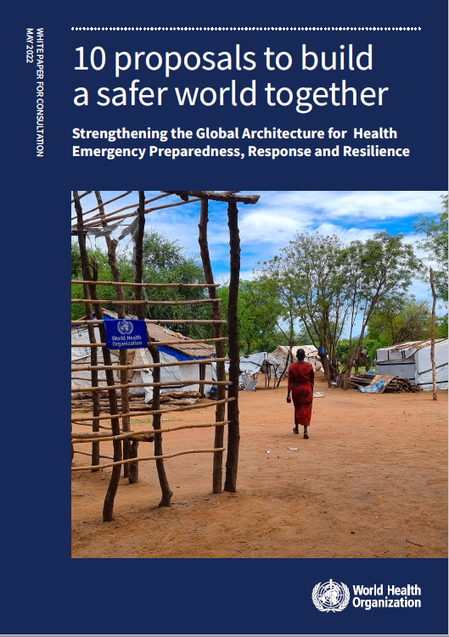
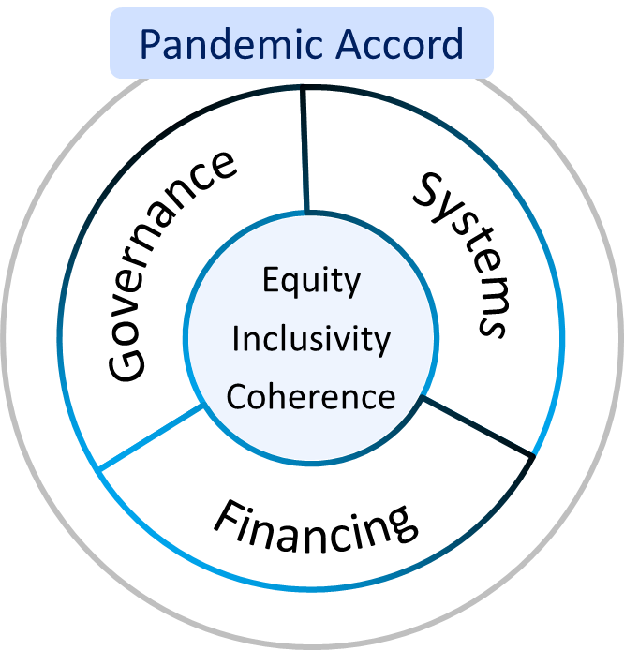
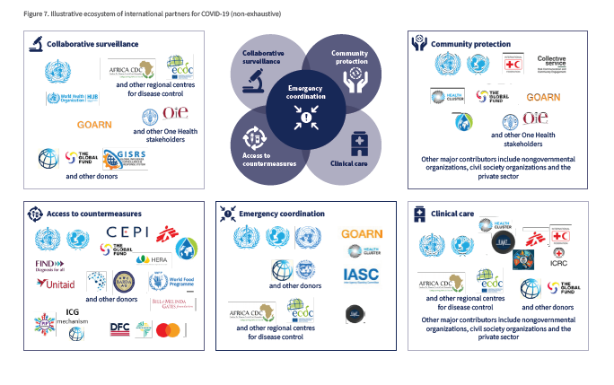
WHO - 10 Proposals to Strengthen the Global Health Architecture for Health Emergency Preparedness & Response (May 2022)
From all major reports & >300 recs…
…to 10 major
proposals in 3 key areas
Source: Building Global Health Resilience - Report of Health Working Group 2

Slide 14
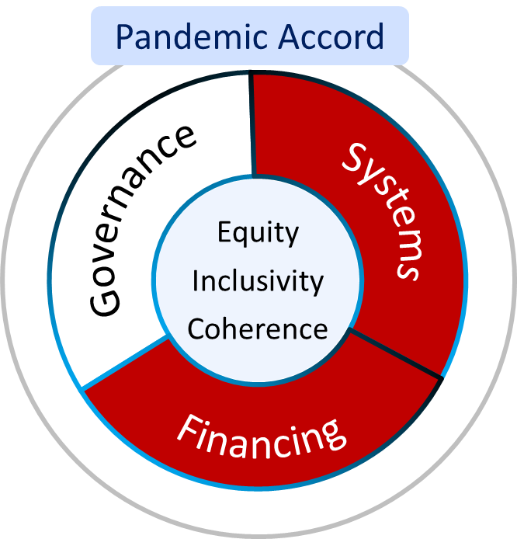
G20 Indonesian Presidency is advancing 3 of the WHO proposals to strengthen the Global Health Architecture for Health Emergencies
Leadership – Global Health Emergency Council & WHO Emergency Committee
Regulation – IHR (2005) amendments
Accountability – UHPRs & independent monitoring
Capacity – rapid health emergency teams
Coordination – of strategy, finance, operations & monitor
Collaboration Networks – surveillance, access to countermeasures, community protection, and clinical care
Catalytic, gap-filling funding – Financial Intermediary Fund (FIF)
Predictable preparedness financing – health & finance coordination platform
Rapidly scalable response financing – expanded contingency fund
Source: Building Global Health Resilience - Report of Health Working Group 2

Slide 15
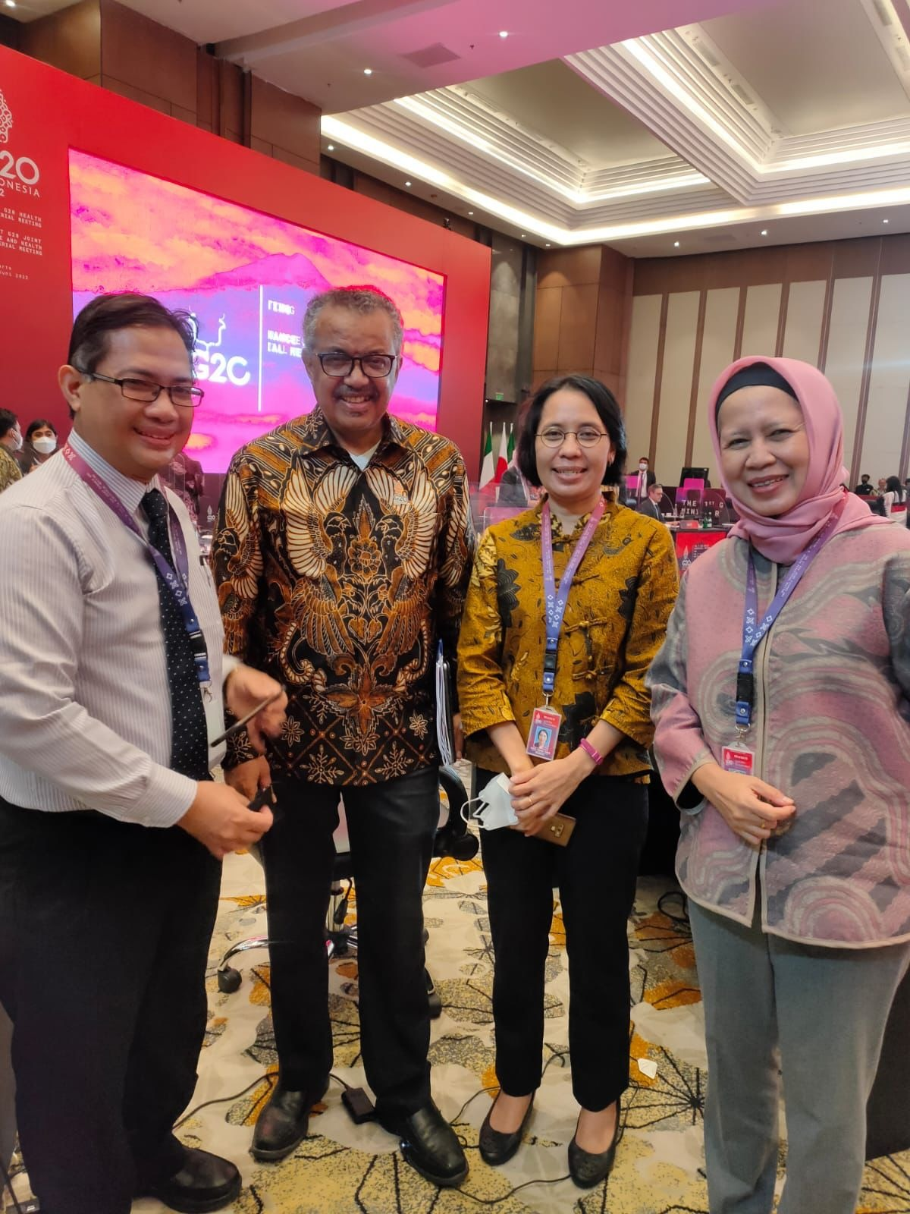
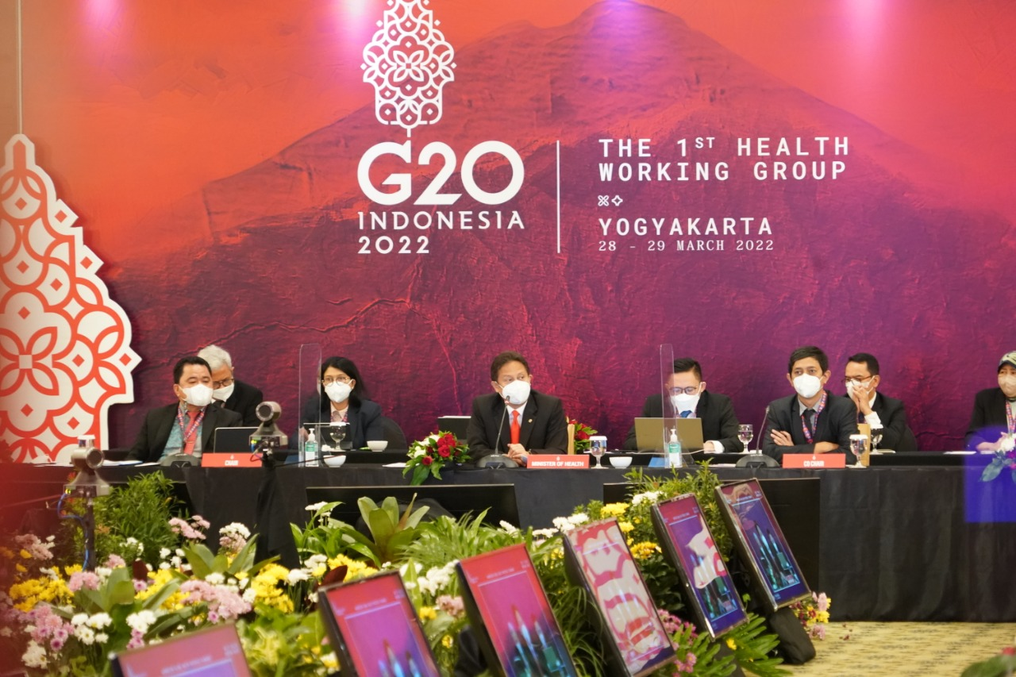

Slide 16
ymahendradhata@ugm.ac.id

