Slide 1
Challenges and research needs to develop early warning and response systems
Kristie L. Ebi, Ph.D., MPH
University of Washington

Slide 2
https://www.worldweatherattribution.org

Slide 3
Vicedo et al. 2021

Slide 4
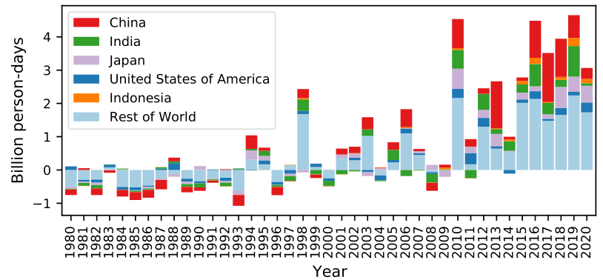
1.1.2: Exposure of Vulnerable Populations to Heatwaves
Children younger than 1 year were affected by 626 million more person-days of heatwave exposure and adults older than 65 years were affected by 3·1 billion more person-days of heatwave exposure in 2020 than in the 1986–2005 average
>65 year old
<1 year old
Notes:
This indicator tracks the change in the number of heatwaves experienced by vulnerable populations around the world.
Exposure to extremes of heat results in a range of health consequences, including heat stress and heat stroke, worsening heart disease, and acute kidney injury. Populations over 65 and newborns are particularly vulnerable to these effects, and are being exposed to heatwaves in increasing numbers.
This indicator tracks the change in the number of heatwave exposure events (with one exposure event being one heatwave experienced by one person aged over 65 or children from birth to 1 year old) and days of heatwave exposure in this population compared with the average number of events in the reference period (1986–2005).
A heatwave was defined as a period of at least two days where both the daily minimum and maximum temperatures are above the 95th percentile of their respective climatologies.
Results show a steady increase in the person-days of exposure for adults over 65 years, with the last 10 years seeing an annual average of 2.9 billion additional events and 3.1 billion more person-days of exposure (or an average of 4.1 days per person >65 years) in 2020, with respect to the 1986-2005 baseline. For children under 1 year, there were an estimated 626 million additional person-days of exposure (4.6 days per person <1 year) affecting this vulnerable group in 2020, compared with baseline years.
Data sources:
ERA5 reanalysis, 2021. European Centre for Medium-Range Weather Forecasts.
Gridded Population of the World. 4 ed (GPWv4), 2021. NASA
Histsoc dataset, 2021. Inter-Sectoral Impact Model Intercomparison Project – 2021 Revision of World Population Prospects, 2021. United Nations DESA/Population Division
United Nation World Population Prospects
Caveats: As two distinct sources were used for population data there may be some inconsistencies between the pre and post 2000 values.
Figure: Change in days of heatwave exposure relative to the 1986–2005 baseline a) (left) in people older than 65 years, and b) (right) in population under 1 year of age.

Slide 5
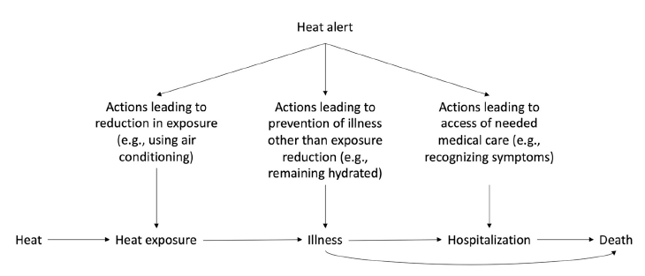
Potential benefits of heatwave early warning alerts
Weinberger et al. 2021

Slide 6
Core elements:
Strategic planning
Alert system
Heatwave and summer preparedness
Communication plan
Working with service providers
Engaging the community
Monitoring, evaluation, and learning

Slide 7
Heatwave Plan for England

Slide 8
Jay et al. 2021

Slide 9
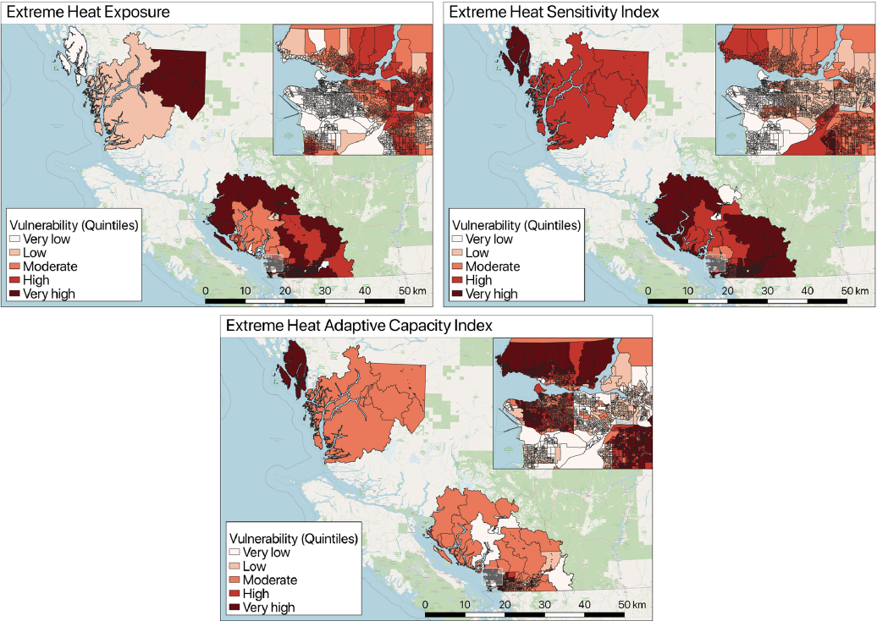
Extreme heat exposure, sensitivity, and adaptive capacity index, British Columbia
Yu et al. 2021

Slide 10
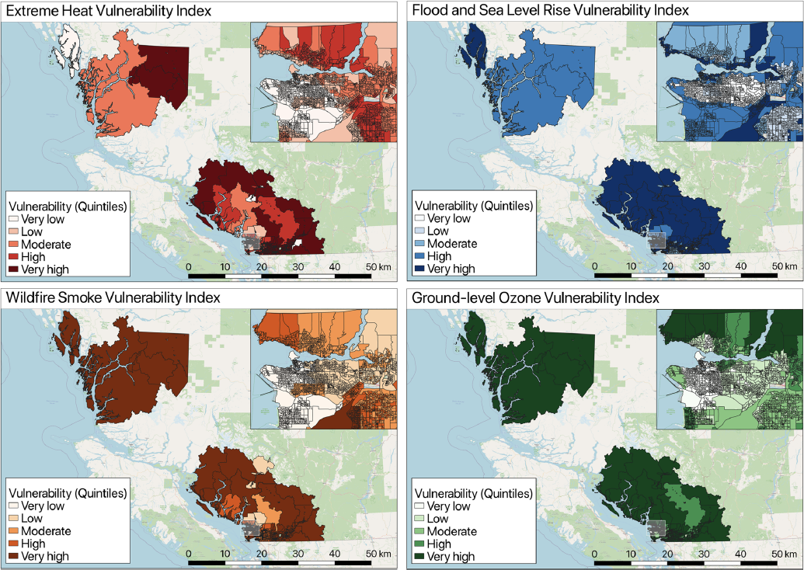
Overall vulnerability index maps for all hazards, British Columbia
Yu et al. 2021

Slide 11
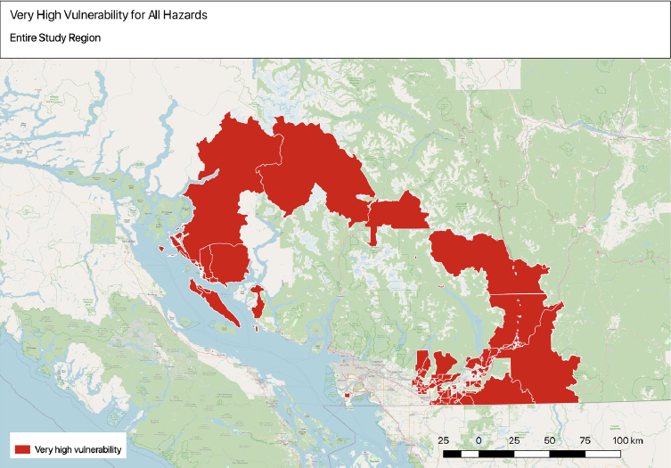
Very high vulnerability for all hazards, British Columbia
Yu et al. 2021

Slide 12
Shindell et al. 2020

Slide 13
Adaptation risk reduction (%) needed to maintain current risk levels
Astrom et al. 2017

Slide 14
GHHIN.ORG

Slide 15
Research needed to:
Quantify the magnitude and burden of climate-sensitive health outcomes
Estimate the extent to which climate change is already causing illness, injuries, and deaths
Project the magnitude and pattern of health risks under a range of climate and development scenarios
Develop, deploy, monitor, and evaluate the effectiveness of policies and measures to increase resilience of health systems and healthcare facilities
Estimate the costs to individuals and health systems of the health risks of climate variability and change
Estimate the health co-benefits of mitigation policies and technologies
Ebi et al. accepted

Slide 17
Physiological pathways of human health strain
Ebi et al. 2021

