Slide 1


Climate Change and Pandemics, Heidelberg, June 23-25, 2022
Early Warning and Preparedness Systems
Joacim Rocklöv
Alexander von Humboldt Professor
Heidelberg Institute of Global Health & Interdisciplinary Centre for Scientific Computing, Heidelberg University

Slide 2
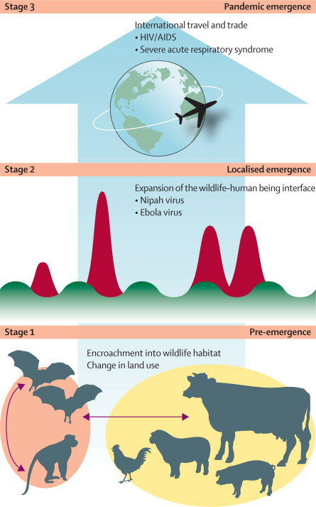
Prevention Vs. adaptation
Climate Change and Pandemics, Heidelberg, June 23-25, 2022
Secondary prevention: prevent spread and disease
Difficult
Impacts on society from interventions, like NPI´s
Residual health burdens
Pandemic prepardness
Climate change mitigation & adaptation
Primary prevention: prevent spillover, outbreaks and pandemics
Upstream – big reward
Little health burdens
Distal to disease, ie the intervention to disease relationship is more difficult to quantify
Morse SS,. Prediction and prevention of the next pandemic zoonosis. The Lancet. 2012 Dec 1;380(9857):1956-65.

Slide 3
The case of Vibrio

Slide 4
Vibrio INFECTIONS
Infections caused by Vibrio species constitute a major concern for public health worldwide
In industrialized nations, infections caused by non-toxigenic cholera or other vibrios species, such as Vibrio parahaemolyticus, Vibrio vulnificus or non-toxigenic Vibrio cholera are a larger concern
The global disease burden of Vibrio infections are unknown, but around 80,000 infections are estimated to occur in the US annualy (CDC).
The concentration of NCV in sea water is an important factor driving the human risk of infection from both direct water contact and foodborne routes
Shellfish often act as a link between the aquatic environment and human disease because many species get nutrients through filtering water and can accumulate and concentrate NCV bacteria

Slide 5
Vibrio Cholera Suitability
From Escobar et al., 2015.

Slide 6
Vibrio Bacteria Ecology
Scientific consensus on the existence of an association between Vibrio concentrations and water temperature and salinity
Once a temperature threshold of 14-17°C for growth is reached, a positive correlation between increasing sea surface temperature and Vibrio concentrations occurs. As such, NCV species are most abundant in the warmest periods of the year
Water salinity is probably the second most important determinant of vibrio growth in the aquatic environment after temperature, attributing 64% and 76% of the variation in Vibrio concentration in water and oysters
Optimum is reached in brackish waters

Slide 7
Trends in the suitability for pathogenic Vibrio outbreaks
www.lancetcountdown.org

Slide 8
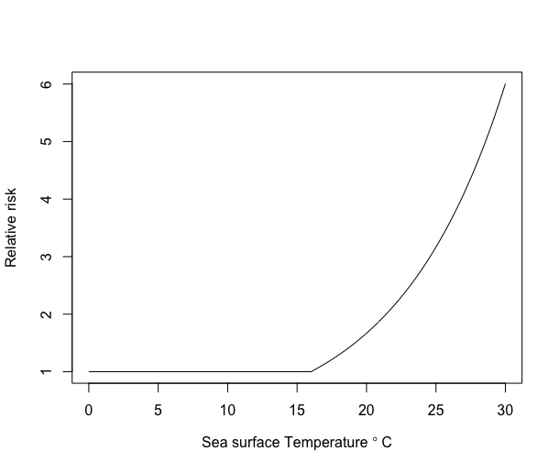
SST Vibrio Relative infection risk, Sweden
Mean age of infection: 41 years
Male/female infection ratio: 2/1
Wound/blood infections: 50%
RR=1.14 (95% CI: 1.02, 1.27) with 2 weeks lag of 1∘C increase of SST
Population behaviour and exposition is unknown
Semenza, Rocklöv et al. EHP

Slide 9
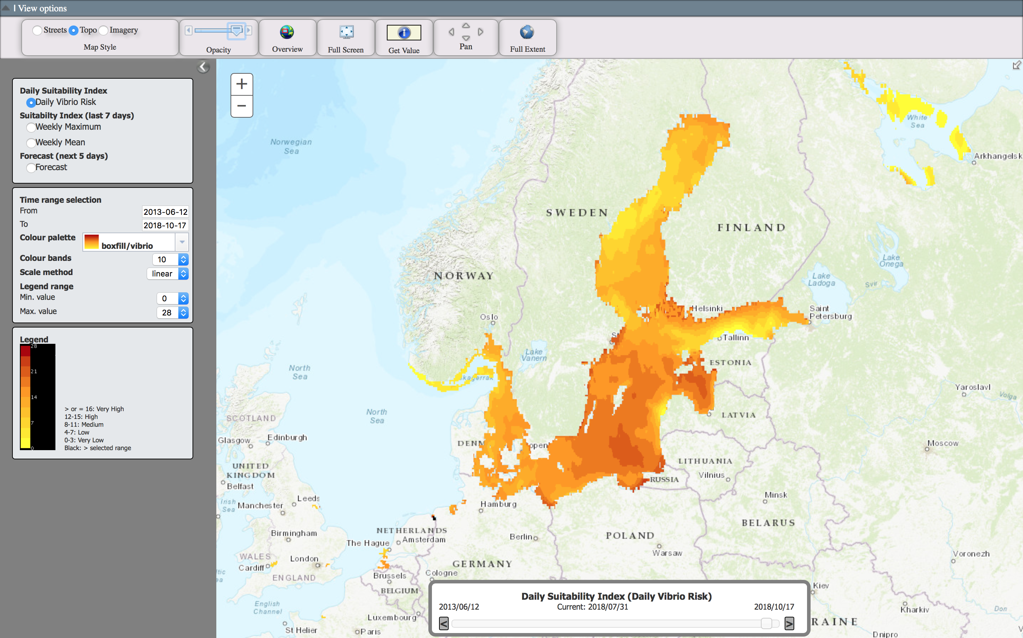
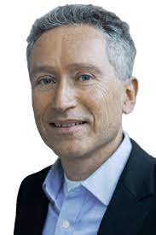
Jan Semenza
https://e3geoportal.ecdc.europa.eu/sitepages/vibrio%20map%20viewer.aspx

Slide 10
The case of West Nile Virus

Slide 11
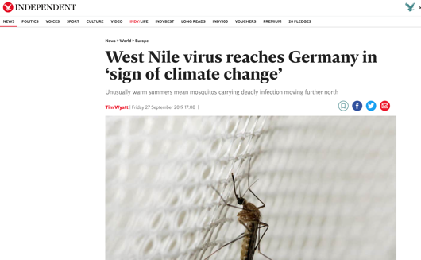
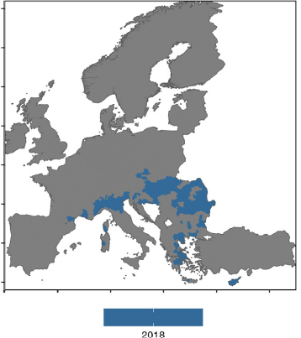
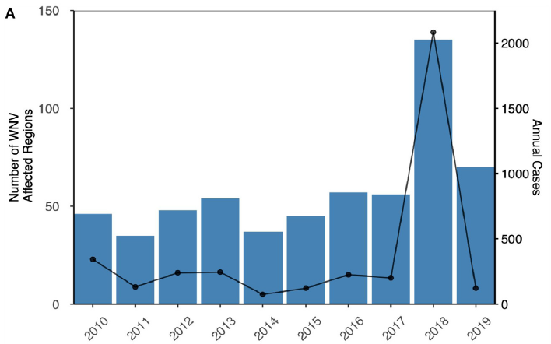
West Nile Virus predictive model
Farooq Z, Rocklöv J, Wallin J, Abiri N, Sewe MO, Sjödin H, Semenza JC. Artificial intelligence to predict West Nile virus outbreaks with eco-climatic drivers. The Lancet Regional Health-Europe. 2022 Jun 1;17:100370.

Slide 12
Model performance
The model, trained on 2010-2017 data, achieved an AUC score of 0.97 and 0.93 when tested with 2018 and 2019 data
Overall, positive summer/spring temperatures anomalies, lower water availability index (NDWI), and drier winter conditions were found to be the main determinants of WNV-outbreaks across Europe.
The climate trends of the preceding year in combination with eco-climatic predictors of the first half of the year showed predictive ability of the entire transmission season
Farooq Z, Rocklöv J, Wallin J, Abiri N, Sewe MO, Sjödin H, Semenza JC. Artificial intelligence to predict West Nile virus outbreaks with eco-climatic drivers. The Lancet Regional Health-Europe. 2022 Jun 1;17:100370.
Notes:
This indicator shows the vectorial capacity (VC) of two mosquito vectors that transmit dengue fever - Aedes aegypti and Aedes albopictus. VC is the average daily rate of subsequent cases in a susceptible population resulting from one infected case, is calculated using a formula including the vector to human transmission probability per bite, the human infectious period, the average vector biting rate, the extrinsic incubation period and the daily survival period.
The second highest VC for both dengue vectors was recorded in 2017, with the 2012-2017 average 7.2% and 9.8% above baseline for Aedes aegypti and Aedes albopictus, respectively (Figure 7). This continues the upward trend of climate suitability for transmission of dengue, with nine of the ten most suitable years occurring since 2000.
Figure: Changes in global vectorial capacity for the dengue virus vectors Aedes aegypti and Aedes albopictus 1950-2017.

Slide 13
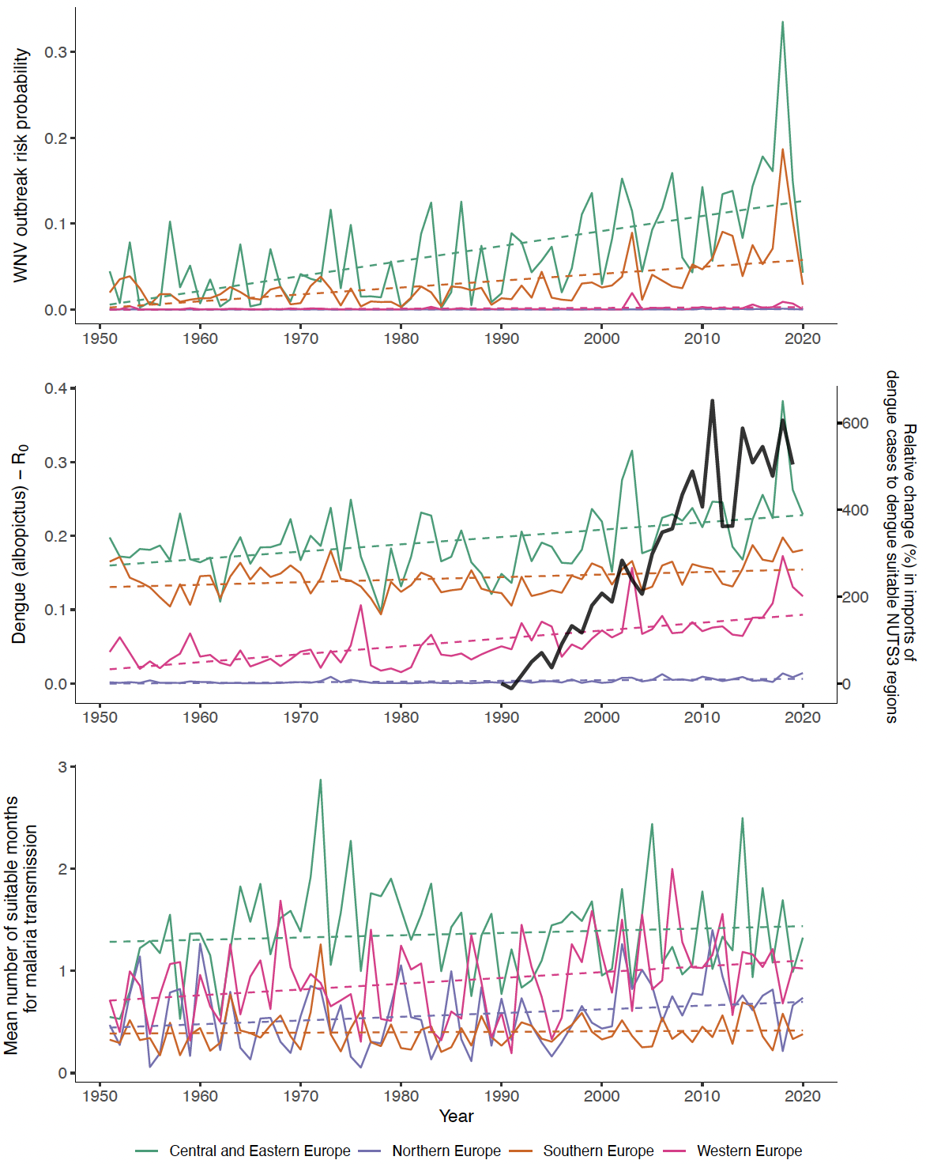
Predicted change in VNV risk in European regions over time
In press, Lancet countdown Europe on climate change and health.
Notes:
This indicator shows the vectorial capacity (VC) of two mosquito vectors that transmit dengue fever - Aedes aegypti and Aedes albopictus. VC is the average daily rate of subsequent cases in a susceptible population resulting from one infected case, is calculated using a formula including the vector to human transmission probability per bite, the human infectious period, the average vector biting rate, the extrinsic incubation period and the daily survival period.
The second highest VC for both dengue vectors was recorded in 2017, with the 2012-2017 average 7.2% and 9.8% above baseline for Aedes aegypti and Aedes albopictus, respectively (Figure 7). This continues the upward trend of climate suitability for transmission of dengue, with nine of the ten most suitable years occurring since 2000.
Figure: Changes in global vectorial capacity for the dengue virus vectors Aedes aegypti and Aedes albopictus 1950-2017.

Slide 14
The case of Aedes Borne Diseases

Slide 15
Global change (%) in R₀ for dengue
R₀ (%)
Arboviruses, i.e. dengue, are expanding
Climate is an important driver of dengue
Almost every year, new record in R₀
www.lancetcountdown.org
Notes:
This indicator shows the vectorial capacity (VC) of two mosquito vectors that transmit dengue fever - Aedes aegypti and Aedes albopictus. VC is the average daily rate of subsequent cases in a susceptible population resulting from one infected case, is calculated using a formula including the vector to human transmission probability per bite, the human infectious period, the average vector biting rate, the extrinsic incubation period and the daily survival period.
The second highest VC for both dengue vectors was recorded in 2017, with the 2012-2017 average 7.2% and 9.8% above baseline for Aedes aegypti and Aedes albopictus, respectively (Figure 7). This continues the upward trend of climate suitability for transmission of dengue, with nine of the ten most suitable years occurring since 2000.
Figure: Changes in global vectorial capacity for the dengue virus vectors Aedes aegypti and Aedes albopictus 1950-2017.

Slide 16
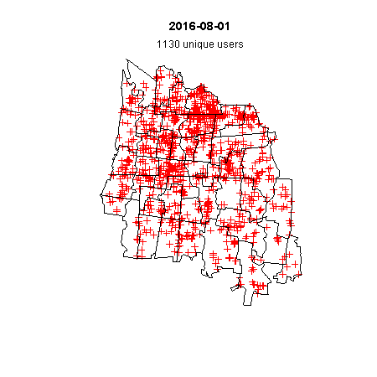
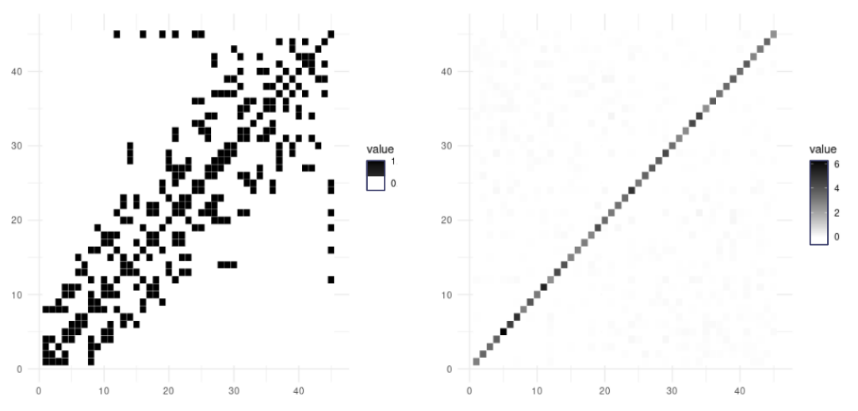
Dengue, Mobility & Weather, Indonesia
Daily geocoded mobility in Yogyakarta
Adjacency matrix neighbors
Adjacency matrix mobility
Spatial covariance through tweet estimated “mobility” from social media (right) + weather data as predictor
In press, Ramadona et al.

Slide 17
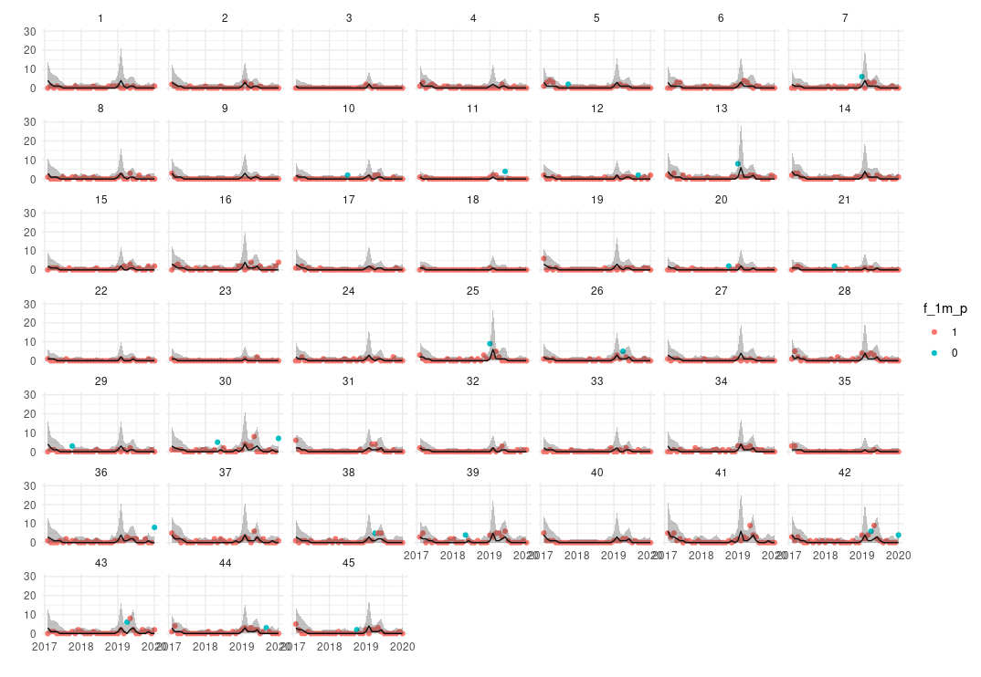
Prospective prediction 2018--2020, 1 month lead time
Model Predictive Performance
temperature + mobilty + population =>
98.7% of prediction CI´s included the observed value in validation across all villages for out of bag years

Slide 18
Compounding impacts of travel and climate change in Europe
In press, Lancet countdown Europe on climate change and health.

Slide 19
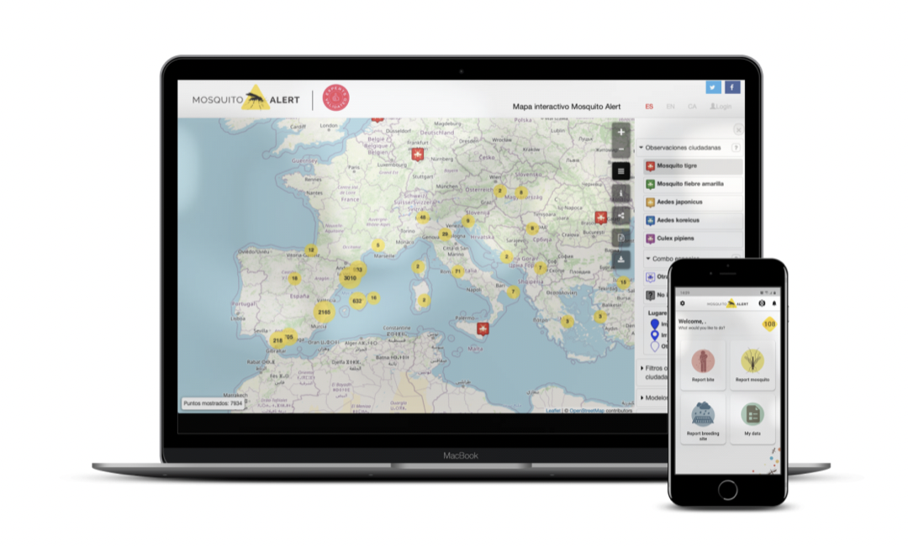
New smart surveillance and citizen science, new opportunities to prepardness and early warnings
http://www.mosquitoalert.com

Slide 20

Part of the Lancet Countdown Europe on climate change and health
19 partners
Role: PI
Focus on OneHealth and Climate Change
Activities:
Indicators development and Early Warnings
Evaluation of green and blue transitions
Computer vision applied to insect data from citizen science
Streaming data into computing tools for analysis, surveillance and pandemic prepardness
Climate projections for prepardness and prevention

Slide 21
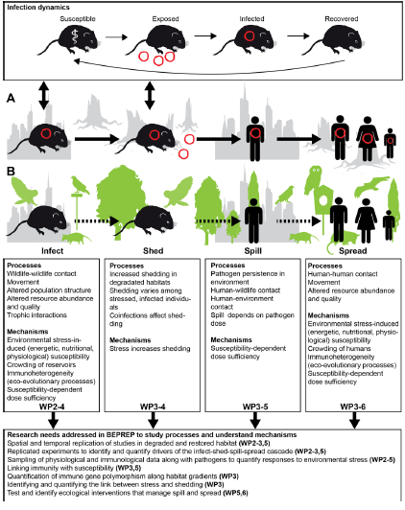
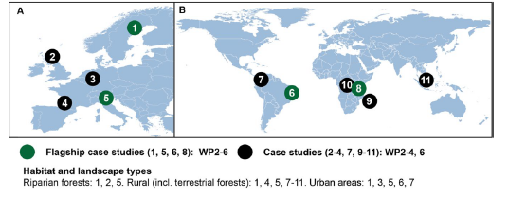
BEPREP: Identification of best practices for biodiversity recovery and public health interventions to prevent future epidemics and pandemics
14 partners
Role: WP lead
Focus on OneHealth and Biodiversity and the prediction of spillover risk

Slide 22
Thank You
joacim.rocklov@umu.se

