Slide 1


A COVID-19 model of Germany and its integration into economic model
Michael Meyer-Hermann (presented by Sahamoddin Khailaie)
Department for Systems-Immunology (SIMM)
Helmholtz Centre for Infection Research, Braunschweig, Germany
www.systems-immunology.de
25.06.2022

Slide 2
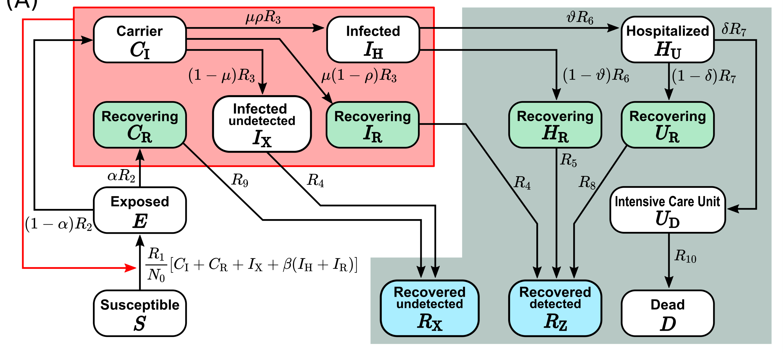
A compartmental model of COVID-19
Integration of knowledge about the mechanism
Prediction capability
Representaion of exponential increase/decline in infection dynamic

Slide 3

A compartmental model of COVID-19

Slide 4
A compartmental model of COVID-19
Reproduction number: Num. of people infected by an infected indv.

Slide 5
Analysis of the reproduction number in Germany
Restrictive measures in March 2020
http://secir.theoretical-biology.de
Gradual loosening
Economy: Full opening?
Health: More restrictions?
Contact inhibition measures were efficient [Dehning et al. Science 2020]
Openings could be tolerated in combination with hygiene and contact measures

Slide 6
Dorn & Khailaie & Stoeckli et al.
https://doi.org/10.1101/2020.08.14.20175224

Slide 7
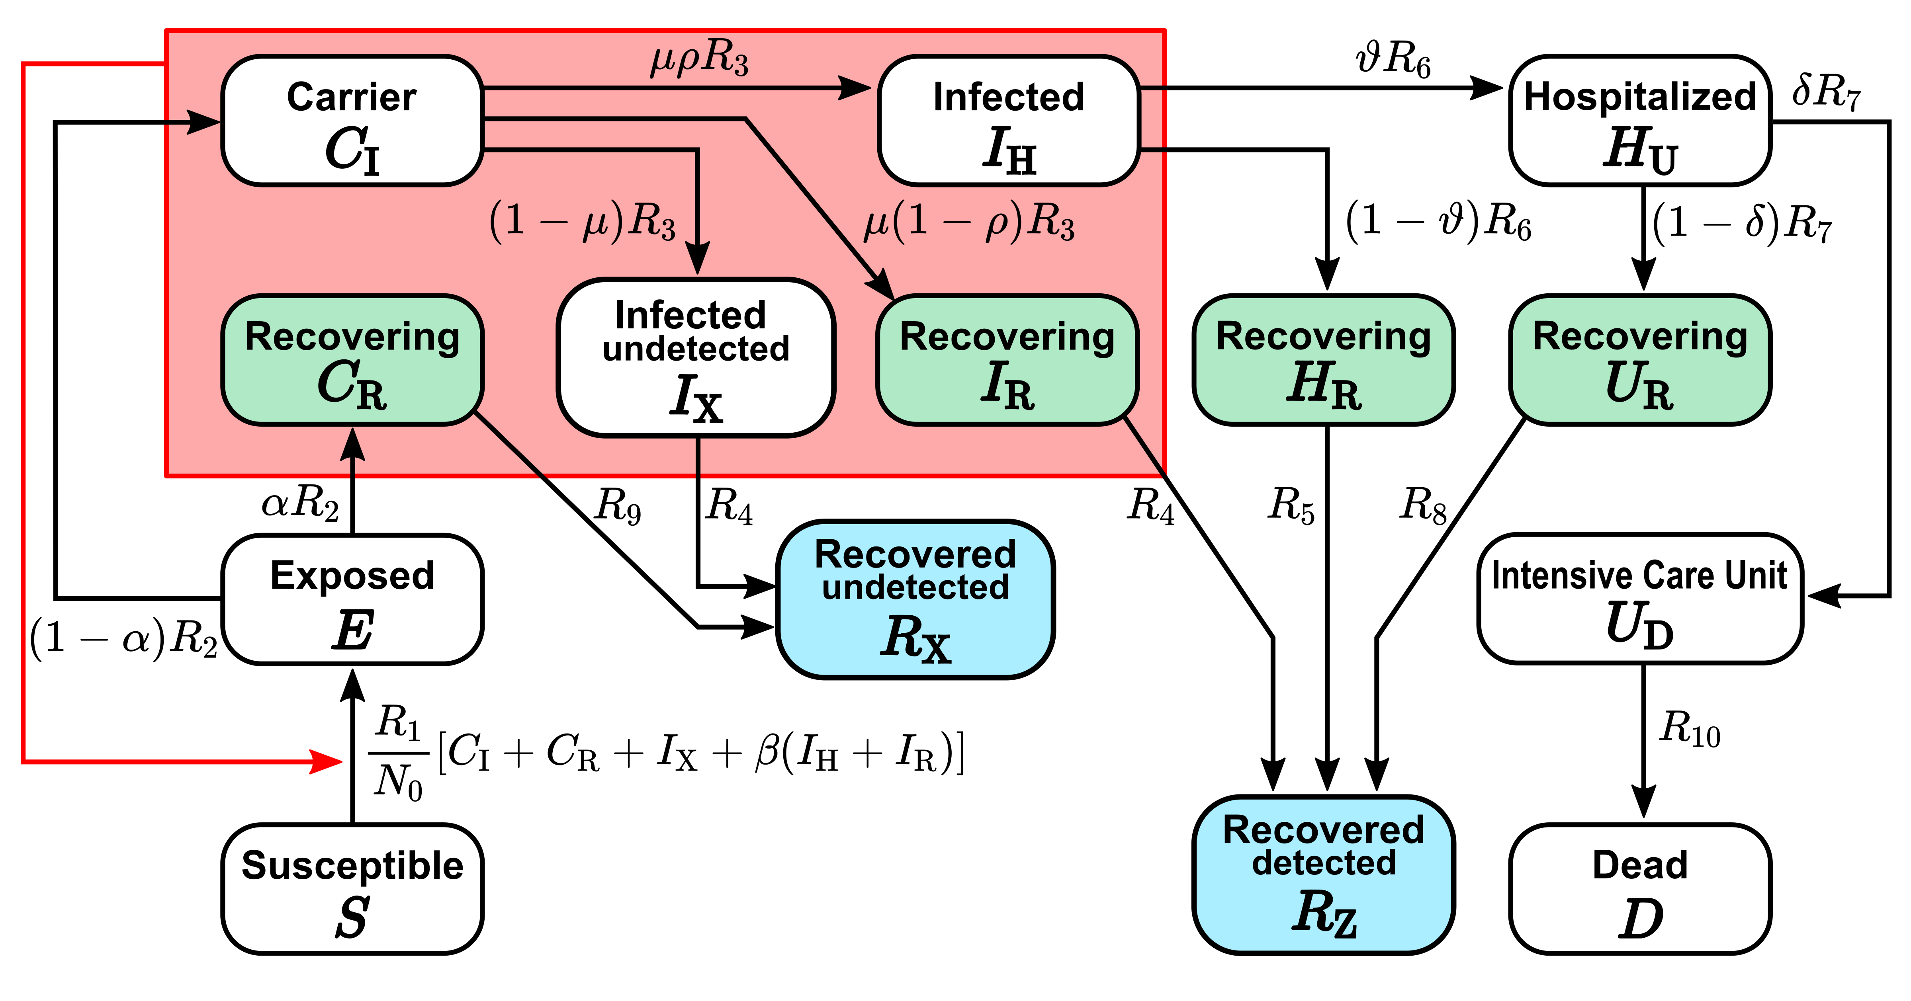
Model and prediction

Slide 8
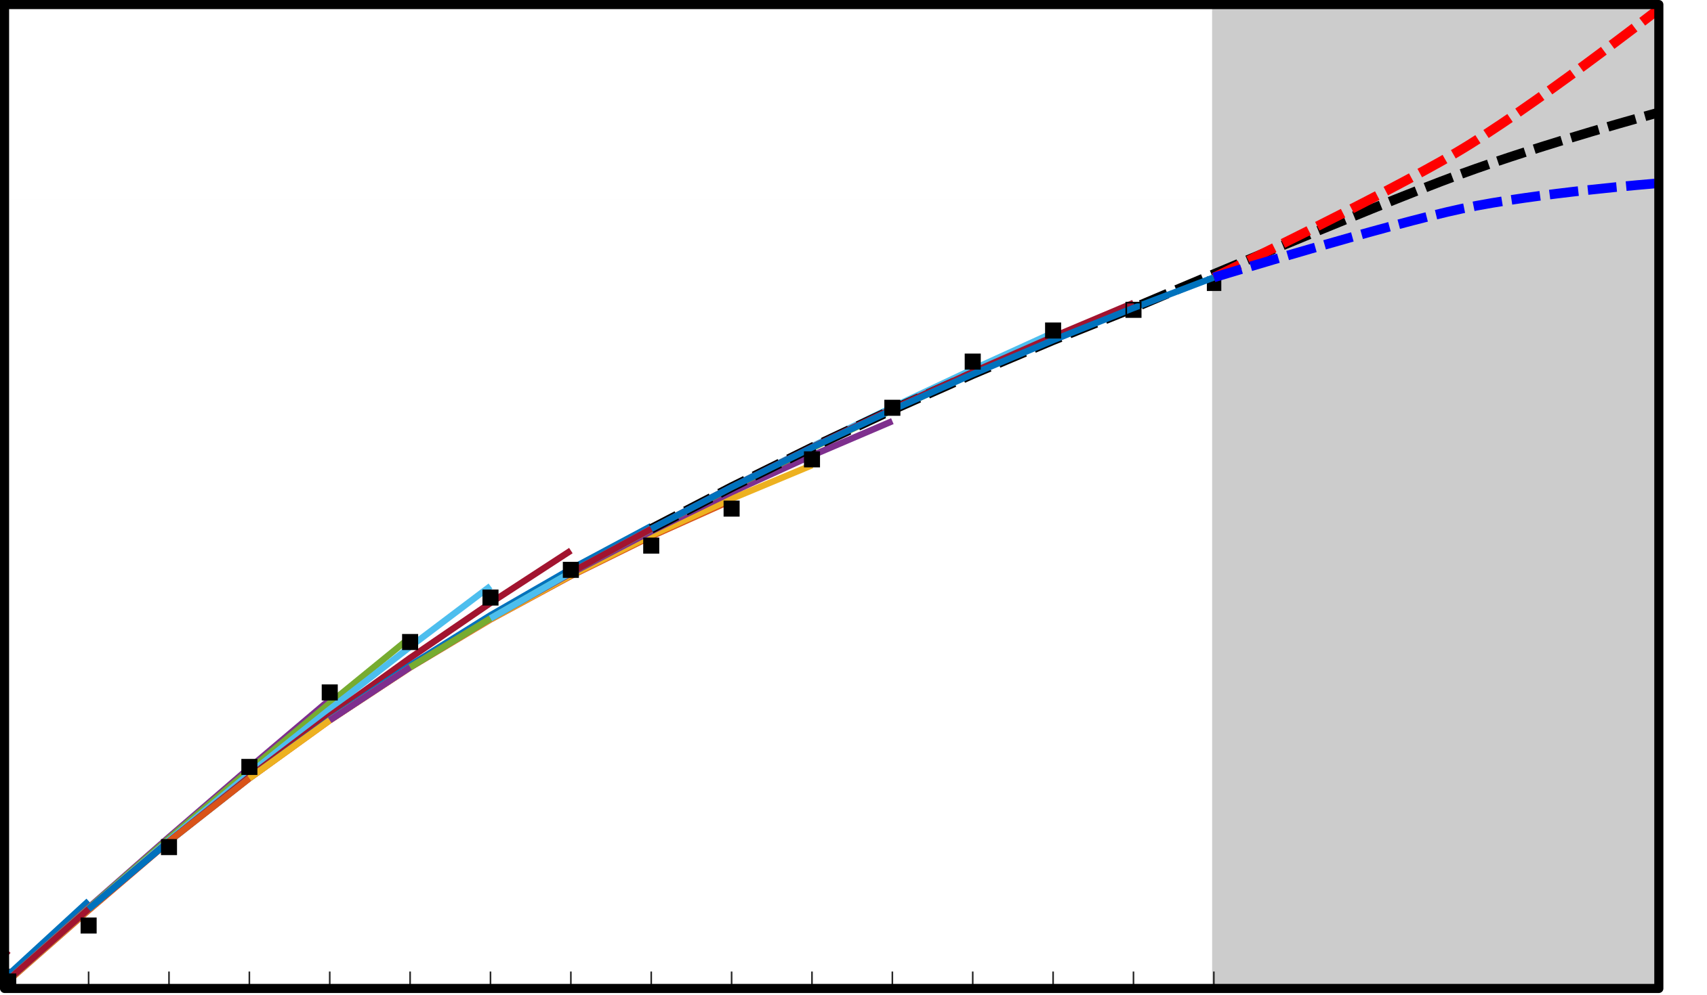
Model and prediction
Data fitting
Prediction
Larger R
Same R
Smaller R
cumulative number of detected cases
Enddate

Slide 9
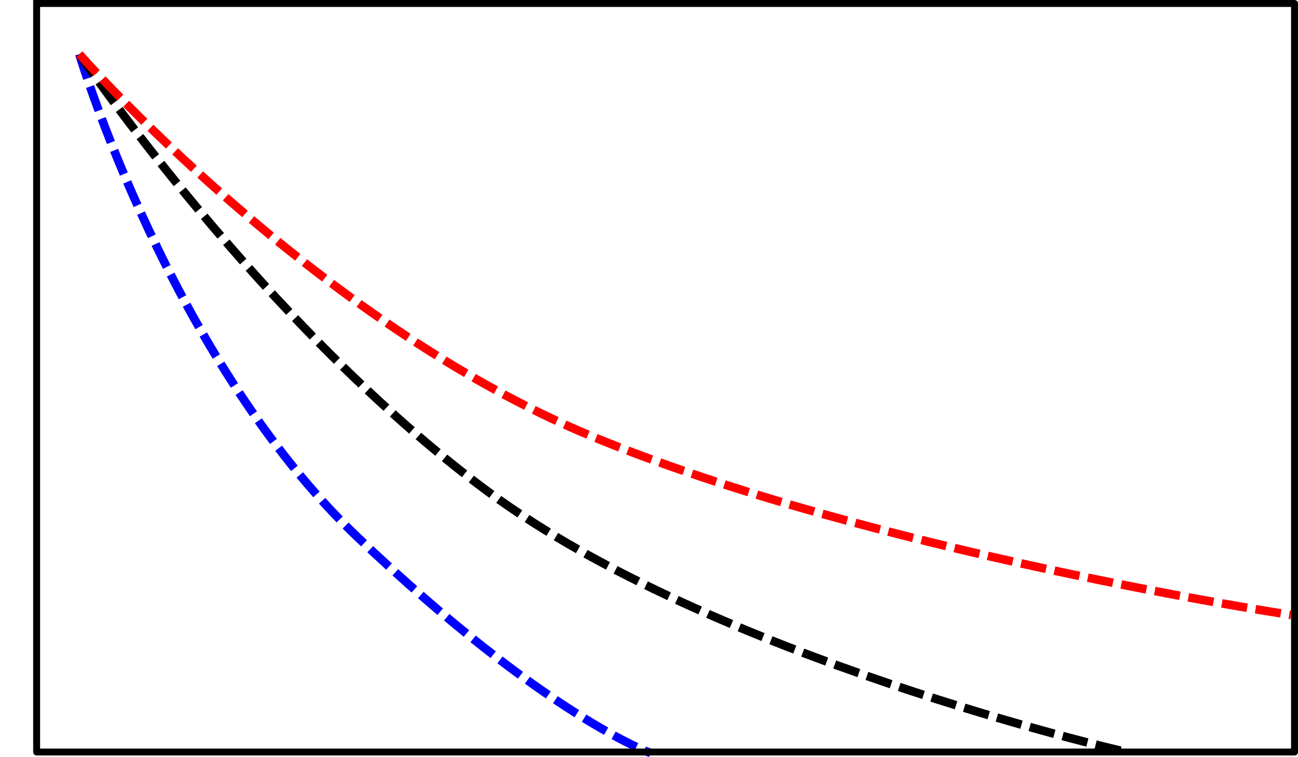
Model and prediction
Data fitting
Prediction
Larger R
Same R
Smaller R
cumulative number of detected cases
Enddate
Assumption:
Reducing the daily new infections to 300 per day would allow to control the epidemic through contact tracing and isolation by the approximately 400 public health offices in Germany.
Prediction of
daily new cases
300 cases/day
Time
Enddate

Slide 10
Model and prediction
Data fitting
Prediction
Larger R
Same R
Smaller R
cumulative number of detected cases
Enddate
Time until reaching a controllable number of new cases (300) per day
Prediction of
daily new cases
(days since April 20th, 2020)
300 cases/day
Time
Enddate
A larger reproduction number delays a control of the epidemic.

Slide 11
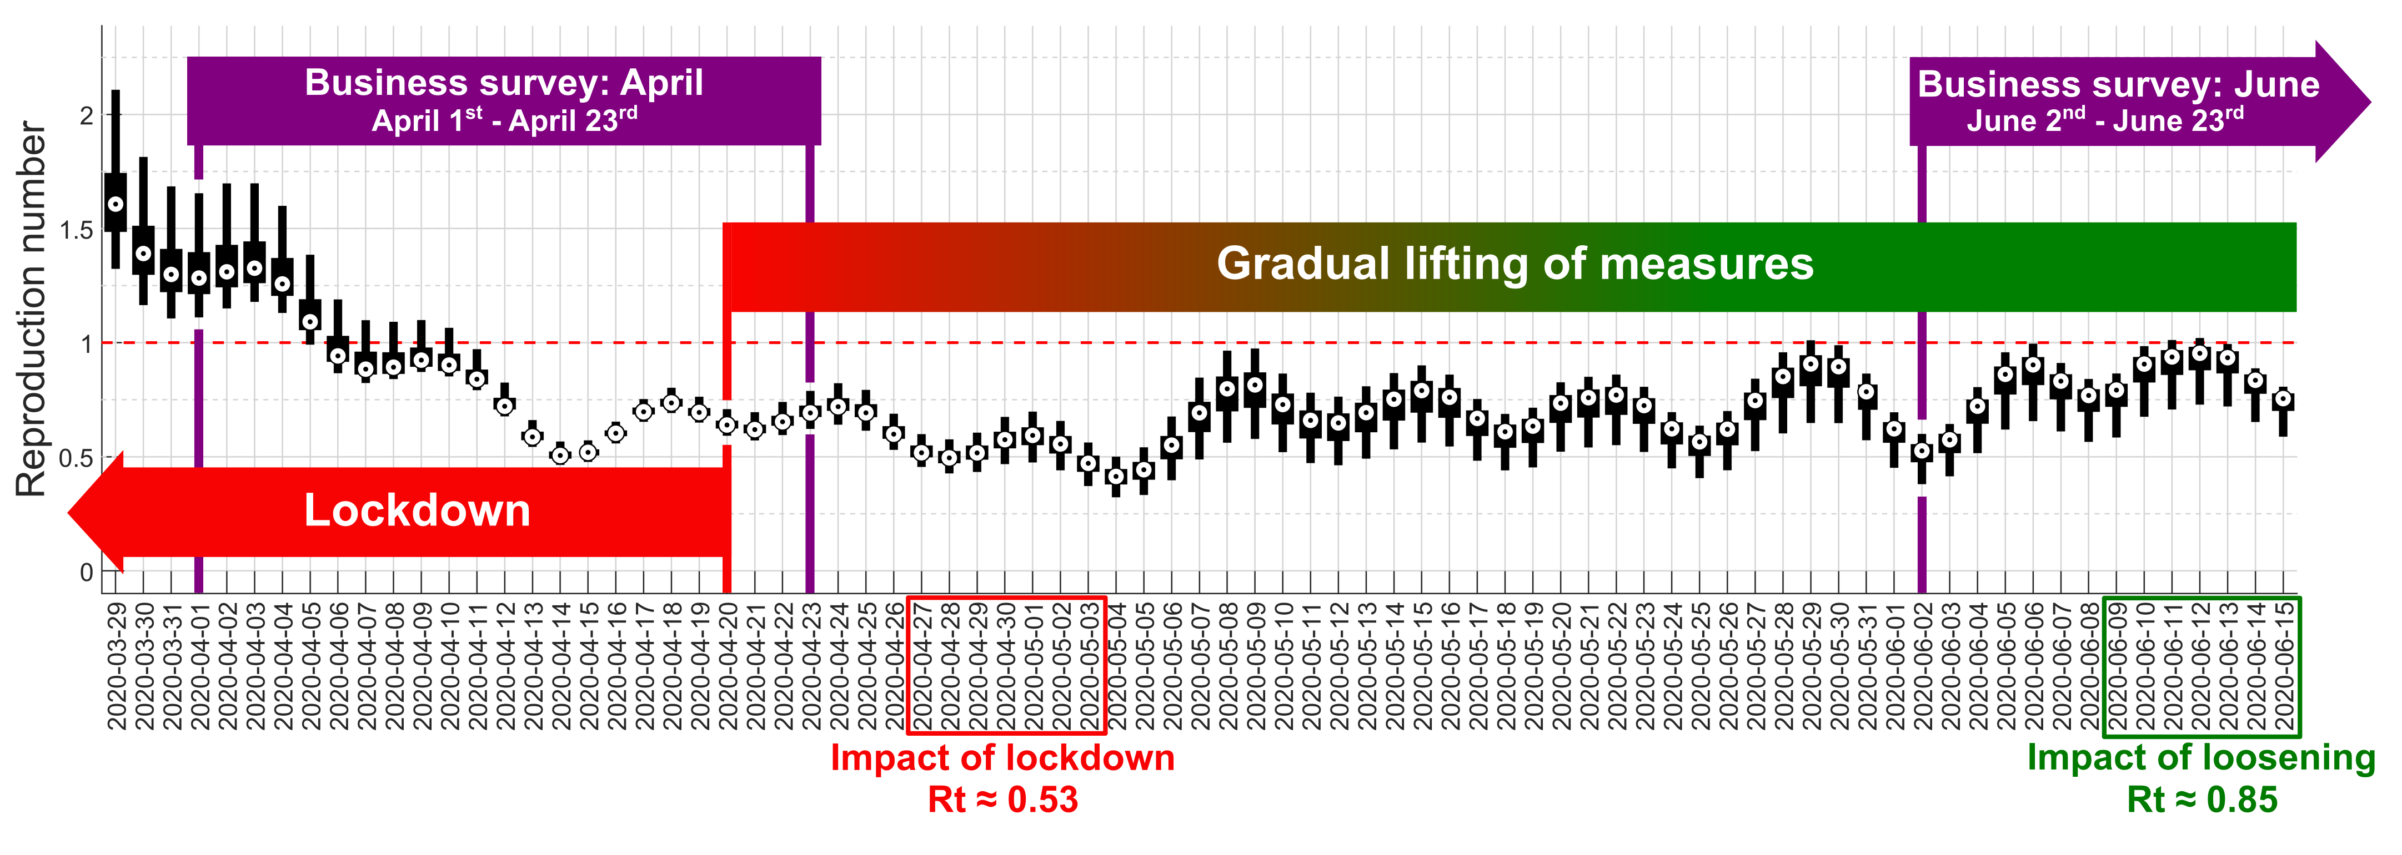
Impact of lockdown and opening
5

Slide 12
Sector dependent Lockdown and Recovery
Business Survey
Business Survey
Recovery of economic sectors from survey
Reach 300 cases per day
model prediction
Period(Sector & R_{t})
Period(R_{t})
Dorn & Khailaie & Stoeckli et al. https://doi.org/10.1101/2020.08.14.20175224

Slide 13
Sector dependent recovery depending on R_{t}
R_{t}=0.53 0.85
Whole sale and retail trade; repair of motor vehicles and motor cycles
Transportation and storage
Activities of households …
Accommodation and food service activities
Dorn & Khailaie & Stoeckli et al. https://doi.org/10.1101/2020.08.14.20175224

Slide 14
The common interest of health and economy
Estimation of relative death toll
From April 20th, 2020
until July 31st, 2021
Relative costs for each scenario
in percentage difference to the reference scenario ( Rt= 0.53 ).
Dorn & Khailaie & Stoeckli et al. https://doi.org/10.1101/2020.08.14.20175224

Slide 15
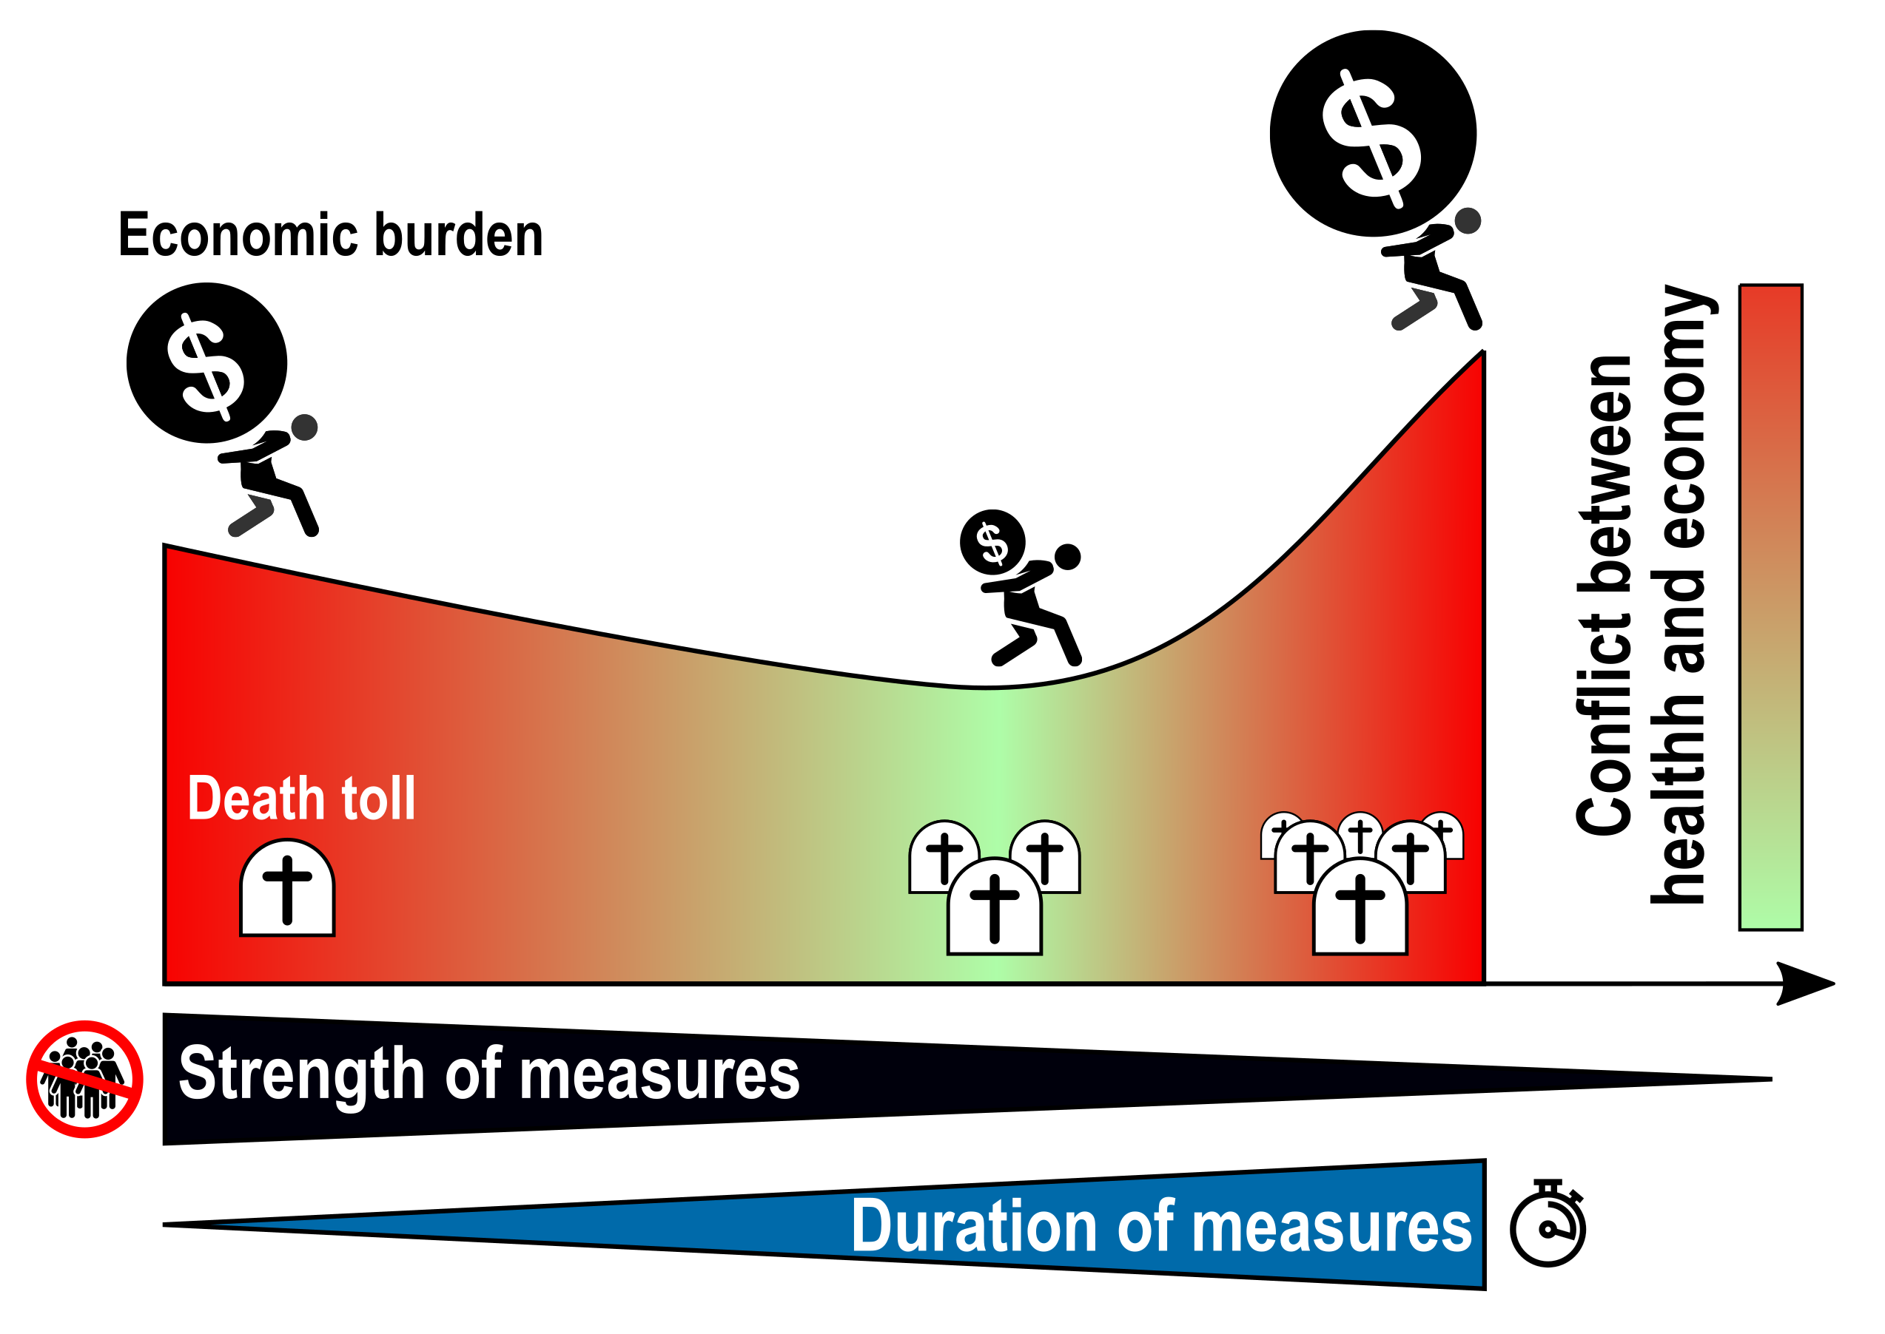
Conclusion
Dorn & Khailaie & Stoeckli et al., Eur J Health Econ. 2022 Mar 19;1-8. doi: 10.1007/s10198-022-01452-y

Slide 16
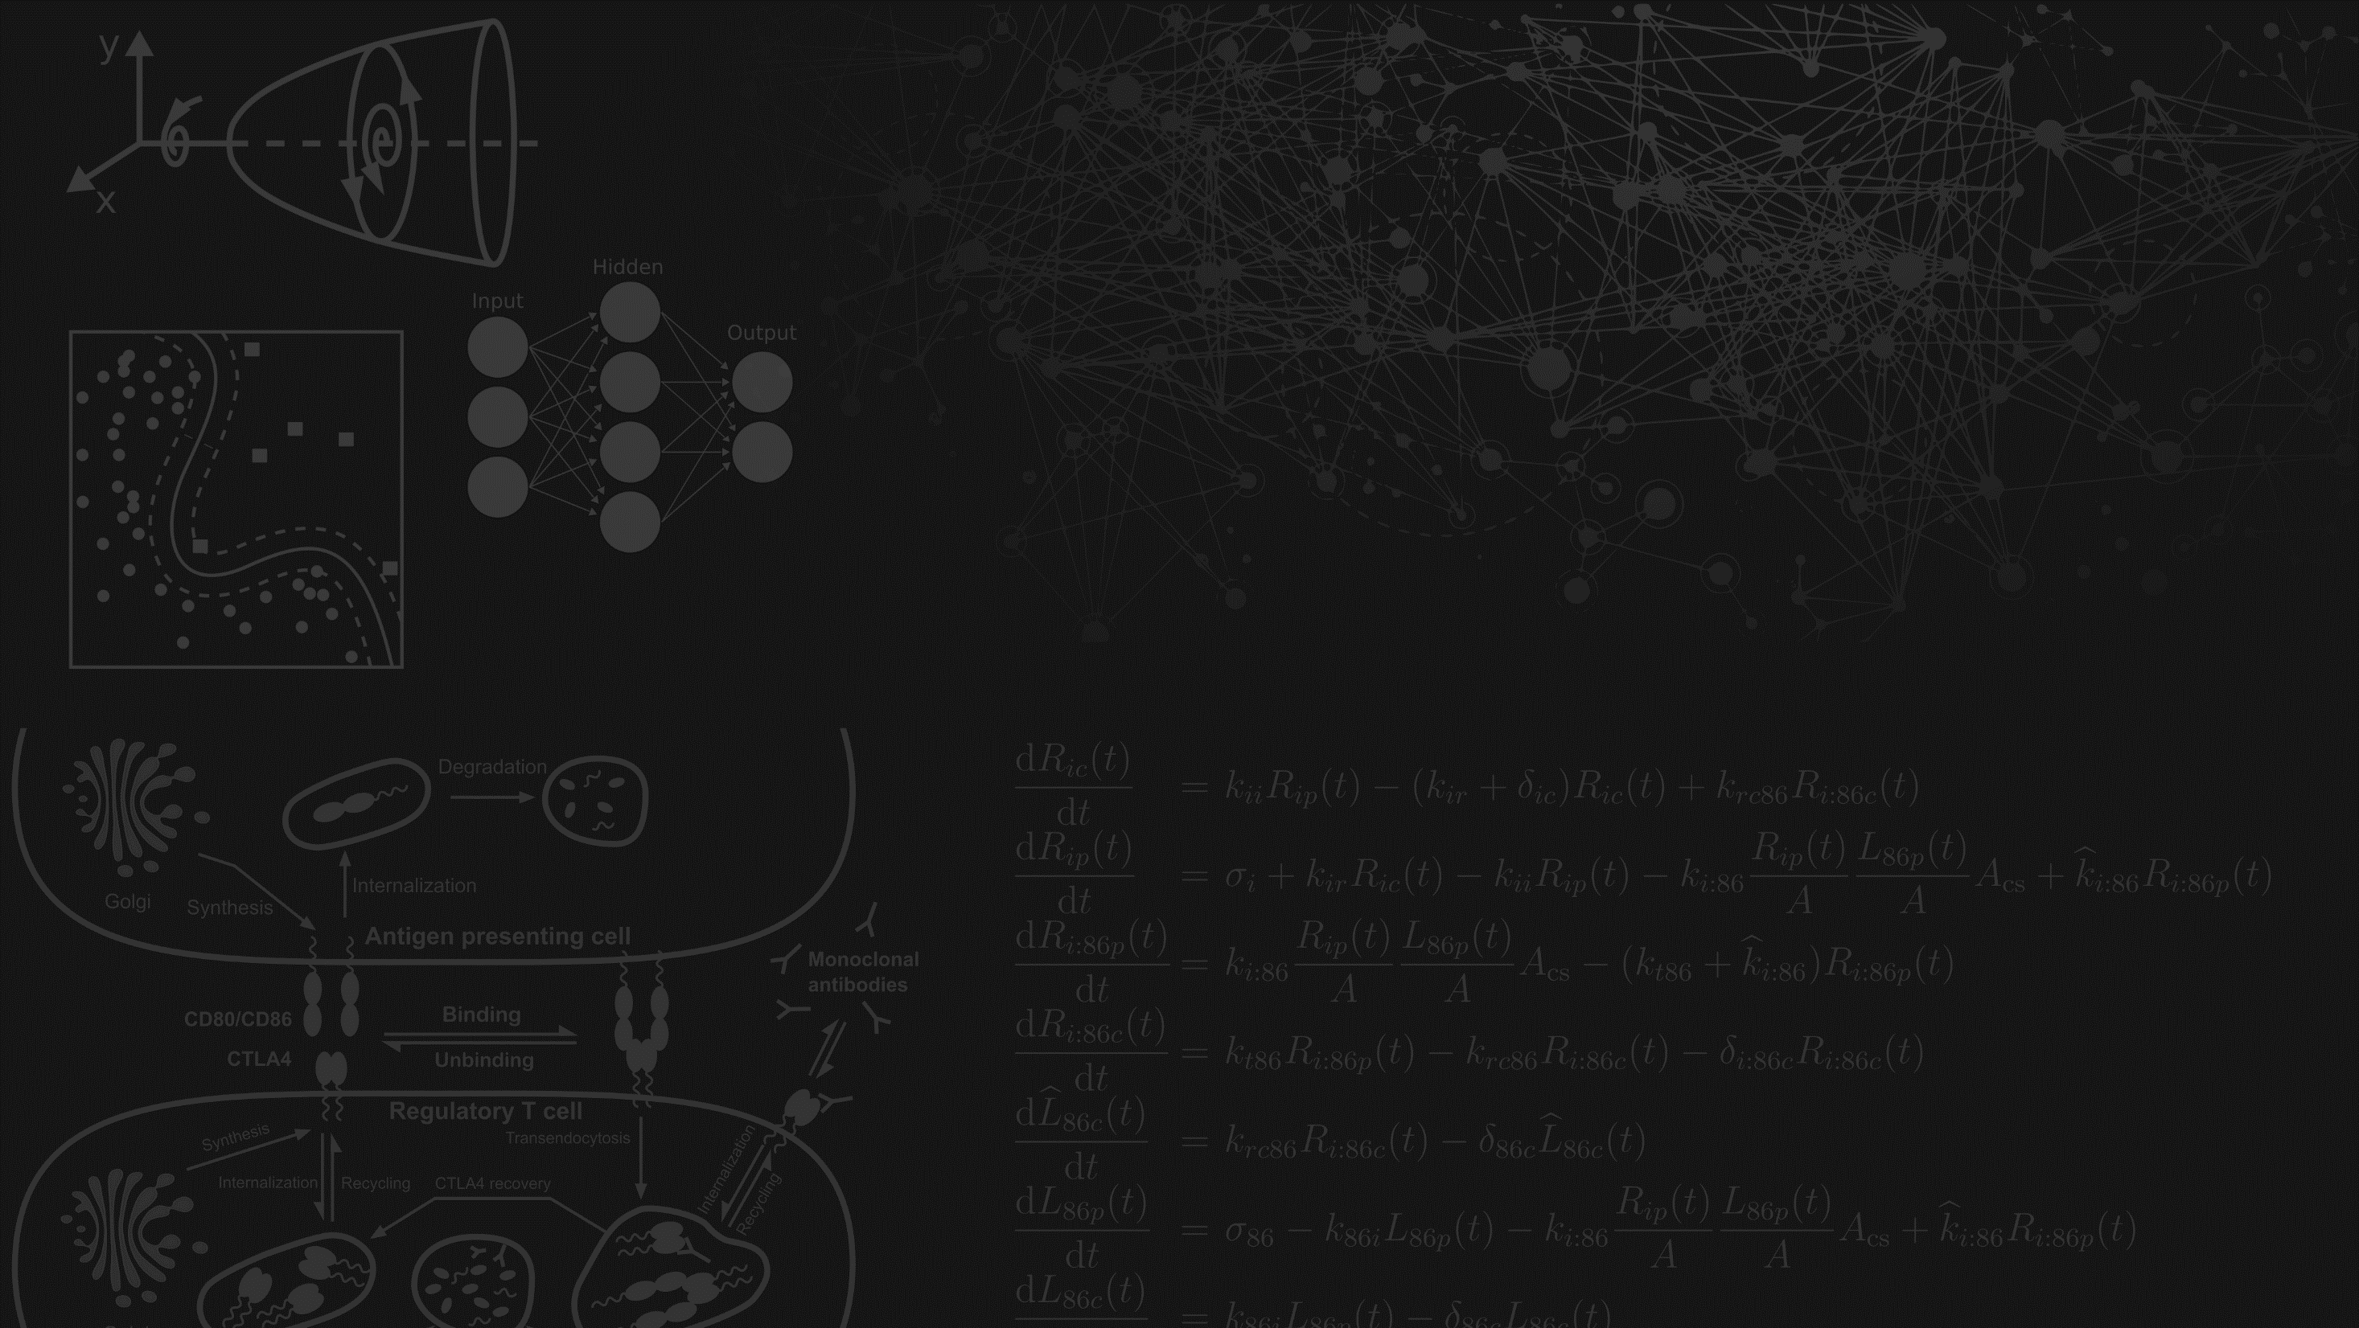
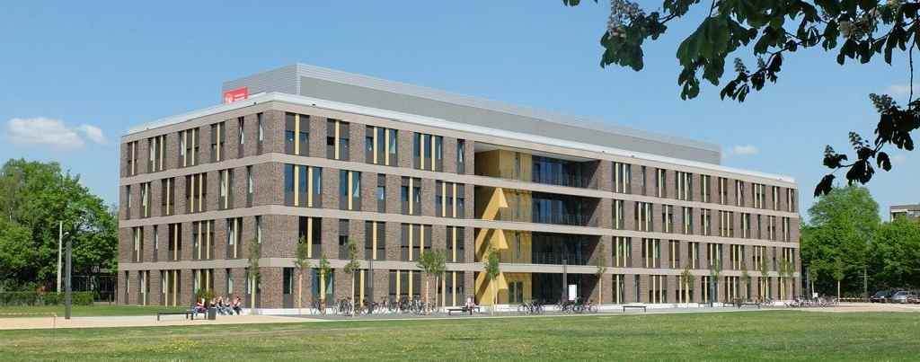
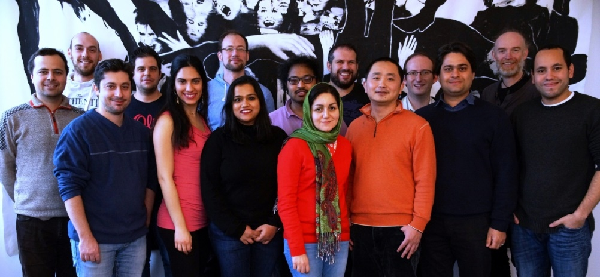
Thanks for your attention
Systems Immunology (SIMM)
systems-immunology.de
2nd floor, Rebenring 56, 38106 Braunschweig
Michael Meyer-Hermann

