Slide 1
Real-time modelling in a changing pandemic
Marc Baguelin
on behalf of the Imperial Real-time modelling team
WHO Collaborating Centre for Infectious Disease Modelling
MRC Centre for Global Infectious Disease Analysis
Jameel Institute
Imperial College London

Slide 2
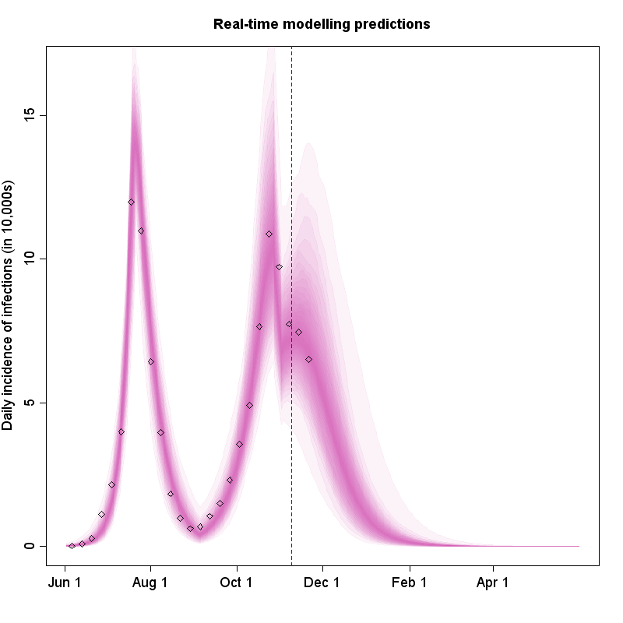
What is real-time modelling?
A mathematical model that has been updated, or fitted, or calibrated, to an ongoing epidemic/pandemic
Reflects what we know about the current epidemic
May be based on previous experience (prior knowledge – Bayesian paradigm)
Uses formal statistical fitting and analysis and epidemic modelling
If done properly then it should give relevant projections about future course of epidemic
Some models can look at alternative scenario of transmission (counterfactuals) and inform policy making
Example of real-time modelling during 2009 influenza pandemic in the UK

Slide 3
What do we do? (Forecasts, scenarios or predictions…)
Forecasts: set of future outcomes associated with a probability distribution (e.g. number of beds with Covid patients at a certain date, with associated uncertainty)
Projections: “extension” of the current trajectories into the future assuming parameters remains “the same”
Scenarios: exploration of potential future trajectories based on fitted parameters and additional assumptions (e.g. change of transmission following a decision)
Scenario – central: one scenario is often highlighted as closest to forecast, but might still depend on e.g. policy decision
Reasonable worst case scenario: a type of scenario where assumptions are taken as the worst possible but remain “plausible” (from expert opinion)
Predictions: broadly synonymous with forecast but less technical – more likely to be used in the news (possibly without uncertainty…)
Nowcasts: set of outcomes describing the current situation associated with a probability distribution. Reflects the uncertainty in understanding the current situation

Slide 4
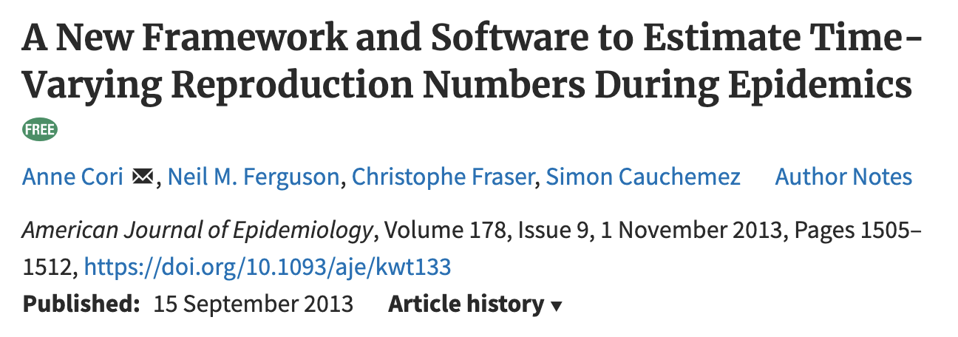
Different models, different purposes
Inclusion of various transmission mechanisms/heterogeneities
Renewal equation based
(EpiEstim – Cori et al)
?
Individual model
Ferguson et al. flu model
Ability to fit to data streams
A lot of existing models (esp. flu and SARS) but no ideal solution, so we decided to develop a new model:
Incorporating the most important transmission mechanisms
Focusing on healthcare pathways
With fine age structure
Stochastic
Using odin (R-based interface/language generating C code)
Able to fit to multiple data streams
Fitted with a particle filter and pMCMC

Slide 5
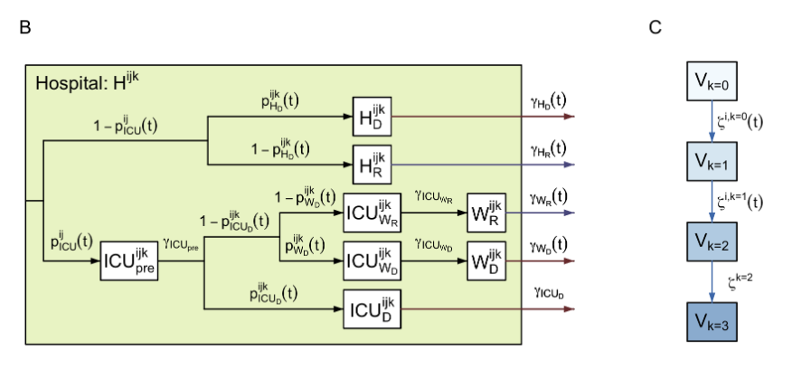
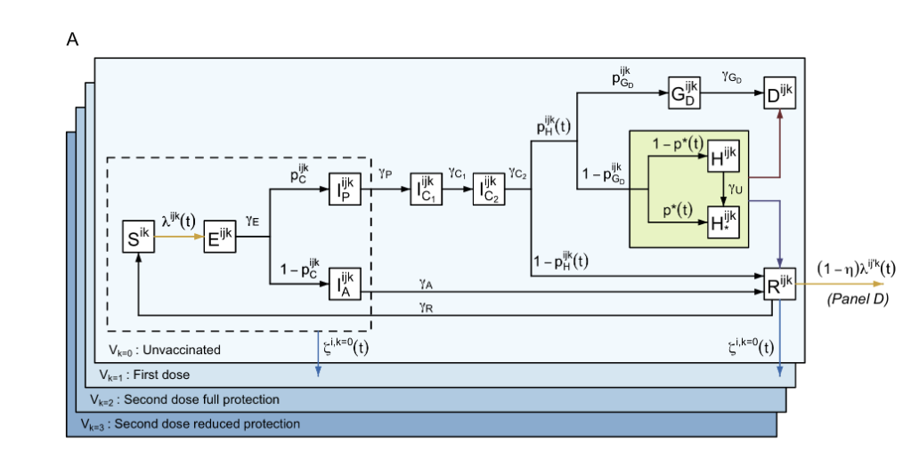
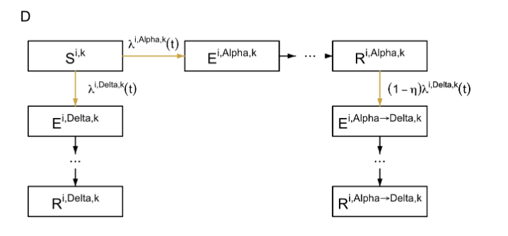
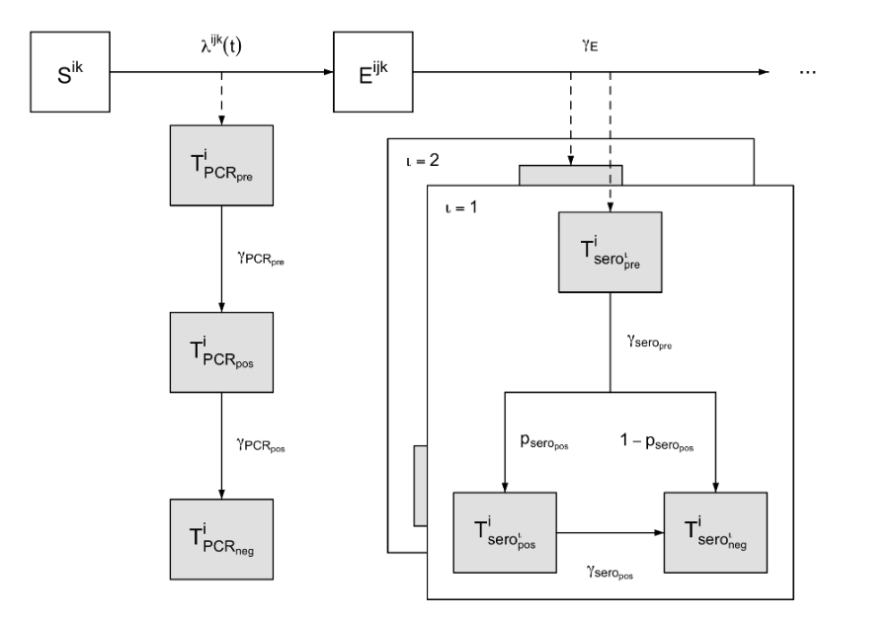
Our SARS-CoV2 transmission model
SEIHR stochastic model, with symptomatic/asymptomatic, and detailed hospital pathways
17 age groups (0-4, 5-9, …, 80+) + care home workers (CHW) & residents (CHR)
Detailed hospital pathways
3 parallel flows for PCR and serology test results
Vaccine strata
Two variants can co-circulate at the same time

Slide 6
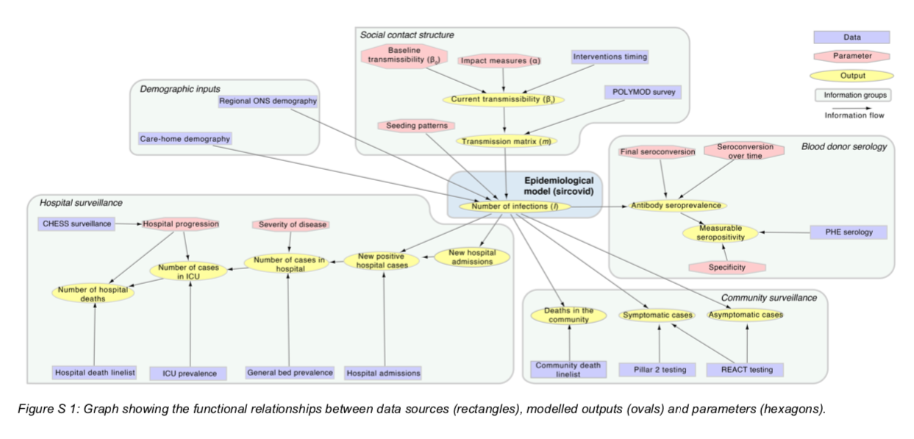
Parameter inference ➢ evidence synthesis
Inference of 30+ parameters using particle MCMC
Other parameters fixed to values from the literature
Social contact structure
Demographics
Blood donor serology
Hospital surveillance
Community surveillance

Slide 7
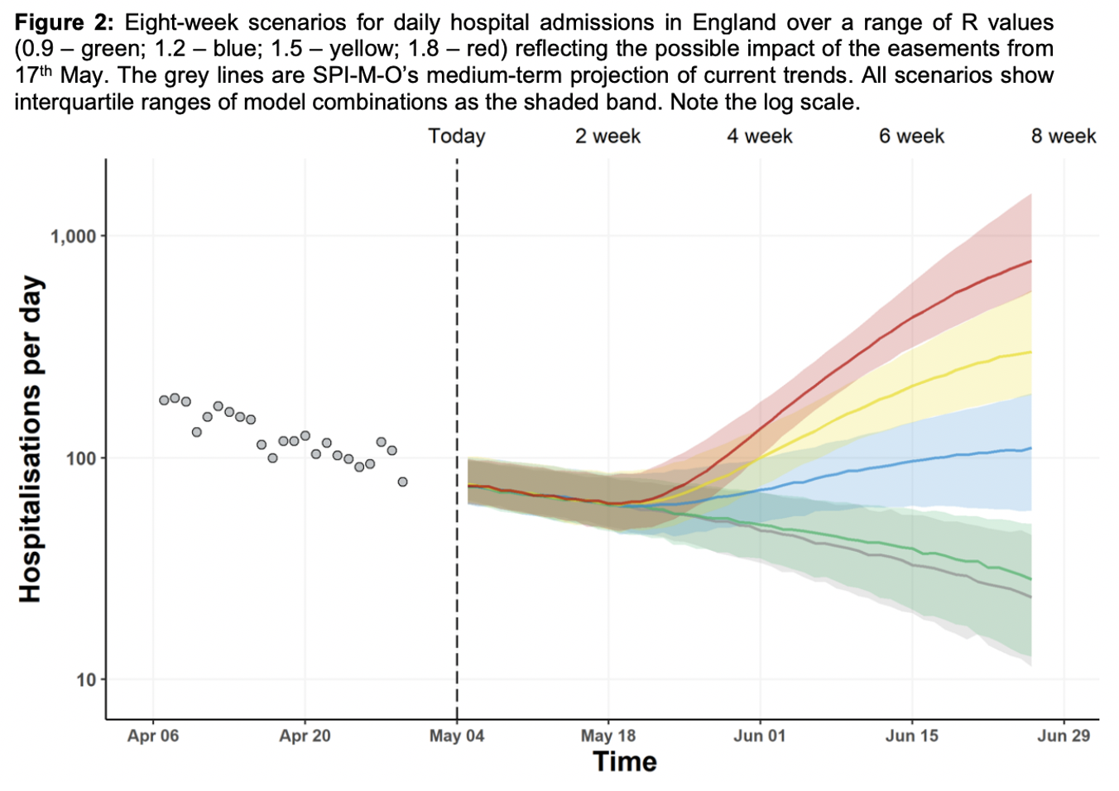
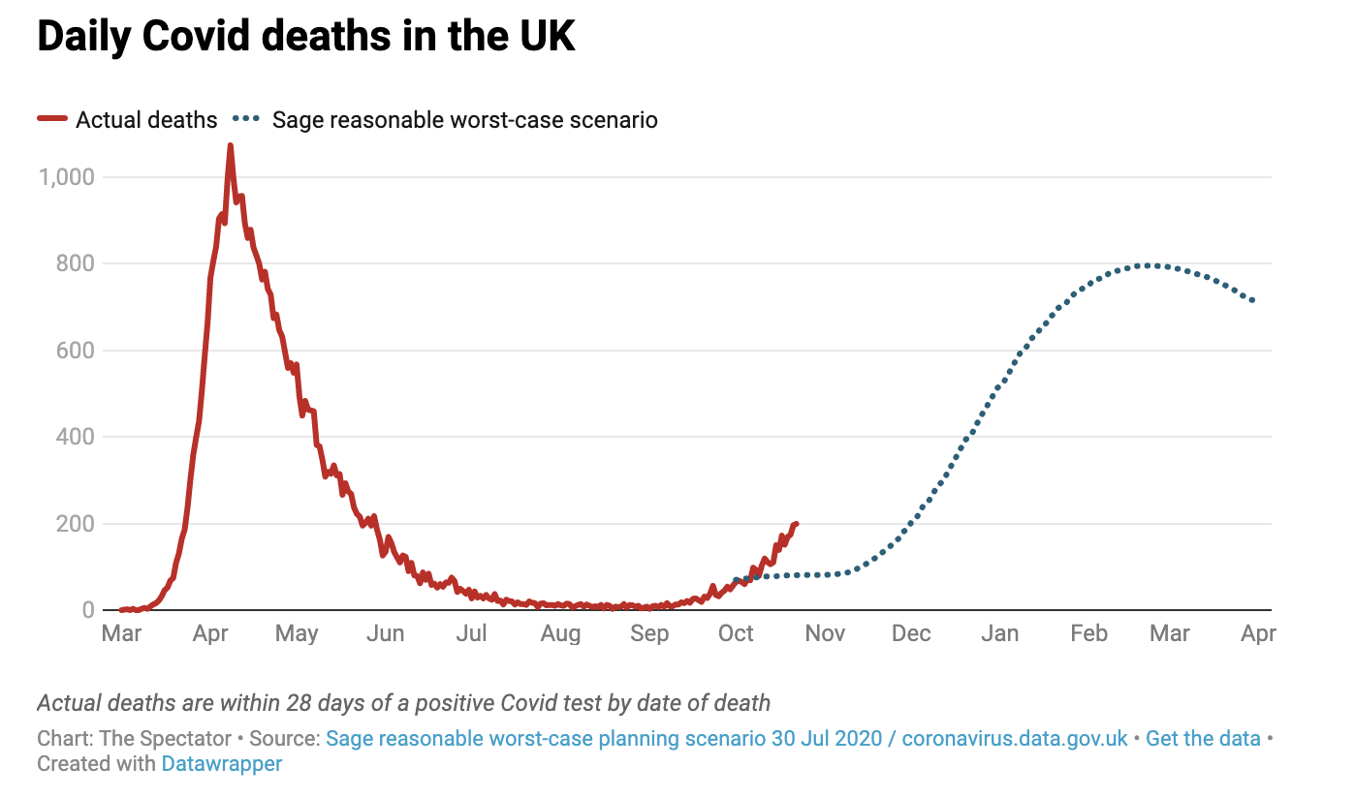
Some contribution to evidence for policy (1)
During the whole pandemic (almost weekly): nowcasts of epidemiological estimates (R, various prevalence, growth rate), medium term projections of epidemiological indicators (hospital prevalence of COVID beds, deaths)
Summer 2020: Reasonable worst-case scenario for Winter 2020
Autumn 2020: Circuit breakers and reimposition of NPI

Slide 8
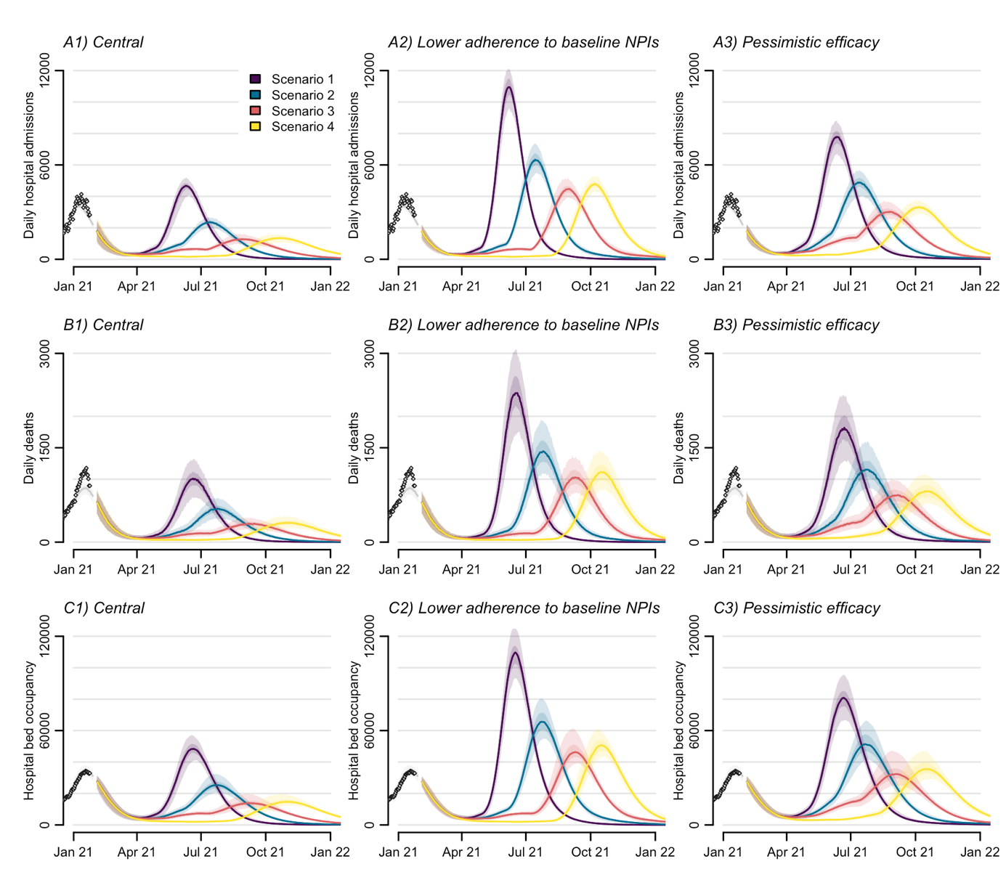
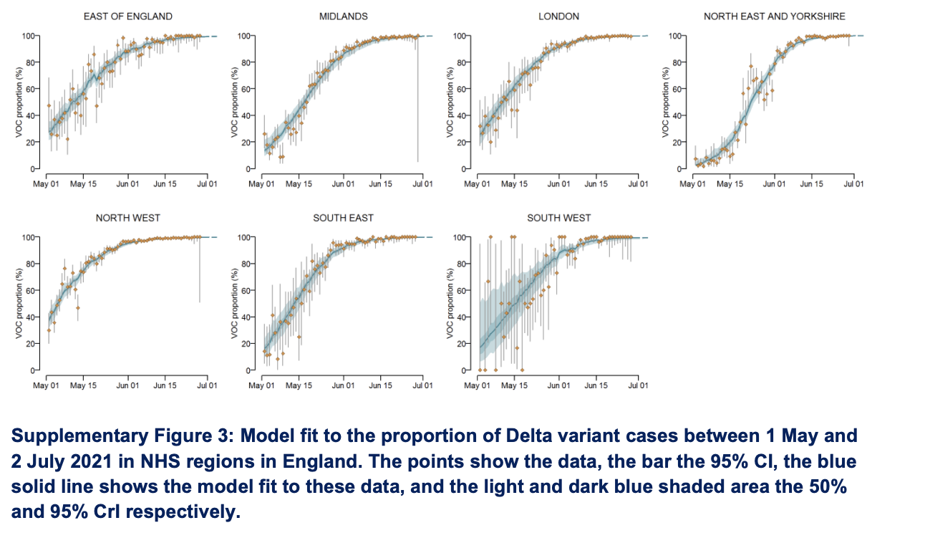
Some contributions to evidence for policy (2)
Early 2021 - Spring 2021: Roadmap modelling at each steps of the lifting of NPI
Winter 2021: Emergence and impact of Omicron

Slide 9
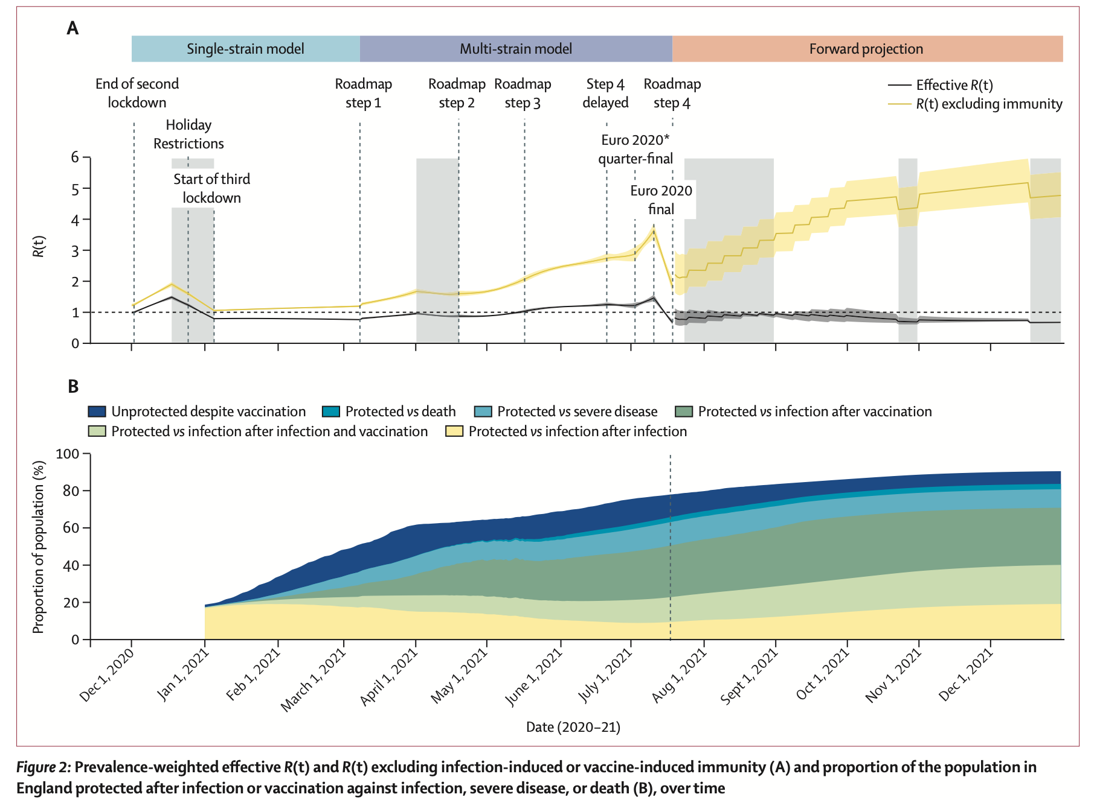
Restrictions maintained R < 1 until mid-May 2021
thanks to an increasing vaccine induced protection
Sonabend et al. The Lancet (2021)

Slide 10
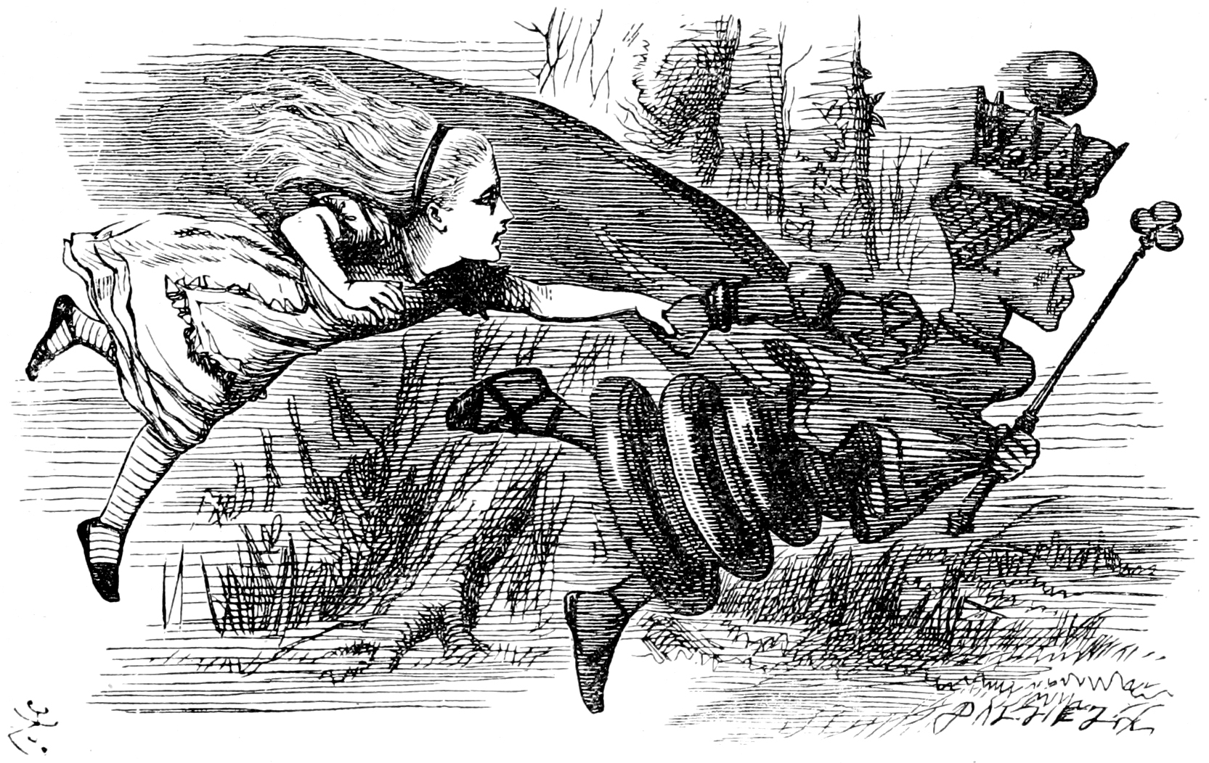
A changing landscape
Current model is more complex than original one:
Variant (WT, alpha, delta, Omicron)
Vaccines (and boosters)
Difficult to disentangle
Immunity (vaccine and infection) waning
Cross immunity in a complex landscape
Population behaviour
Time series are longer and longer (more than two years now)
We need to include more data sets to inform different component of the model
Big data but obsolete data?
In March 2020 we were lacking data
In December 2021 we couldn’t inform the degree of immunity escape vs increased transmission and change in severity

Slide 11
A need to understand the decision pipeline
Data 1
Outcome 1
Data 2
Outcome 2
Model(s)
Decision
Data 3
Outcome m
Data n
Outcome 3
Other evidence
€$£
€$£
E(€$£ + QALY)

Slide 12
Further questions
In order to (1) scale down current surveillance (2) plan for future pandemics we need to understand how each of the data stream informs the epidemiological outcomes and at what price
We need to understand how the choice of models are driving these outcomes (model choice)
We need to understand what outcome are relevant for decision making – this has likely changed during the pandemic (from deaths to pressure on the NHS)
Importance of public information, data are necessary to monitor and explain decisions to the public
Necessity of multidisciplinary studies including (health) economics, modelling, social sciences
Can lead to more optimal and resilient surveillance systems
Data 1
?
Outcome 1
?
Data 2
Outcome 2
Model(s)
Decision
Data 3
Outcome m
Data n
Outcome 3
Other evidence
€$£
€$£
E(€$£ + QALY)

Slide 13
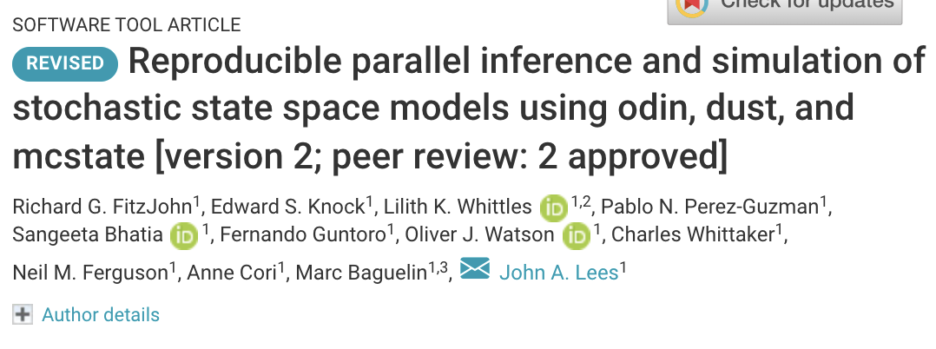
A toolkit to facilitate robustness and reproducibility
Our work has led to several R packages:
Efficient coding of compartmental models (deterministic or stochastic):
odin
Simple iteration of stochastic
models (e.g. as part of a particle filter): dust
All our analyses are done using the R package orderly, which facilitates reproducibility
Easy SMC inference for odin models:
mcstate
https://mrc-ide.github.io/odin/
https://github.com/mrc-ide/dust/
https://github.com/mrc-ide/mcstate/
https://github.com/mrc-ide/sircovid
https://github.com/vimc/orderly
A stochastic SARS-CoV-2 transmission model, coded in odin:
sircovid

Slide 14
References
All our reports are available at:
https://www.imperial.ac.uk/mrc-global-infectious-disease-analysis/covid-19/covid-19-reports/
Report 41 including the first part of what I presented:
https://www.imperial.ac.uk/mrc-global-infectious-disease-analysis/covid-19/report-41-rtm/
SAGE reports summarizing the rest:
https://assets.publishing.service.gov.uk/government/uploads/system/uploads/attachment_data/file/958913/S1024_SPI-M_vaccination_ask_Imperial_College.pdf
https://assets.publishing.service.gov.uk/government/uploads/system/uploads/attachment_data/file/963440/S1129__Unlocking__Roadmap_Scenarios_for_England_.pdf
https://assets.publishing.service.gov.uk/government/uploads/system/uploads/attachment_data/file/975910/S1183_SPI-M_Imperial_College_London_Evaluating_England_s_Roadmap_out_of_Lockdown.pdf
Our R packages:
https://mrc-ide.github.io/odin/
https://github.com/mrc-ide/dust/
https://github.com/mrc-ide/mcstate/
https://github.com/mrc-ide/sircovid
https://github.com/vimc/orderly
Papers:
[1] Fitzjohn et al. Wellcome Open Research, 2021
[2] Knock et al. Science Translational Medicine, 2021
[3] Sonabend et al. The Lancet, 2021

Slide 15
Acknowledgements
Imperial College London COVID-19 response team
UKHSA colleagues and front line health professionals
Andre Charlett
Nick Gent
NHS blood transfusion service
Gayatri Amirthalingam
Nick Andrews
REACT1 study investigators
Anne Cori
Yasin Elmaci
Neil Ferguson
Rich Fitzjohn
Katy Gaythorpe
Azra Ghani
Wes Hinsley
Natsuko Imai
Stephen Johns
Edward Knock
John Lees
Pablo Perez-Guzman
Thomas Rawson
Raphael Sonabend
Divya Thekke Kanapram
Sabine Van Elsland
Bob Verity
Lilith Whittles

Slide 16
The reproduction number R How to estimate and interpret it Anne Cori
Thank you for your attention
Questions?

