Slide 1
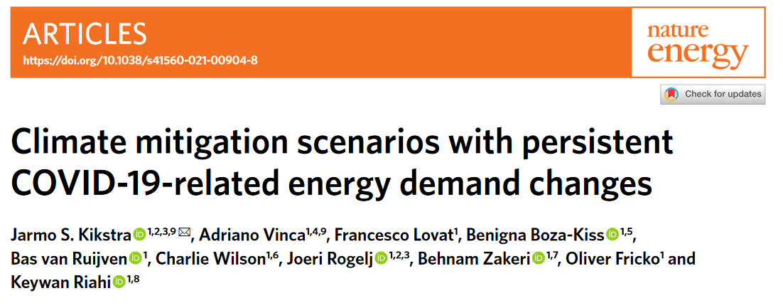

COVID and climate mitigation
60th Jubilee Symposium, Heidelberg Institute of Global Health
25.06.2022
Jarmo Kikstra
kikstra@iiasa.ac.at
^{Heidelberg Symposium}
Collaborators:
Adriano Vinca, Francesco Lovat, Benigna Boza-Kiss, Bas van Ruijven, Charlie Wilson, Joeri Rogelj, Behnam Zakeri, Oliver Fricko, Keywan Riahi
Notes:
Thanks for having us, and inviting us to speak, we are very happy and honoured to be presenting our work here.
Adriano and I will be talking about our exploration of “what implications there could be for reaching climate goals if some of the activity changes seen during the pandemic would persist.”
For this, we have done an integrated analysis of the shock and recovery of energy demand.

Slide 2
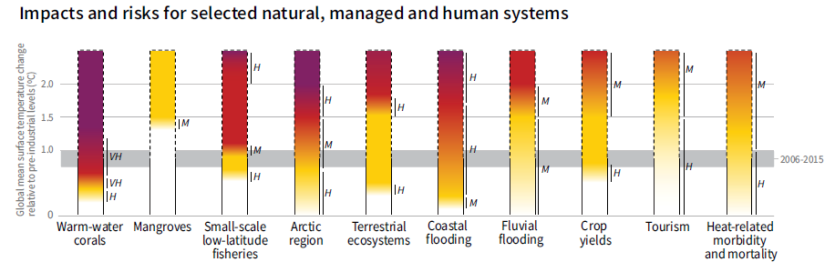
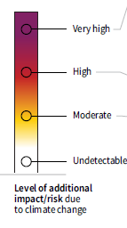
The climate crisis
Reasons for concern
Notes:
But first, let’s take a step back.
I always find it important to start with why we are doing this research.
If we, as a global society, do not manage to limit anthropogenic warming, climate change impacts will be felt across the globe, and affect many different systems.
Here, a couple of examples of the risks of impacts from additional levels of global warming.
As you probably know, widespread coral bleaching is already happening,
the Arctic is melting at increased pace,
coastal flooding is becoming more common,
and extreme heat events are increasing.

Slide 3
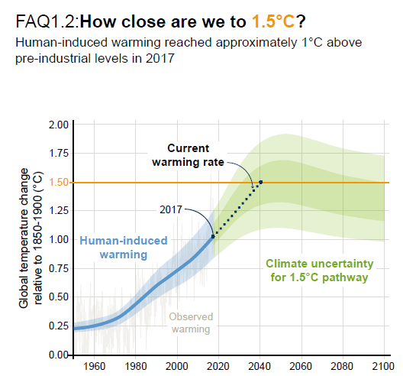
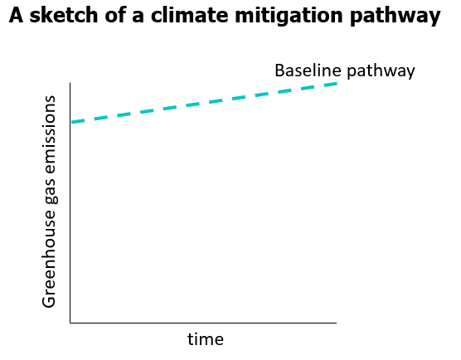

The climate mitigation challenge
Pathway with
carbon budget
3
Notes:
Here we see the human-induced global warming over the past half decade.
From this, it is clear that a strong break with the past is required.
If global society does not manage to transform the systems currently relying on fossil fuels, it will miss the 1.5C target well within the coming two decades.
We are interested in finding pathways towards a future that stabilizes global temperatures, with ambitious climate targets requiring very stringent climate change mitigation action.
We need to move away from our current, baseline trajectory, onto a pathway that stays within a specified emissions budget.
Pathways that meet the Paris Agreement approximately halve global emissions every decade.

Slide 4
Modelling climate mitigation
Integrated assessment framework
MESSAGEix-GLOBIOM
  Comprehensive integrated framework
    Couples all important aspects (energy, economy, land-use, etc.)
  Internally consistent scenarios.
  Regional differentiation
  Energy and economy focus for this work
Krey, V., et al. "MESSAGEix-GLOBIOM Documentation-2020 release." (2020).
Notes:
To perform this analysis of pathways towards a world with net-zero emissions, we use an integrated assessment framework developed at IIASA.
The MESSAGEix-GLOBIOM framework is comprehensive, including all important aspects including energy, economy, and land-use systems.
It allows us to investigate internally consistent scenarios, with a regional differentiation.
Like for many of the previous scenarios created with this framework, our scenarios will also be used in the upcoming IPCC assessment on climate change mitigation.
For this session, we will focus specifically on one important sub-section of this framework, namely the energy and economy.

Slide 5
Research question and Importance
Research question.
A moment to assess impacts of observed large-scale change in demand
“How large are the benefits for climate mitigation if a low energy demand recovery is pursued?”
What if activity changes persist?
Notes:
For us, as researchers, the past year has also offered a unique moment for studying impacts on energy demand.
We have seen large scale changes across all sectors and aspects of society, and these changes are mostly driven by changes in behaviour and demand, often due to lockdown restrictions.
Thus, we, probably with many others, asked ourselves what the potential could be for climate mitigation here, if we don’t just bounce back to old habits, but some changes in activity and related energy demand would persist.
Could this lead to significant benefits for climate mitigation efforts?

Slide 6
Research question and Importance
Need for demand-side mitigation modelling
Challenges
Requires a lot of bottom-up work
Improvements
More holistic policy advice
More explicit debate between systemic change and implications for individual change

Slide 7

Methods overview
Steps for assessing COVID-19 related changes in the energy system
1. Qualitative bottom-up assessment of activity levels during pandemic
2. Illustrative recovery scenarios of varying persistence of activity changes
Data collection and literature assessment on a sub-sectoral level. Focus on activity and structural changes
3. Energy demand pathways and GDP sensitivity analysis
(annual timesteps until 2025)
4. Perform climate mitigation simulations
Notes:
Mention a couple of well known sources

Slide 8
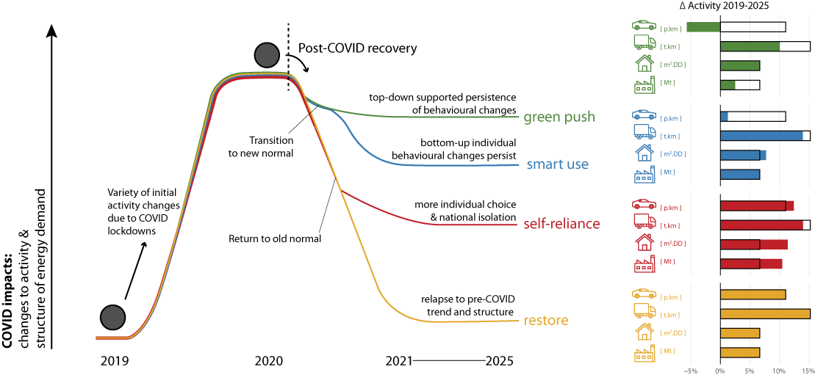
Methods overview
1. Qualitative bottom-up assessment of activity levels during pandemic
2. Illustrative recovery scenarios of varying persistence of activity changes
3. Energy demand pathways and GDP sensitivity analysis
(annual timesteps until 2025)
4. Perform climate mitigation simulations
Transition to new normal
Return to normal

Slide 9
Restore
Back to pre-COVID trend and structure
Return to normal
No structural change
Back to previous normal, historic demand trends
Economic impact on industrial production
restore

Slide 10
Self-reliance
Back to ‘old’ normality, with persistence of individualistic behaviors
+24% private cars
+11% building utilization
+10% industry activity (and steel production)
self-reliance
Return to normal
Notes:
Teleworking and individual and longer trips, new age of tourism online retail
More home-stay, while also larger/safer work spaces
Economic impact & glocalization

Slide 11
Smart use
Transition to new normality, learning from some COVID induced changes that lead to demand reduction
-10% activity
(+5% public transport)
Minor increases
No activity changes
Transition to new normal
smart use
Notes:
Some level of teleworking, reduced commuting, rediscovery of non-motorized trips, online retail
More home-stay, while no change to non-residential demand
Small reduction and restructuring in production

Slide 12
Green push
Transition to new normality, high persistence of low-demand changes
- 20% transport activity
(+25% public transport, -17% aviation)
↑ utilization rate, ↓ office space
-5% industry activity (and steel production)
green push
Transition to new normal
Notes:
Large reduction in commuting and long-distance trips, promoted alternative transport
Intensification of teleworking, while reductions in work floor space
Repurposing in production

Slide 13
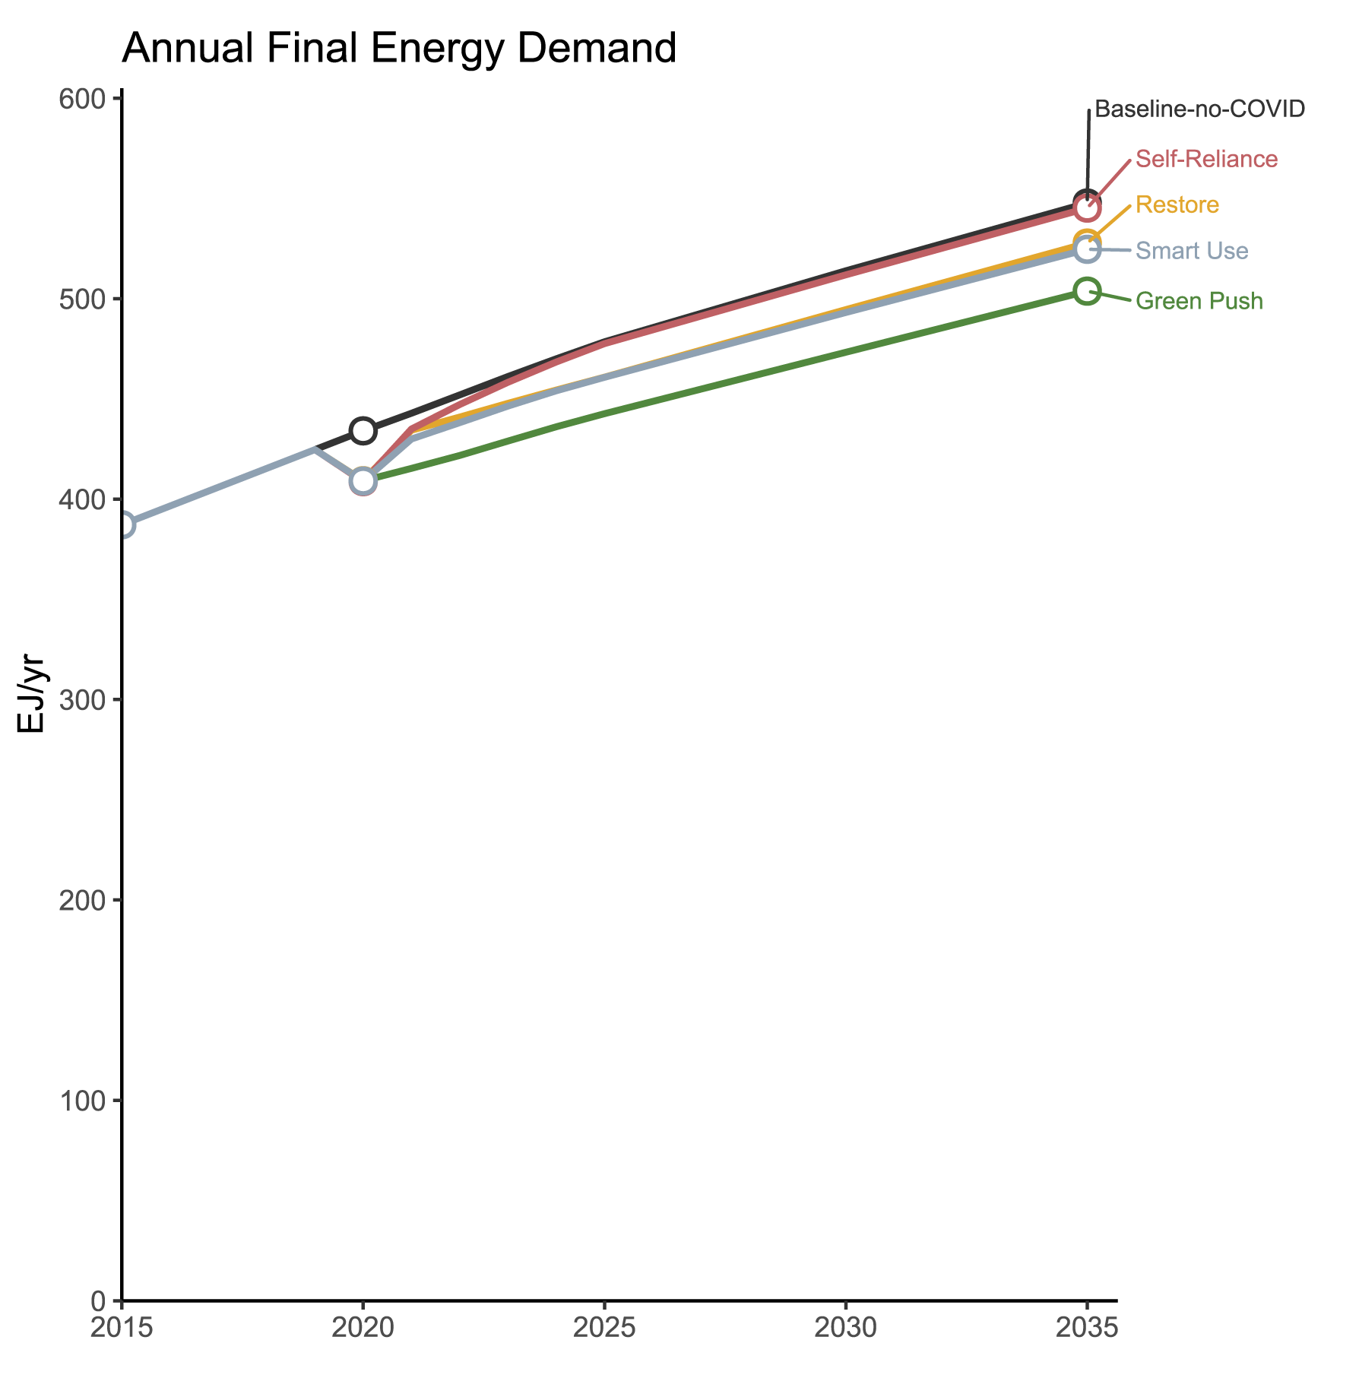
Methods overview
1. Qualitative bottom-up assessment of activity levels during pandemic
2. Illustrative recovery scenarios of varying persistence of activity changes
3. Energy demand pathways and GDP sensitivity analysis
(annual timesteps until 2025)
4. Perform climate mitigation simulations
Notes:
PLC energy demand pathways

Slide 14
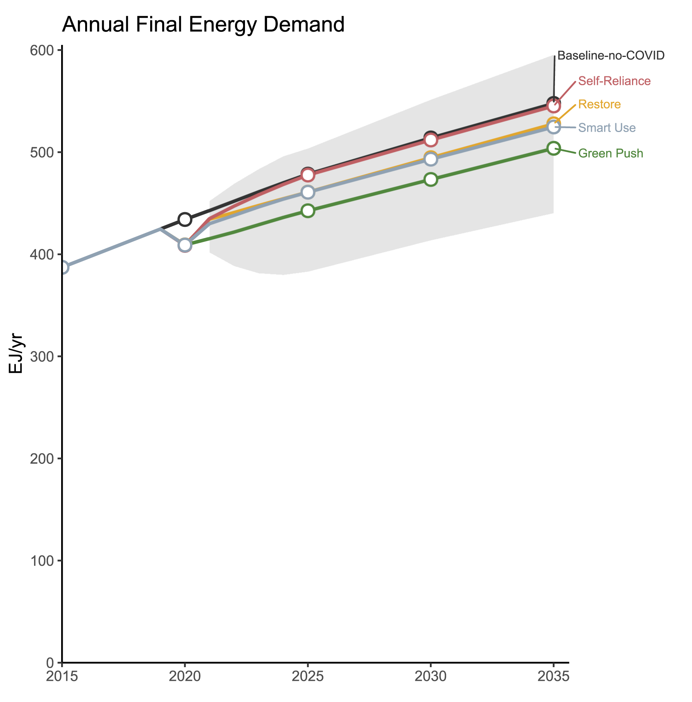
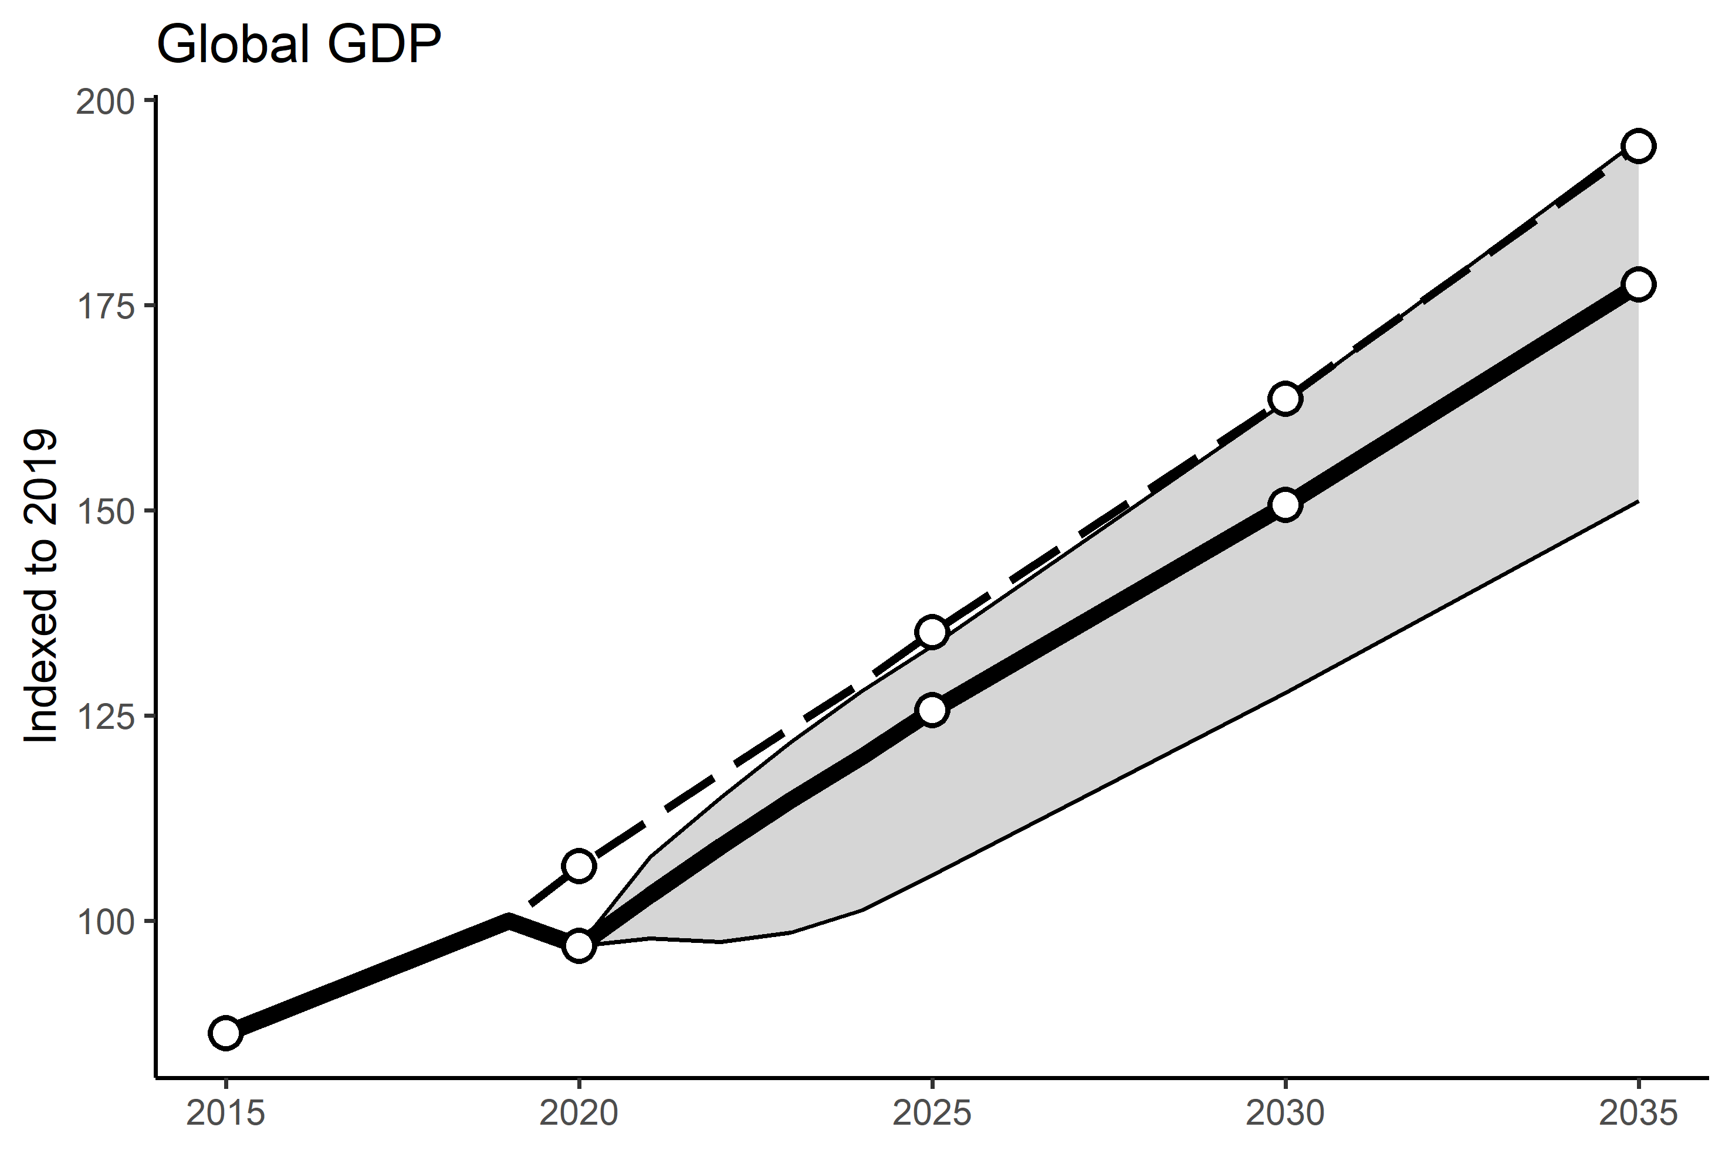
Methods overview
1. Qualitative bottom-up assessment of activity levels during pandemic
2. Illustrative recovery scenarios of varying persistence of activity changes
3. Energy demand pathways and GDP sensitivity analysis
(annual timesteps until 2025)
4. Perform climate mitigation simulations
Notes:
Mention major sources, WB and IMF. Which provide drop in 2020 and expected recovery. We define multiple recovery pathways ~ f( time for recovery, recovery rate), coupled with each energy uncertainty scenario define the grey area

Slide 15
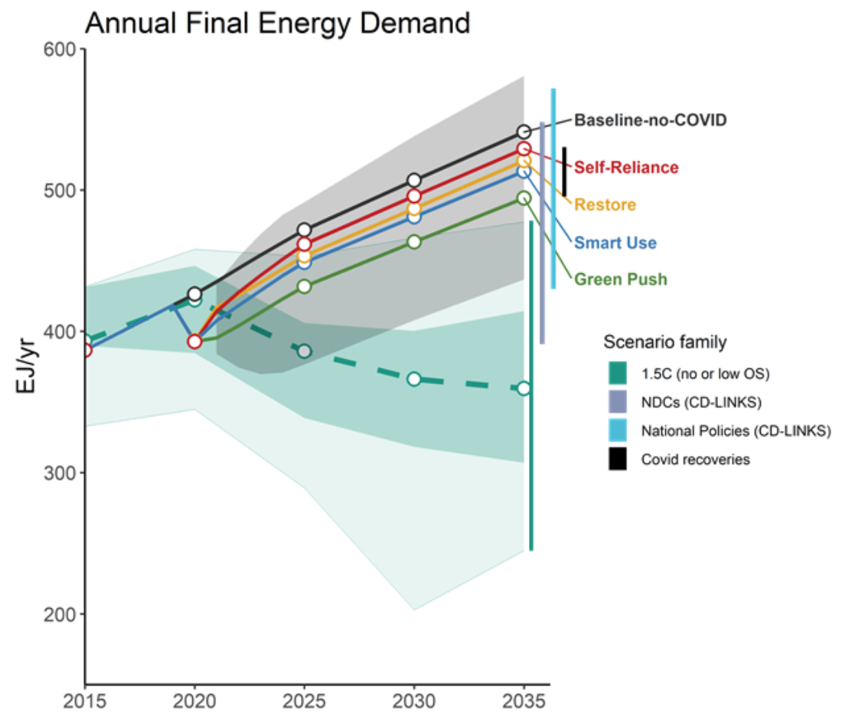
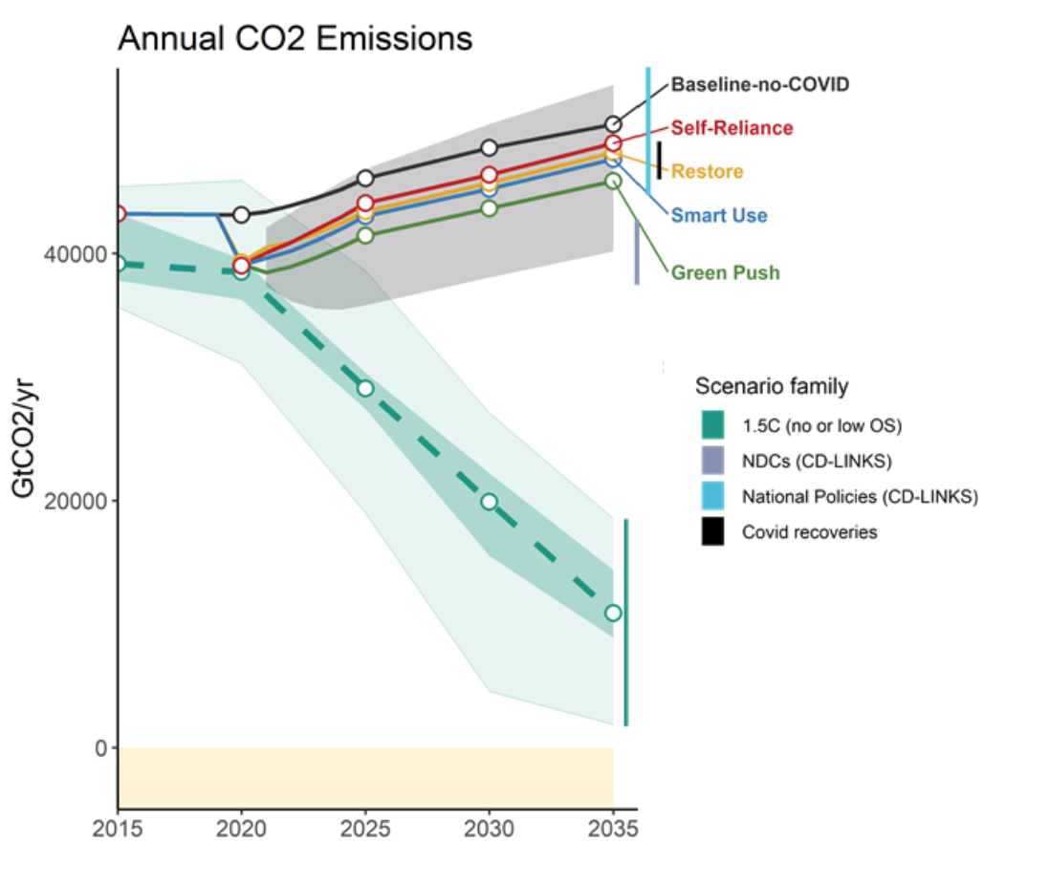
Impact of COVID-19: Energy demand and CO2
The possible reductions are substantial:
By 2025:
Final energy demand reductions* of
1 to 36 EJ/yr
Demand changes related to COVID will not bring us close to climate-stabilizing pathways.
By 2030:
Cumulative CO2 emissions
reductions* of 14 to 45 GtCO2
*Compared to a no-COVID baseline.
COVID recovery pathways
1.5 C pathways

Slide 16
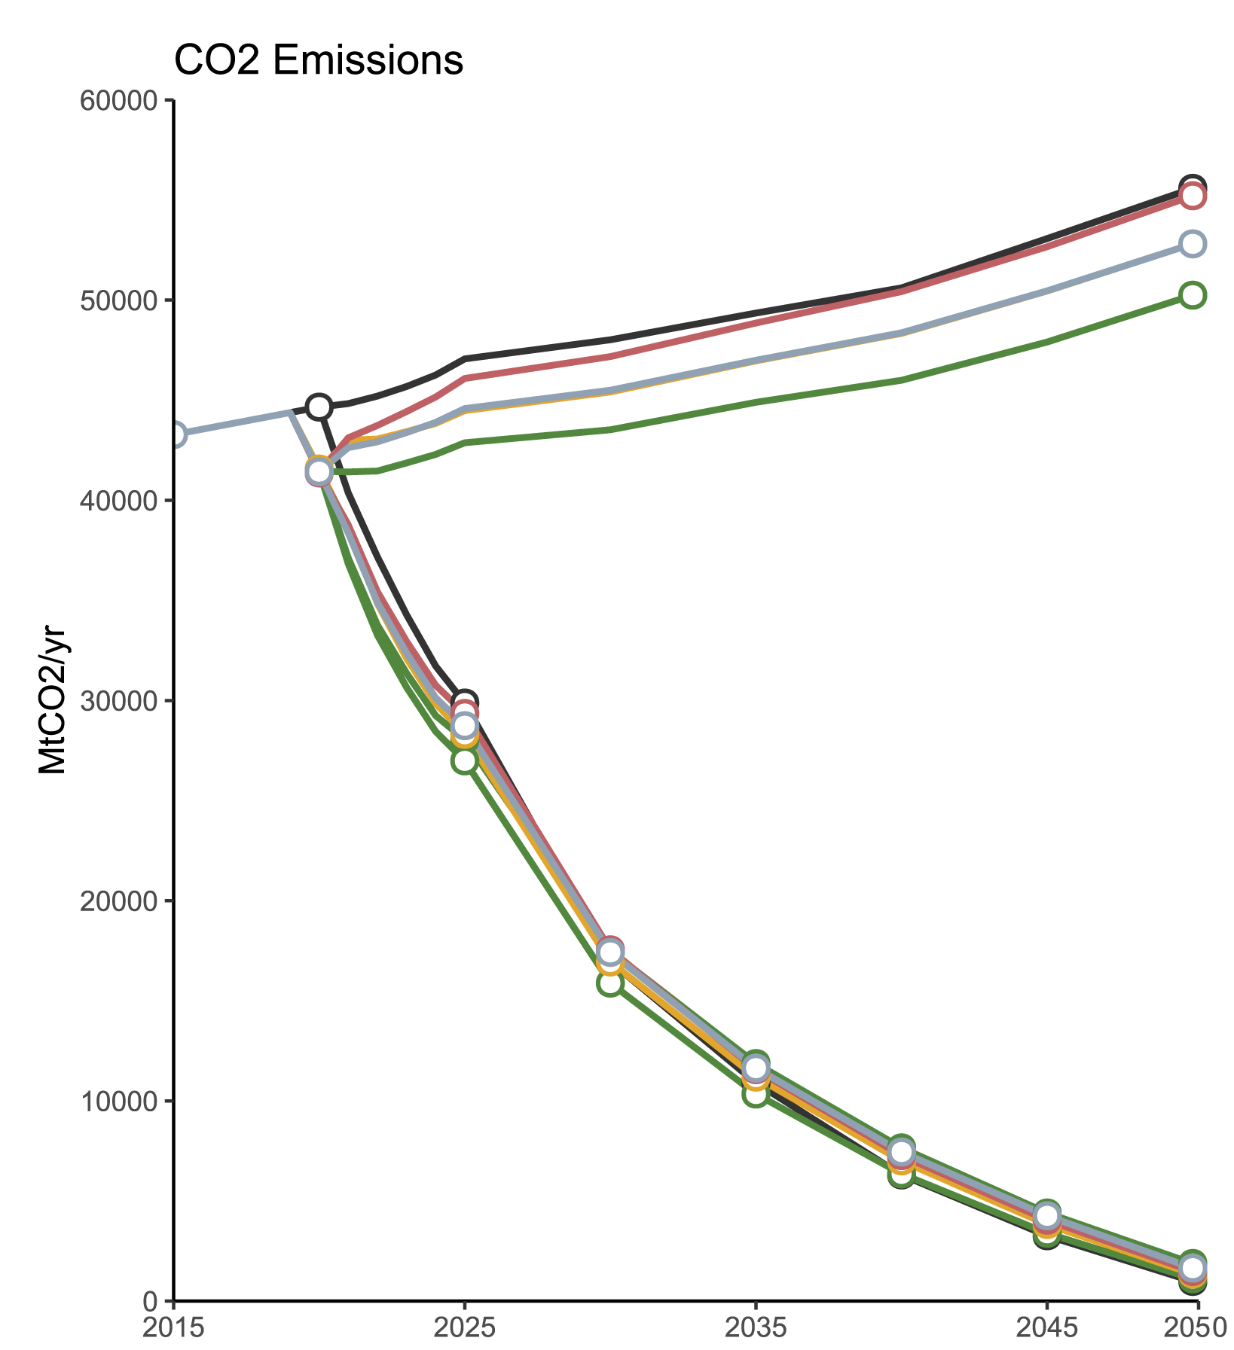
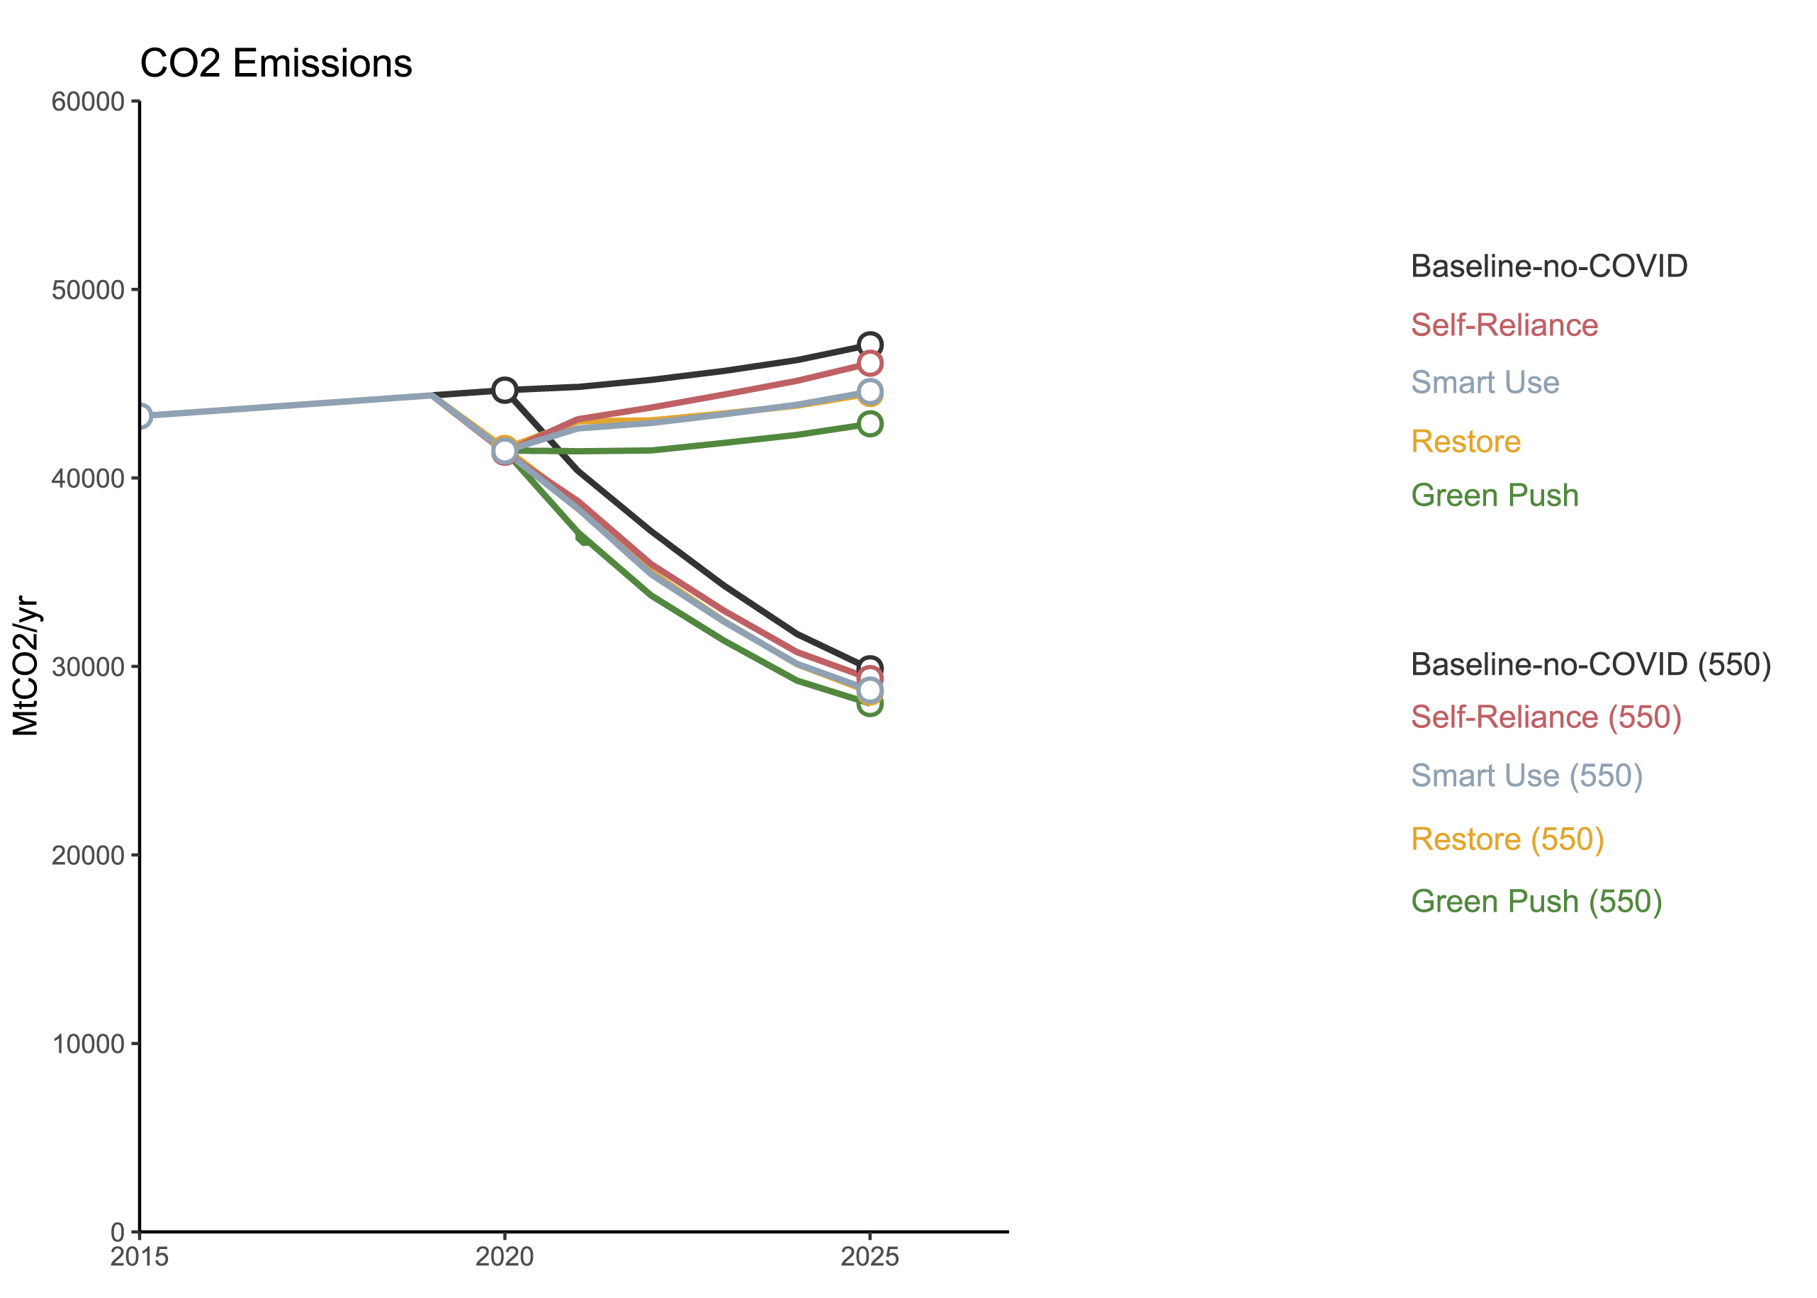


Methods overview
1. Qualitative bottom-up assessment of activity levels during pandemic
2. Illustrative recovery scenarios of varying persistence of activity changes
3. Energy demand pathways and GDP sensitivity analysis
(annual timesteps until 2025)
4. Perform climate mitigation simulations
Short-term
Long-term
Current trend + COVID recovery
Mitigation targets + COVID recovery
Notes:
Jarmo: so now we are going to focus

Slide 17
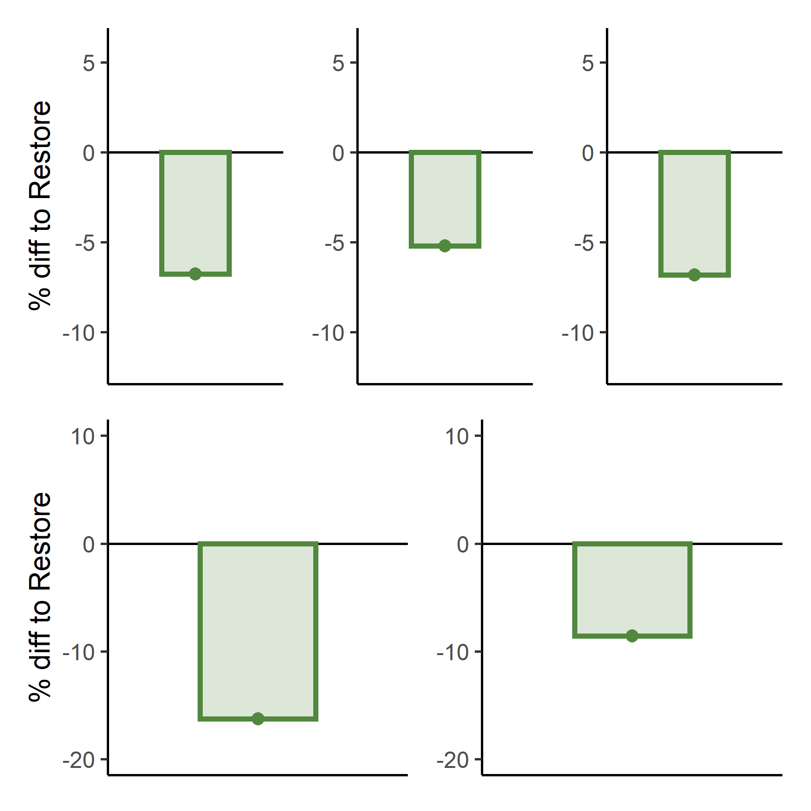
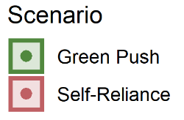
Effects on mitigation challenge
Compared to restore (“back to normal”)
Transport decarbonization speed
In green push (green), reduced energy demand means a lowered decarbonization challenge
Higher transition challenge
Lower transition challenge
Notes:
For this presentation, we focus here first on the green push scenario, which comes with the strongest reduction in energy demand.
We compare it to Restore (the zero line in the plot), a situation where everything (in the energy system) goes back to the pre-pandemic normal.
We find noticeable differences in the speed of decarbonization after the recovery period (post-recovery decarbonization pace in 2025-2040).
Here, an example for transport, where the speed of decarbonization is between 5 and 10% lower under green push than it is under restoring back to normal.

Slide 18
Effects on mitigation challenge
Compared to restore (“back to normal”)
Transport decarbonization speed
In green push (green), reduced energy demand means a lowered decarbonization challenge
This reduced energy means the transformation of energy supply is somewhat slower in green push:
  Lower Transport electrification challenge
Higher transition challenge
Electrification
Transport
Lower transition challenge
Notes:
This lower decarbonization need, also means that the supply-side transformation can be a bit slower (but still very fast as seen in the last figure Adriano showed!)
Electricity generation: the share of solar and wind in electricity generation.
Carbon costs: the net present value of the global carbon price multiplied by annual greenhouse gas emissions, for the period 2020-2030.
Decarbonizing Buildings, Industry, and Transport: increase of post-recovery decarbonization pace in 2025-2040 compared to the reference scenario under the same climate target.
Coal Phase-out: reduction in cumulative coal energy production capacity reduction overinin 2020-2030.
Electrification Transport: share of electricity of transport energy in 2030.
Energy Investments: cumulative energy supply investments 2020-2030.

Slide 19
Effects on mitigation challenge
Compared to restore (“back to normal”)
Transport decarbonization speed
Solar and Wind electricity share
In green push (green), reduced energy demand means a lowered decarbonization challenge
This reduced energy means the transformation of energy supply is somewhat slower in green push:
  Lower Transport electrification challenge
  Lower renewables upscaling challenge
Higher transition challenge
Electrification
Transport
Lower transition challenge
Notes:
Electricity generation: the share of solar and wind in electricity generation.
Carbon costs: the net present value of the global carbon price multiplied by annual greenhouse gas emissions, for the period 2020-2030.
Decarbonizing Buildings, Industry, and Transport: increase of post-recovery decarbonization pace in 2025-2040 compared to the reference scenario under the same climate target.
Coal Phase-out: reduction in cumulative coal energy production capacity reduction overinin 2020-2030.
Electrification Transport: share of electricity of transport energy in 2030.
Energy Investments: cumulative energy supply investments 2020-2030.

Slide 20
Effects on mitigation challenge
Compared to restore (“back to normal”)
Transport decarbonization speed
Solar and Wind electricity share
In green push (green), reduced energy demand means a lowered decarbonization challenge
This reduced energy means the transformation of energy supply is somewhat slower in green push:
  Lower Transport electrification challenge
  Lower renewables upscaling challenge
This also has economic advantages, such as:
  Lower mid-term carbon prices
Higher transition challenge
Electrification
Transport
Lower transition challenge
Carbon pricing
Notes:
Electricity generation: the share of solar and wind in electricity generation.
Carbon costs: the net present value of the global carbon price multiplied by annual greenhouse gas emissions, for the period 2020-2030.
Decarbonizing Buildings, Industry, and Transport: increase of post-recovery decarbonization pace in 2025-2040 compared to the reference scenario under the same climate target.
Coal Phase-out: reduction in cumulative coal energy production capacity reduction overinin 2020-2030.
Electrification Transport: share of electricity of transport energy in 2030.
Energy Investments: cumulative energy supply investments 2020-2030.

Slide 21
Effects on mitigation challenge
Compared to restore (“back to normal”)
Transport decarbonization speed
Solar and Wind electricity share
In green push (green), reduced energy demand means a lowered decarbonization challenge
This reduced energy means the transformation of energy supply is somewhat slower in green push:
  Lower Transport electrification challenge
  Lower renewables upscaling challenge
This also has economic advantages, such as:
  Lower mid-term carbon prices
  Lower energy investments in the coming decade(s)
Higher transition challenge
Electrification
Transport
Lower transition challenge
Carbon pricing
Energy investments
Notes:
Electricity generation: the share of solar and wind in electricity generation.
Carbon costs: the net present value of the global carbon price multiplied by annual greenhouse gas emissions, for the period 2020-2030.
Decarbonizing Buildings, Industry, and Transport: increase of post-recovery decarbonization pace in 2025-2040 compared to the reference scenario under the same climate target.
Coal Phase-out: reduction in cumulative coal energy production capacity reduction overinin 2020-2030.
Electrification Transport: share of electricity of transport energy in 2030.
Energy Investments: cumulative energy supply investments 2020-2030.

Slide 22
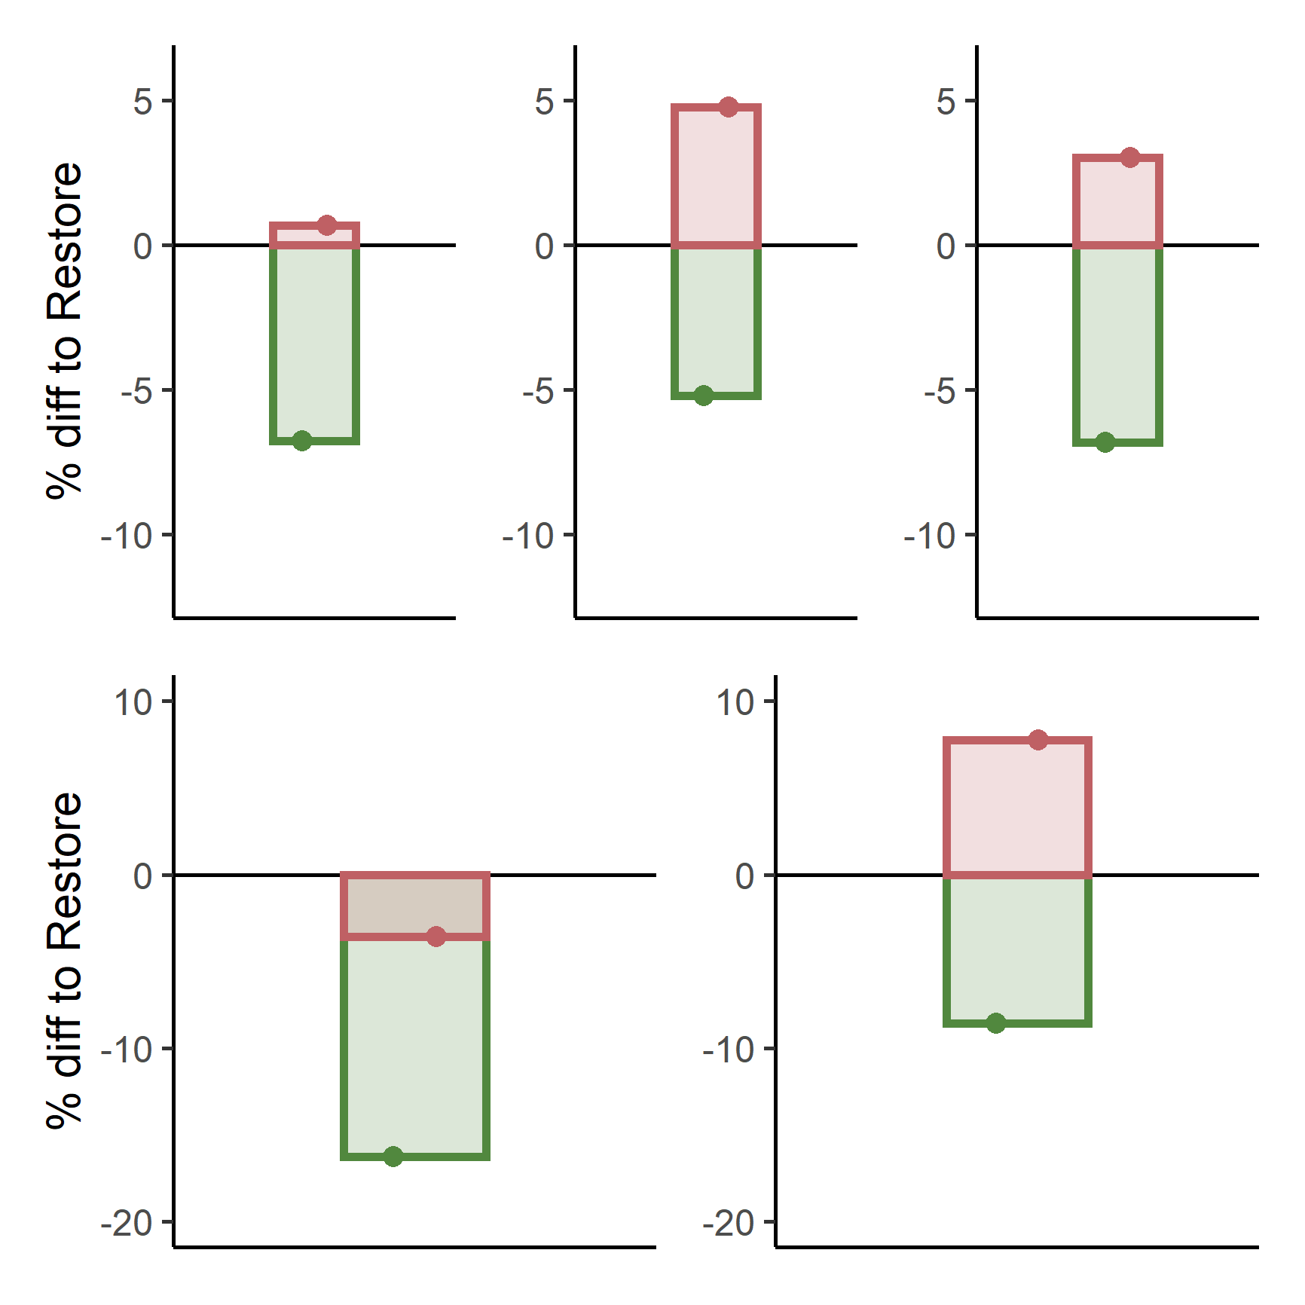
Effects on mitigation challenge
Compared to restore (“back to normal”)
Transport decarbonization speed
Solar and Wind electricity share
In self-reliance (red), a higher energy demand means a higher decarbonization challenge
To meet this higher energy demand, especially in transport, the energy system needs to:
  Electrify transport even faster
  Scale up renewables even faster
To drive this faster transition, our pathways have:
  Higher mid-term carbon prices
  Higher energy investments in the coming decade(s)
Higher transition challenge
Electrification
Transport
Lower transition challenge
Carbon pricing
Energy investments
Notes:
For self-reliance, with higher individualization and private car use, the effects are basically opposite,
with higher energy demand practices needing a faster transition that needs much more investments.

Slide 23
Research gap
1. No flexible, fast, robust way to make scenarios that respond to short-term impacts.
-> also applies to the war in Ukraine
-> no good way to assess/calculate the impact of current large events on climate mitigation
2. “Can long-term climate mitigation scenarios (IPCC WGIII) be combined more strongly with global health analysis?”
Notes:
On the flip side,
this brings us to the final conclusion, that
we have found that
lower energy demand practices on the short term, of the level that has been observed during the pandemic, can clearly reduce climate mitigation challenges.

Slide 24
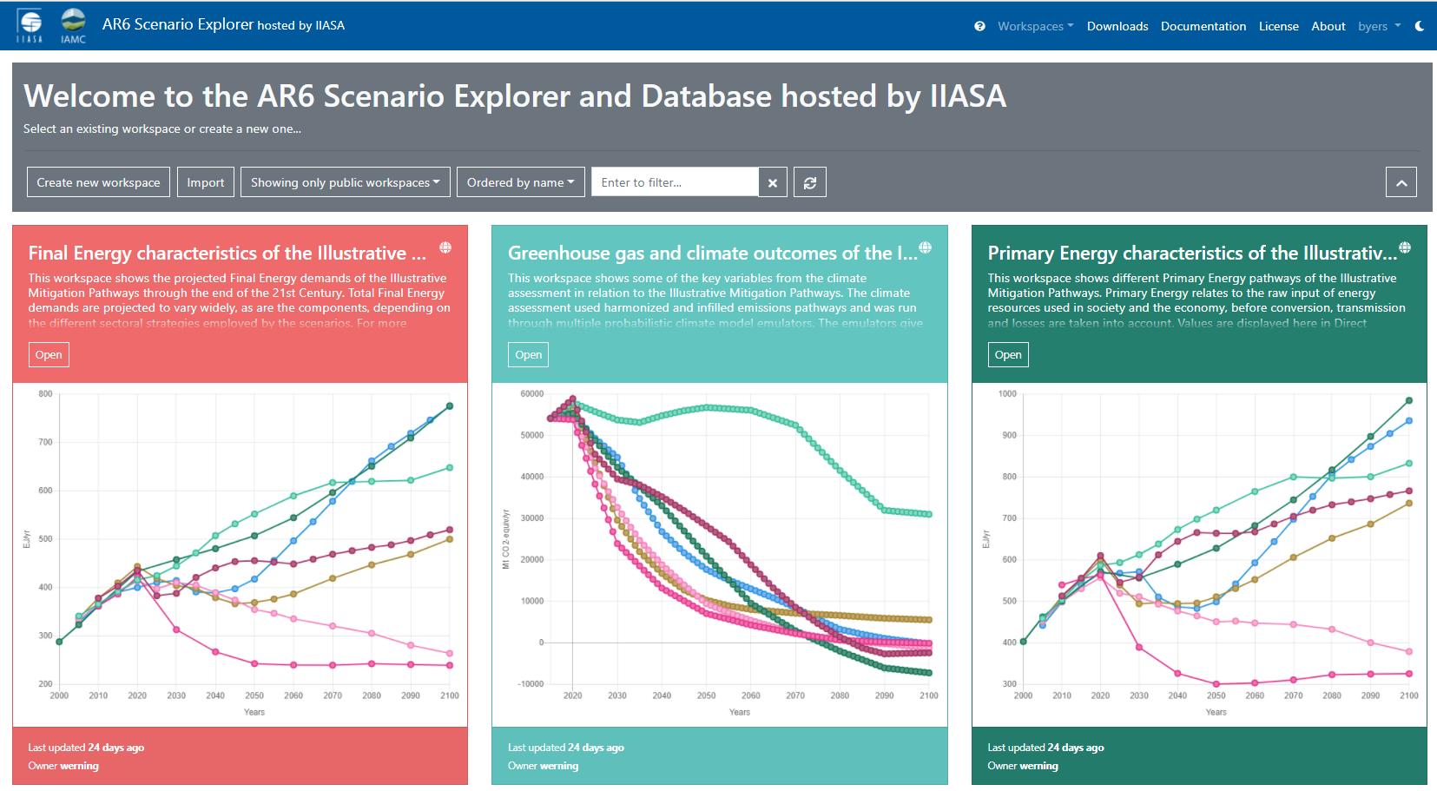
Research gap
2. “Can long-term climate mitigation scenarios (IPCC WGIII) be combined more strongly with global health analysis?”
IAMC AR6 Scenario Explorer at https://data.ece.iiasa.ac.at/ar6/
Notes:
On the flip side,
this brings us to the final conclusion, that
we have found that
lower energy demand practices on the short term, of the level that has been observed during the pandemic, can clearly reduce climate mitigation challenges.

Slide 25
Take-home messages
Without systemic climate policies, no strong climate effect from demand changes.
Big challenge to 1.5C means that missing the ‘entry-point’ with a higher energy demand recovery is very costly.
Transport mode shifts accounts for the largest effects in shock and recovery
Notes:
Less text.
“In itself, without further systemic changes, changed energy demand practices do not affect pathways toward climate targets much.”
What we have learned, is that if global society fails to implement systemic changes besides the pandemic-induced activity changes, there will not be a significant climate effect.
Next to that, we have learned that given the already large challenge of reaching 1.5C, higher energy demand is associated with significantly higher transition costs.
In other words, the big challenge ahead of us means that ‘missing the entry-point’ that this recovery from the pandemic could mean, has large implications.
We have also learned that related to the pandemic, the biggest sectoral factor is clearly transportation, with support for sustainabvle mode shifts being important

Slide 26
Conclusion
The world is currently missing the chance to recover from the pandemic with low energy demand practices (travel, work, consumption, production) reduces climate mitigation challenges.
Jarmo Kikstra
kikstra@iiasa.ac.at
^{Heidelberg Symposium}
Collaborators:
Adriano Vinca, Francesco Lovat, Benigna Boza-Kiss, Bas van Ruijven, Charlie Wilson, Joeri Rogelj, Behnam Zakeri, Oliver Fricko, Keywan Riahi
Notes:
On the flip side,
this brings us to the final conclusion, that
we have found that
lower energy demand practices on the short term, of the level that has been observed during the pandemic, can clearly reduce climate mitigation challenges.

