Slide 1



WASHA Takwimu – “Ignite Data”
Research Training for Data Science and Global Health

Slide 2
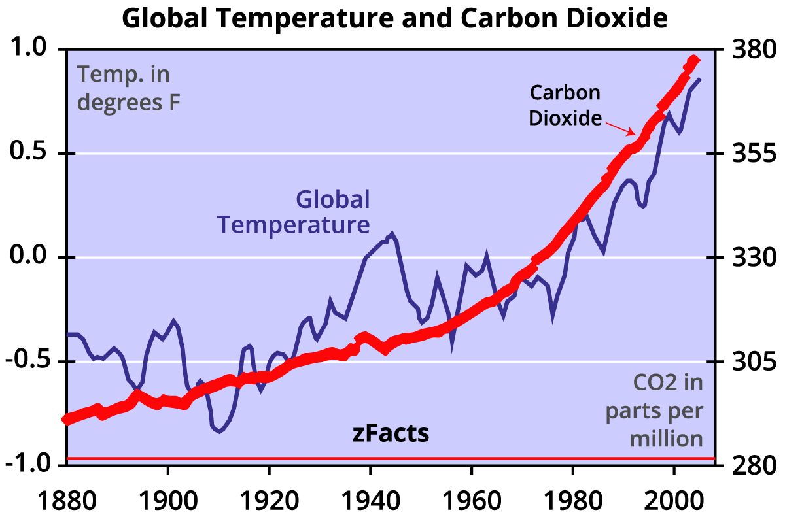
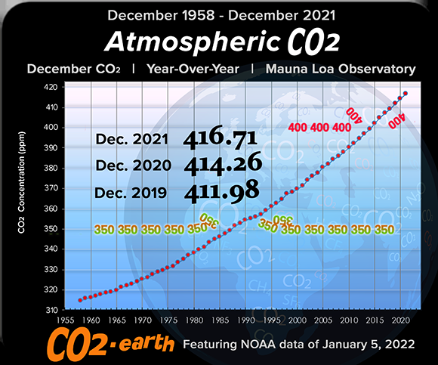
Exponential Co² & Temp increases
    Evidence of atmospheric carbon dioxide levels and global mean annual temperature increases since 1880
S.Stoft zfacts.com, 2017
https://www.show.earth/kc-monthly-co2-widget
Changes in rainfall patterns (frequency and intensity), drought events, El Niño events, impacting on terrestrial ecosystems

Slide 3
Developing Decision Support Systems: Role of Data Science
How can we improve sustainable management of resources & mitigate against Climate Change impacts
Where do we start and where do we want to go
  Sustainable Development Goals as benchmarks
  Develop indices that can best assess the performance of our interventions
    Crop Suitability Index
    Nutrition and health Index
    Rangeland health
Data sources
  Health Information
  Crop, Water and Soil Data
  Climate data
  Satellite information
  UN Databases
Science & Technology for Processing
  Machine Learning – Supervised/Unsupervised
  Deep Learning – CNN, RNN
  Artificial Intelligence
  Cloud Computing for huge data sets – GEE
  Remote Sensing data processing
  Physical – based Models
    Radiative transfer modeling techniques to quantify crop/vegetation traits
Indices & prediction
Notes:
Collectively, these will build an Early Warning System. A hub of structured and unstructured data, backed by scientific experimentations, benchmarked against developed indices that provide trajectory and feedback data.

Slide 4

Data science in health and food systems
Advances in data science and artificial intelligence (AI) have the potential to transform health and food systems research and health care in Africa
Extensive and diverse datasets are already available on the African continent
  routine health data – national three-tiered standardized HIV patient record reporting system tier.NET
  National Health Laboratory Services (NHLS) database in South Africa and health facility surveys
  Health and demographic surveillance systems (HDSS) and Demographic Health Surveys (DHS) with nutrition data
  crop production and vulnerability assessments; food price and food insecurity data e.g. FEWSNET
  geospatial data and agro-climatology data including on rainfall, sea, and land surface temperature, weather hazards and weather prediction and satellite image products
Data science can support key public health functions, e.g.
  Surveillance; prevention and health promotion; linkage to care and care monitoring; can boost the functioning of health and food systems
  Better understanding of climate, weather, and dietary patterns and inform policy decisions to improve nutrition and health.

Slide 5
“Big data” opportunities to address health systems and food systems challenges are increasing
Analysis of real-world routine data – integrated across sources and data structures – can provide powerful insights to bridge the knowledge gap and provide new solutions to some of Africa’s most pressing health challenges
Need for innovation in techniques and new computational methods, digital phenotypes, machine learning and AI approaches
Data science led by African-based scientists will be key for the future and addressing the health needs across the continent
  Gap: research and policymaking in SSA has been limited by a severe shortage of data scientists

Slide 6
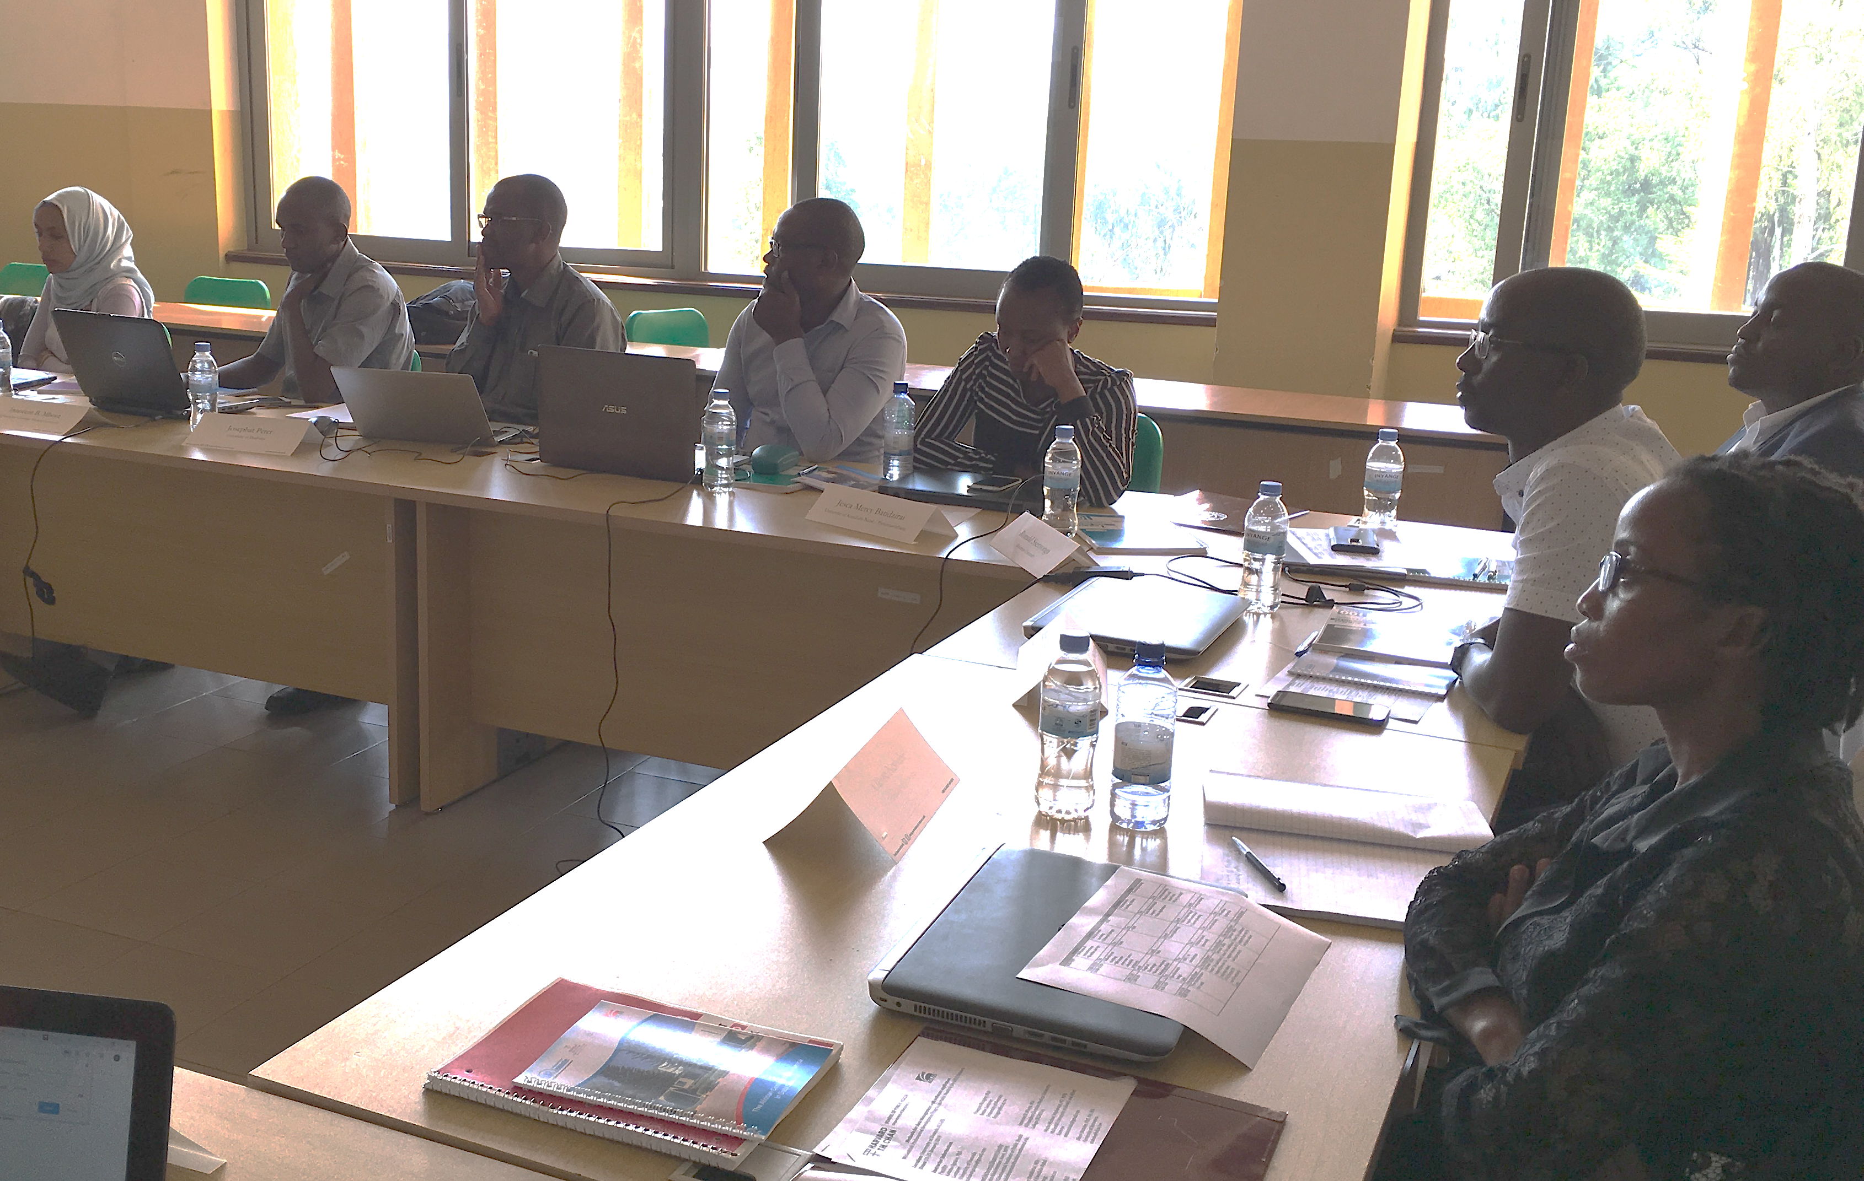
Data science and health systems
Data science has potential to generate new insight for healthcare and public health and to provide the foundations for new interventions and health systems reforms and provide solutions to some of the problems that most vex health policy makers e.g.
  Quantification of need for prioritization: urgent healthcare gaps that are likely to remain unmet even if health systems provide interventions free of charge, e.g. HIV treatment, TB treatment, or vaccination – descriptive statistics
  Prediction of need for intervention targeting and tailoring: where and to whom should we provide a health intervention – predictive algorithms, e.g., Random Forests, Boosting, Neural networks
  Identification of profiles of need for the design of health packages and policies: pressing knowledge gaps on health risks, prevention, and treatment needs – such as the clustering of risk behaviors (intersectionalities) and multi-morbid conditions (syndemics) – clustering algorithms, e.g., DBSCAN, GMM, k means
  Causal effects of health interventions for policy choices: what works? – experiments and quasi-experiments (RDD, ITS, DiD, IV)
  Causal effect heterogeneities of health interventions: what works for whom? – micro-experiments and multiarm bandit trials and micro-quasi-experiments

Slide 7
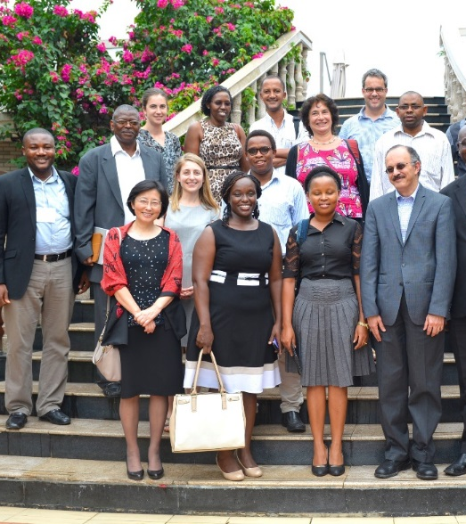
Background
HSPH, UKZN, Heidelberg
Hub: UKZN
Spoke partners (ARISE countries)
  Ghana, Nigeria, Tanzania, and Uganda.
Multi-disciplinary team of researchers and expert faculty with in-depth experience in data science methods and its application in two domains, which are global health priorities:
    (i) health systems strengthening
    (ii) food systems, climate change and planetary health

Slide 8
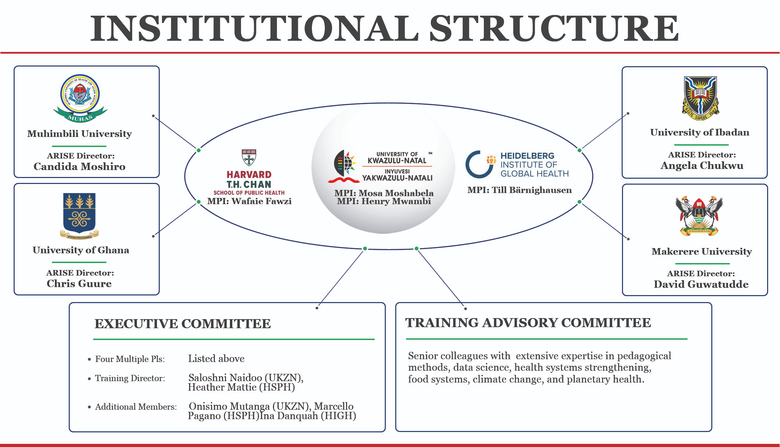

Slide 9
Project aims
Long-term goal:
  To develop advanced data skilled researchers in health data science in Africa through a rigorous curriculum and set of training and research activities designed to address the health needs of African countries
Specific aims:
Train mid-level and senior researchers at UKZN to work as educators and Pis leading independent research programs focused on using data science to address important global health challenges of national, regional, and global relevance.
Build a critical mass of junior public health and medical professionals across SA, Ghana, Nigeria Tanzania and Uganda who can design and successfully carry out rigorous health research projects using data science.
Develop and institute a sustainable master’s degree program in health data science at the UKZN to serve the research training needs in SA and the African region.

Slide 10
Key activities: Aim 1
Train mid-level and senior researchers at UKZN to work as educators and principal investigators leading independent research programs focused on using data science
  Train and support 17 master’s students, and 5 two-year postdoctoral fellows, using a data science curriculum and training program that is (i) competency-based, (ii) mastery-oriented, (iii) application-focused, and (iv) digitally enhanced.
  Mentoring by a supervisory team
  Opportunities for practical training in internships, capstone projects, and academic research projects.

Slide 11
Key activities: Aim 2
Build a critical mass of junior public health and medical professionals across SA Ghana, Nigeria Tanzania and Uganda
  Short course instructions to 350 professionals and researchers, of whom 50 will complete a series of four courses and obtain a graduate certificate in health data science innovation.
  Conduct monthly seminars and annual symposia for program participants
  Ongoing mentorship offerings throughout the duration of the program.

Slide 12
Key activities: Aim 3
Develop and institute a sustainable master’s degree program in health data science at the UKZN to serve the research training needs in SAf and the African region
  Develop and institute a sustainable master’s degree program training 15 students in health data science at UKZN each year, starting in Year 5 of the grant.
  Will build upon the curriculum of courses developed and taught as part of this program and relevant courses at UKZN and draw from the Master of Science (SM) in Health Data Science at HSPH

Slide 13
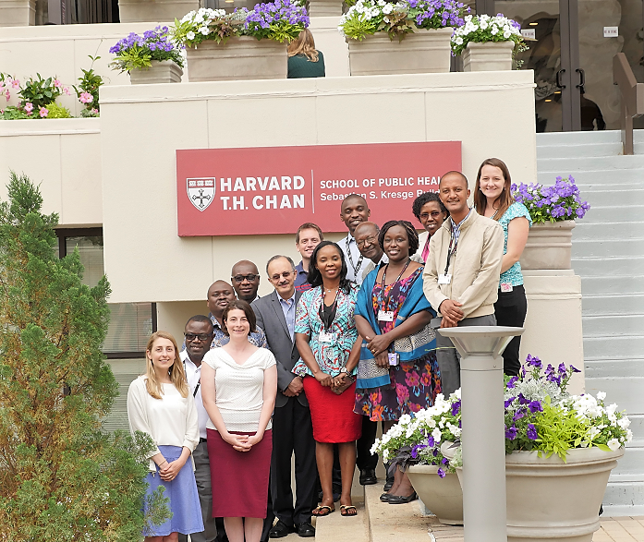
GRANT Implementation Structure
Leadership team
Executive Committee (EC)
Training Advisory Committee
ARISE Directors
Program Faculty Mentors

Slide 14
Leadership team
Dr Wafaie Fawzi
Richard Saltonstall Professor of Population Sciences, and Professor of Nutrition, Epidemiology, and Global Health at HSPH.
Dr. Fawzi leads research on maternal, neonatal and child and adolescent health, and infectious diseases, with emphasis on nutritional factors
Dr Mosa Moshabela
Deputy Vice Chancellor Research and Innovation, UKZN
Dr. Moshabela leads school-wide efforts to advance academic leadership, transdisciplinary research, medical and health professions education, rural health scholarship, and transformation in higher education.
Dr Henry Mwambi
Professor at the University of KwaZulu-Natal.
Dr Mwambi’s main areas of research are in applied statistics, biostatistics and infectious disease modelling at the individual and population level.
Dr Till Bärnighausen
Alexander von Humboldt University Professor Director, Heidelberg Institute of Global Health.
Dr Bärnighausen’s research focuses on the causal impacts of health systems interventions and reforms for HIV and other chronic diseases, such as hypertension, diabetes and depression on population health, economic and social outcomes.

Slide 15
Executive committee
Dr Heather Mattie
Executive Director of the Masters of Health Data Science Program at HSPH and a Lecturer in Biostatistics.
Dr. Mattie’s research focuses on the intersection between biostatistics, data science, and network science. She serves as a co-Training Director for the program, leading all training activities at HSPH.
Dr Saloshni Naidoo
Associate Professor, Head of Public Health Medicine, School of Nursing and Public Health, UKZN.
Dr. Naidoo leads capacity development and postgraduate training of Public Health Medicine Specialists, master’s and doctoral students in public health . She serves as co-Training Director for the program, leading training activities at UKZN.
Dr Onisimo Mutanga
Professor and Academic Leader at UKZN’s School of Agriculture, Earth and Environmental Science.
Dr Mutanga’s expertise lies in Ecological Remote Sensing, with particular emphasis on vegetation pattern analysis and monitoring as well as agricultural land use mapping.
Dr Marcello Pagano
Professor of Statistical Computing at HSPH.
Dr Pagano’s research in biostatistics focuses on computer intensive inference and surveillance methods that involve screening methodologies, with their associated laboratory tests, and in obtaining more accurate testing results.
Dr Ina Danquah
Robert Bosch Foundation Junior Professor of Sustainability Science and Research Group Leader for “Climate Change, Nutrition and Health” at Heidelberg Institute of Global Health (HIGH), Heidelberg University.
Dr. Danquah’s research focuses on characterizing the responsiveness of dietary habits to climate change and associations between sustainable diets and chronic diseases among African populations.

Slide 16
ARISE Directors
Dr Angela Chukwu
Professor at University of Ibadan with 15 years of teaching and research in statistics with applications in the life sciences and public health.
Dr. Chukwu is proficient in classical statistical methodologies including the analysis of experimental data
Dr Chris B. Guure
Senior Lecturer at the University of Ghana in the Department of Biostatistics.
Dr Guure’s research interests include survival analysis, clinical trials methodology, evidence-based medicine and meta-analysis, hierarchical or multilevel modeling, joint modeling of longitudinal and survival data.
Dr David Guwatudde
Professor of Epidemiology and Biostatistics at the School of Public Health, Makarere University College of Health Sciences.
Dr. Guwatudde has extensive experience in leading training efforts at Makerere, and leads research related to communicable and non-communicable diseases
Dr Candida Moshiro
Senior Lecturer and Statistician in Department of Epidemiology and Biostatistics School of Public Health & Social Sciences, MUHAS.
Dr Moshiro led the establishment of the new master’s in implementation science program at MUHAS in partnership with Harvard as part of Fogarty-funded D43 training grant

Slide 17
Training advisory committee
TAC: Comprised of 10 senior colleagues with extensive experience in the data science methods and the two selected health domains of (i) health systems and (ii) food systems, climate change, and planetary health
Programs coordinators: Isabel Madzorera (HSPH) and Nisha Nadesan-Reddy (UKZN)
TAC will provide guidance to the EC to create transformational learning experiences for trainees, offering support for innovative teaching and experimentation in the training program’s learning environments.
TAC will meet in person and virtually 2-3 times a year to plan in-country course offerings; review trainee applications, research progress, proposals, and performance; and evaluate recruitment policies.

Slide 18
Program Faculty Mentors
Comprised of 62 faculty
Expertise in methodological and substantive aspects of data science research (statistics, epidemiology,
computer science, machine learning, and AI) and in the two selected data science domains
  Harvard: T.H. Chan School of Public Health, Harvard School of Medicine, the School of Engineering and Applied Sciences
  UKZN: School of Nursing and Public Health at the College of Health Sciences; and the School of Mathematics, Statistics and Computer Science, and the School of Agriculture, Earth, and Environmental Sciences (SAEES) within the College of Agriculture, Engineering and Science
  Heidelberg university: Heidelberg Institute of Global Health, Institute of Public Health, Computer Science
  Other global universities

Slide 19
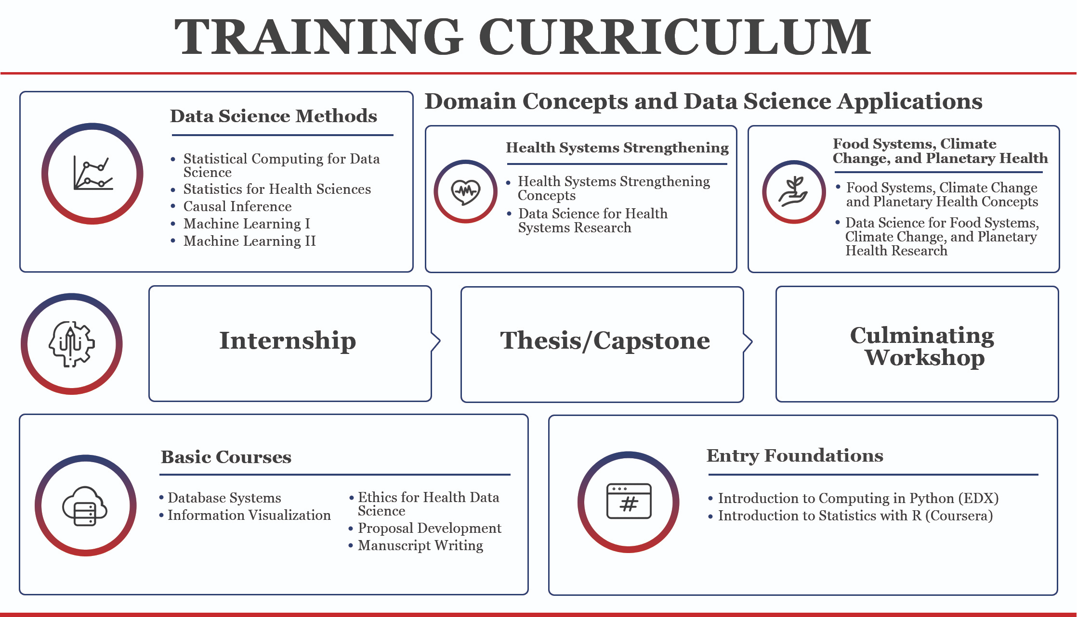

Slide 20
South-South Collaboration
The collaboration by researchers across countries in the South is integral to developing research capacity in health data sciences in the continent.
Example: Africa Research Implementation Science and Education (ARISE) Network
Mission: To develop the next generation of scientific leaders tackling Africa’s most pressing health challenges
ARISE: comprised of 21 leading institutions for public health research and training – 19 in 9 countries in Africa:
  Botswana, Burkina Faso, Ethiopia, Ghana, Nigeria, Rwanda, South Africa, Tanzania, and Uganda, and HSPH and HIGH.
ARISE brings together expertise in research methods, program design, implementation science, and measurement and evaluation, and robust training and mentoring infrastructure.
Through South-South collaborations such as this and triangular cooperation, we can facilitate equitable partnerships and collaboration between researchers in the region.

Slide 21
South-North linkages
The project includes Mentors from Harvard University, the University of Heidelberg and others
Potential for collaborations and mentoring of postdocs and students, as well as for students to train for a Masters in Health Data Sciences at Harvard
Mentoring in health data sciences and domains (health systems and food systems, climate change and planetary health) is critical for developing capacity in this project

Slide 22
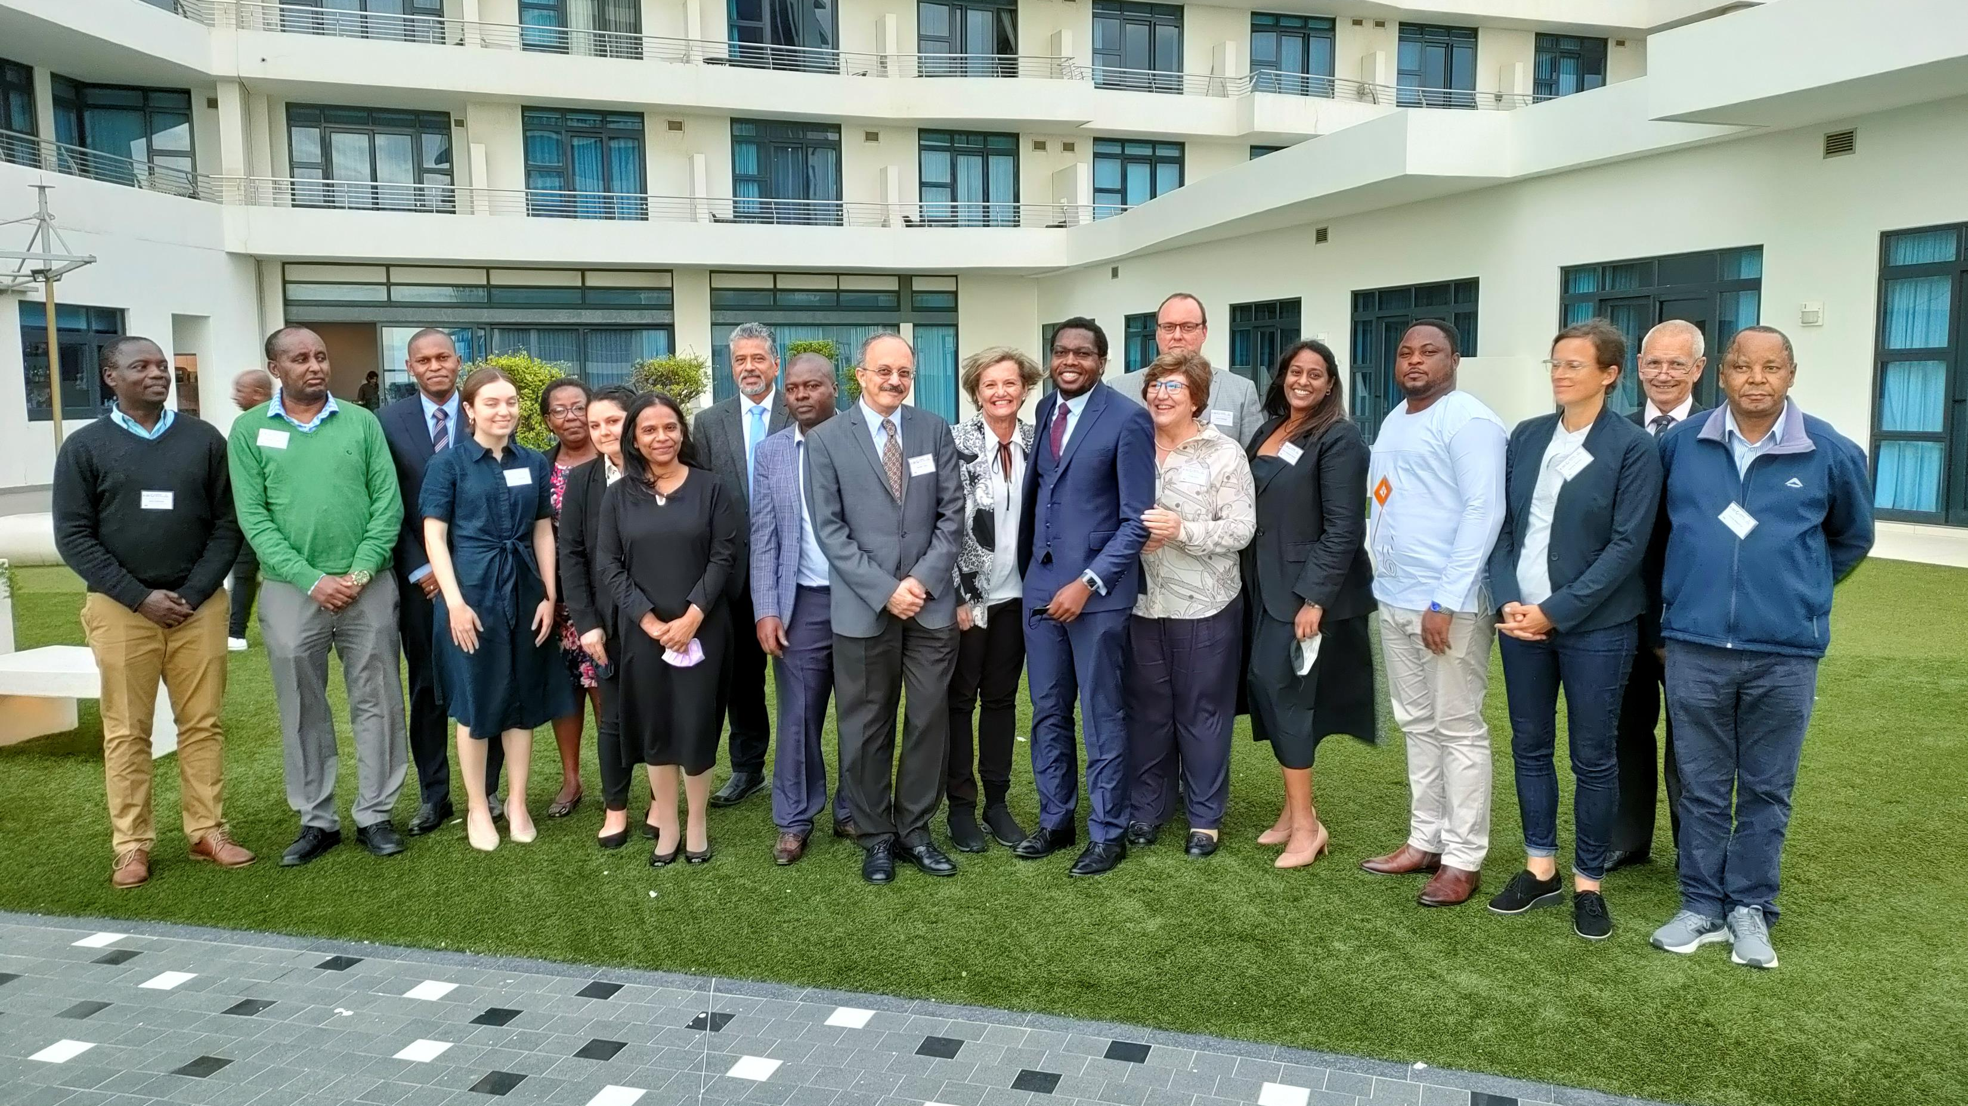

Slide 23
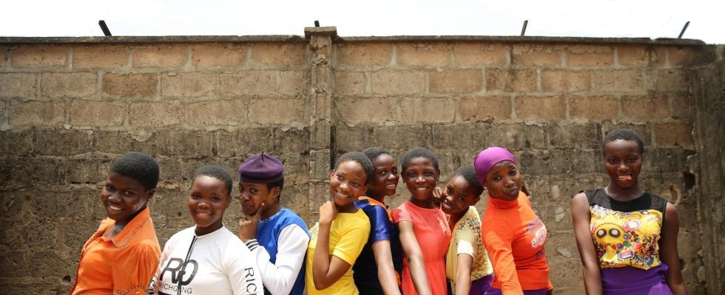
SIYABONGA

