Slide 1
Global Health Education in times of crises
60th Jubilee Symposium, Heidelberg, June 25, 2022
Tim Evans,
Director McGill School of Population and
Global Health

Slide 2
Outline:
The evolving context for education related to global health
Some starting points for responding to growing needs and demands in global health

Slide 3
Higher Education for Health: an evolving context

Slide 4
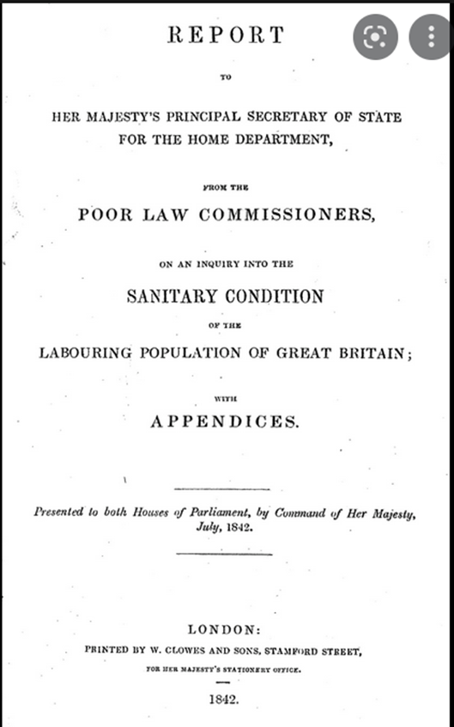
Crises create new demands for health professionals!
“…for the general means necessary to prevent disease, it would be good economy to appoint a district medical officer, independent of private practice, with the securities of special qualifications, and responsibilities to initiate sanitary measures and reclaim the execution of the law”
Sir Edwin Chadwick – Report on the Sanitary Condition of the Labouring Population, 1837.

Slide 5

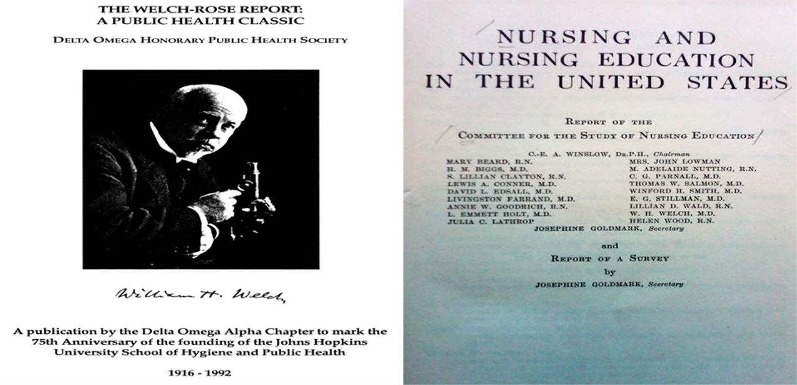
Flexner, Welch-Rose, and Goldmark reports

Slide 6
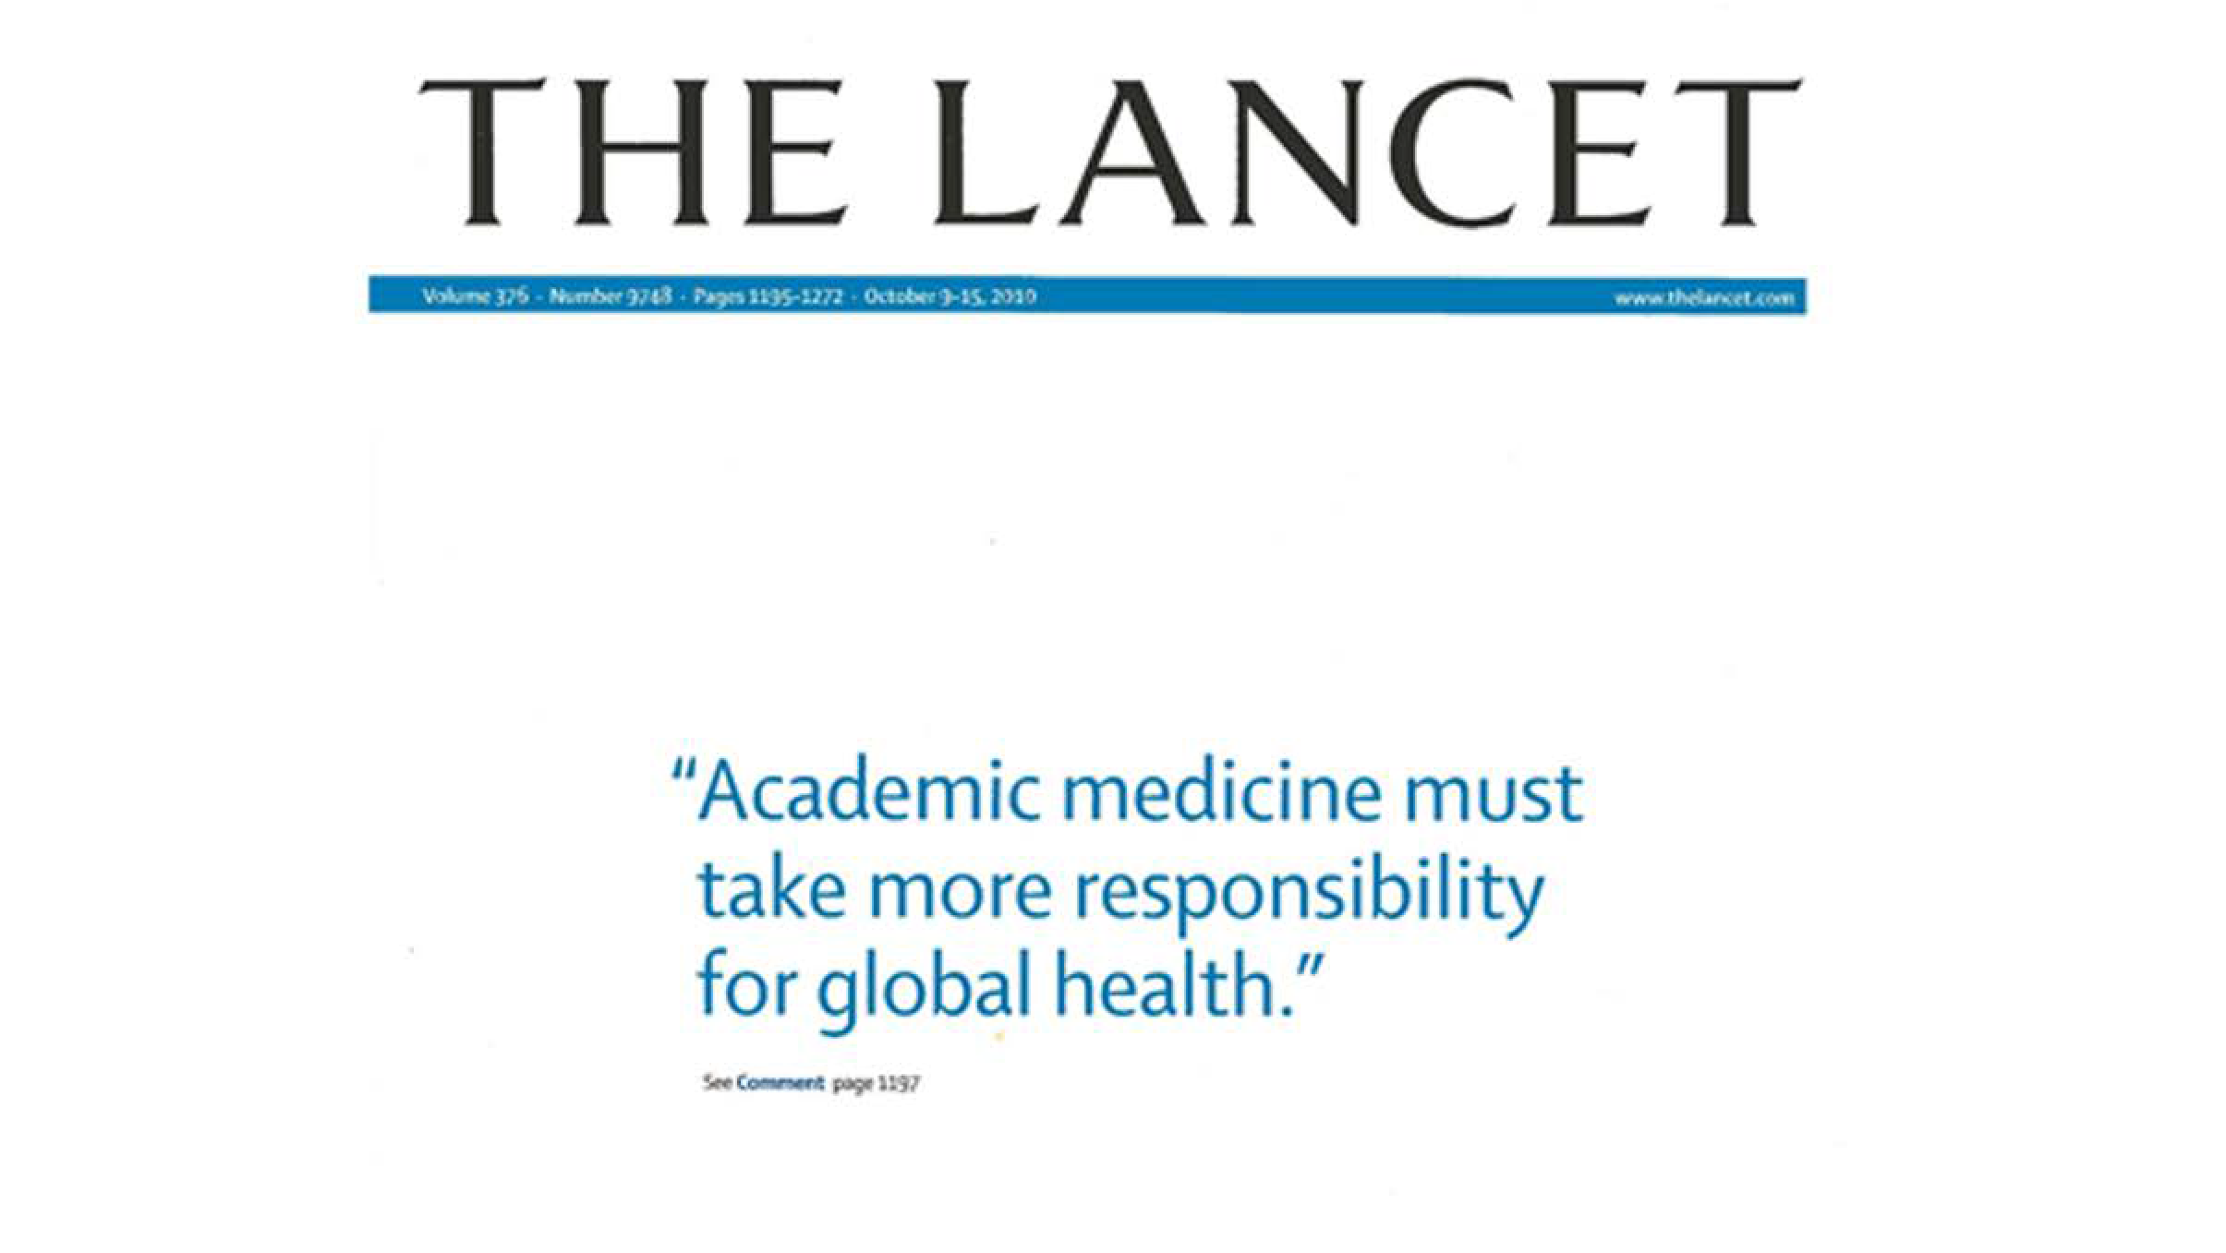
The Lancet, October 2010

Slide 7

Acute health workforce challenges in the context of COVID-19
Limited surge capacity
  hospitals and long term care,
  public health cadres e.g. testing personnel
  Procurement + supply chain specialists
Unsafe working conditions
High rates of burnout
Accelerated workforce attrition
Hubris outpaced humility

Slide 8





While herd immunity my help to end the pandemic, herd mentality will not!!!
https://www.immunology.org/john-snows-pump-1854
https://gbdeclaration.org/

Slide 9
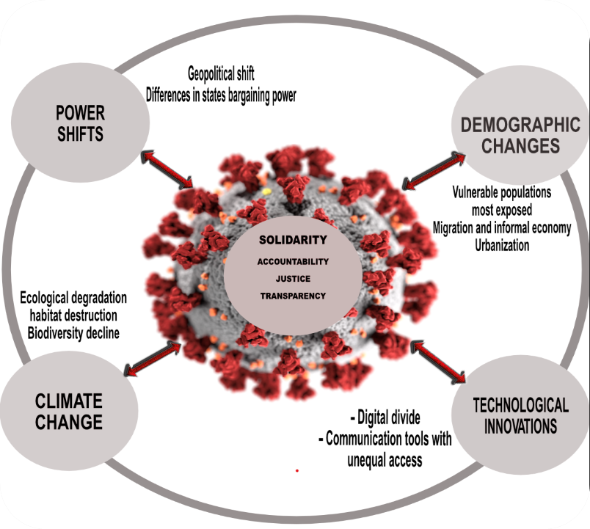
The brave new world of global health
“COVID-19 is not a pandemic. It is a syndemic. Limiting the harm caused by SARS-CoV-2 will demand far greater attention to NCDs and socioeconomic inequality….. Richard Horton
https://www.thelancet.com/action/showPdf?pii=S0140-6736%2820%2932000-6
“It is not just viruses that cross borders. Tobacco, unhealthy ultraprocessed foods and sugar sweetened beverages are transnationally marketed maladies and aggressively advertised addictions” Srinath Reddy
https://www.newindianexpress.com/opinions/2020/nov/13/global-health-will-get-abooster-shot-2223177.html

Slide 10
Context 2020+ for global health education
Pandemics, Syndemics and Climate Change
Infectious/chronic, emergent/ neglected, under/over nutrition, health and humanitarian emergencies
Systemic inequalities
racial/BIPOC, age/gender, within/between countries, structural/dynamic, colonial/neo-colonial
Systems Performance Shortfalls
coverage, quality, affordability, speed, surge, sustainability, expectations, trust
Health Tech and Digital futures
“emics and omics”; AI and Apps; precision and personalized ; mis and dis- infodemics; ethics and regulatory

Slide 11



Slide 12

Reflecting on the values that drive the academy
Higher education accentuates inequality!
  standardized tests scores track wealth
  reconfiguring inequality to align with “ability”
  A “diploma divide” and “the credentialed elite”
The underbelly of meritocratic hubris:
  the best and the brightest are winners
  An “implicit” insult associated with not having a degree
  “It is hard indeed in a society that makes so much of merit to be judged as having none”- Michael Young
  fuels distrust in science and experts

Slide 13
Some starting points:

Slide 14
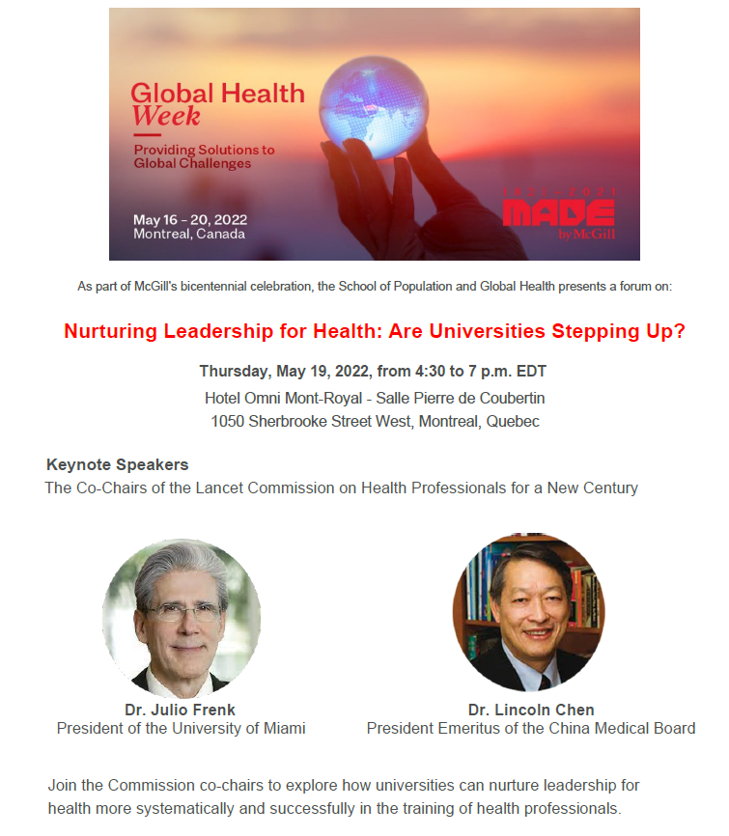
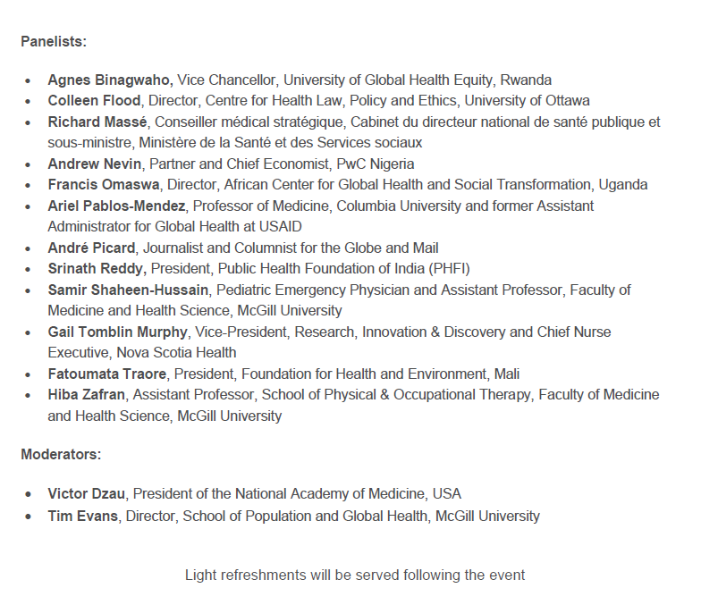
Nurturing leadership for health…

Slide 15

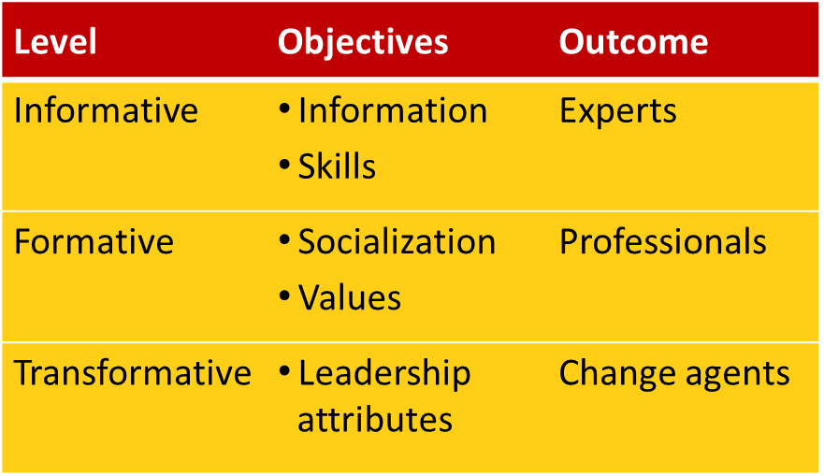
Are we “transforming education to strengthen health systems in an interdependent world”?

Slide 16

Dimensions of a new strategy
K
Z
Q
P
L
INSTRUCTIONAL
INSTITUTIONAL
TECHNOLOGICAL PLATFORMS

Slide 17


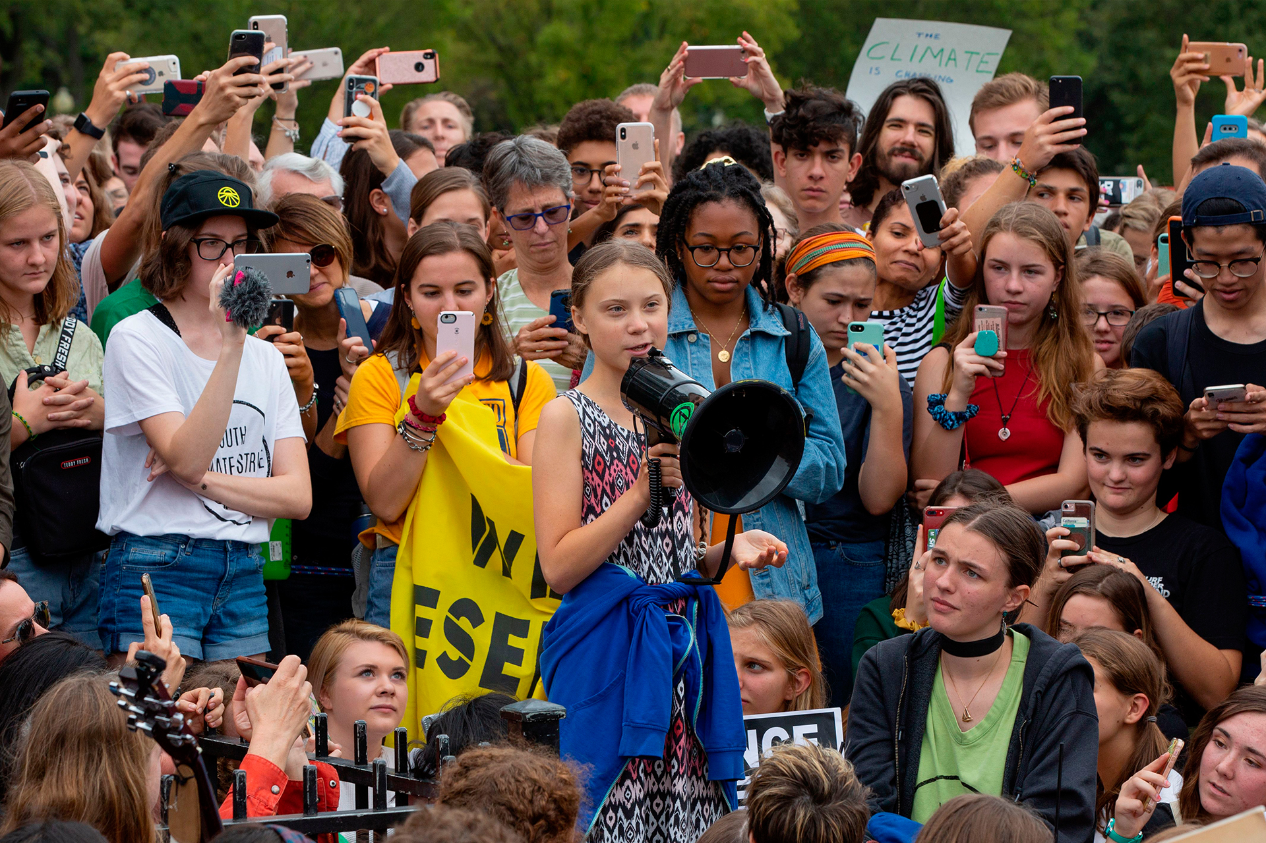
Understanding the next generation of learners…
Borderless—local and global citizen
Boundary-less—across disciplines
Real-world experiential learning…
Global Health School WithOut Walls (GHS WOW!)

Slide 18
Undergraduate Joint Faculty Program
in Population & Global Health
8 required courses
5 thematic streams
Community-based experiential learning
Admissions: beyond academic record, emphasis on diversity
Framed around 6 key competencies
Offered by SPGH & the
Faculty of Arts
54 credits
Creating globally minded agents of change!

Slide 19
Six key competencies
Positionality & partnerships | Explain the role of power, privilege and social justice while demonstrating continuous self-awareness when working in teams, and different cultures/contexts and/or worldviews
Interdisciplinary problem solving | Demonstrate the ability to apply a determinants-of-health, systems-based, reflexive, and ethical approach to interdisciplinary population and global health problem-solving and discourse
Origins of systemic inequities | Describe how historical and politico-economic forces (e.g., colonialist, neoliberal) have shaped and continue to impact global health policy, research and practice
Research literacy | Describe quantitative and qualitative research principles and key data analytic techniques used in evidence-based problem solving
Ethical foundations & frameworks | Define and apply various ethical frameworks relevant to population and global health in a manner that is culturally sensitive, collaborative and responsive to organizational and community needs
Knowledge mobilization | To equitably receive, summarize, critically appraise and explain global health ideas to diverse audiences through visualization and other methods

Slide 20
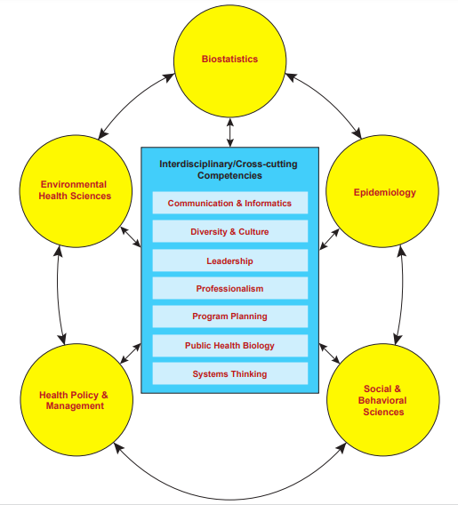
MPH core competencies (ASPPH 2006)
Time for a re-think?
Notes:
ASPPH’s Master of Public Health core competencies, identified by national consensus in 2006, are still a relevant resource and guide for educators, administrators, and students. These competencies set a baseline for skills that master students should be competent in upon graduation. The MPH Core Competency Model includes competencies in the five traditional core areas of public health and seven interdisciplinary/cross-cutting areas and applies to students upon graduation from a CEPH-accredited school or program of public health:

Slide 21
Foster competencies in contemporary ethical challenges
Informed consent
Medical decision-making
Human subjects research
Resource allocation
Medical aid-in-dying
Artificial intelligence/algorithms in medicine
Refugee and humanitarian health
Pandemic Ethics
Animal ethics/use in science
Climate crisis
Inclusion issues in research
Telemedicine/remote healthcare

Slide 22

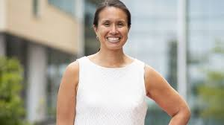
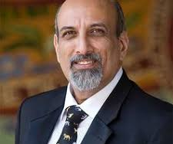
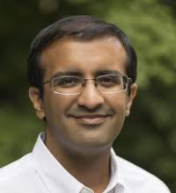
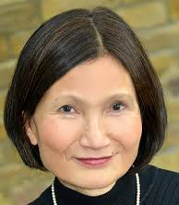

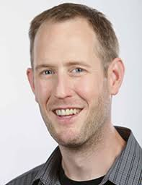
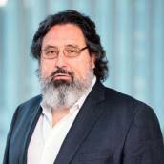
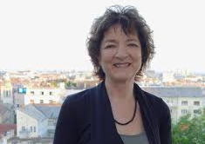

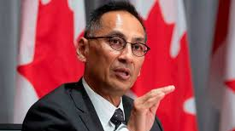
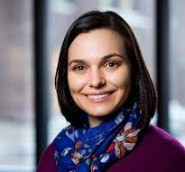
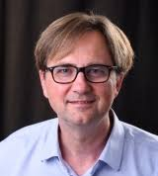
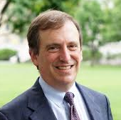

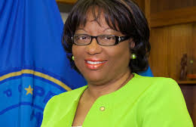
12 weeks
Recognized on McGill’s co-curricular record
Enrollment of 90 undergraduate and graduate students
Epidemiology, Public Health, Medicine, Nursing, and other
30+ Speakers

Slide 23
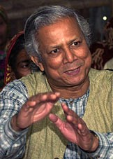
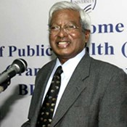
Entrepreneurship in Global Health
1/10/2022

Slide 24
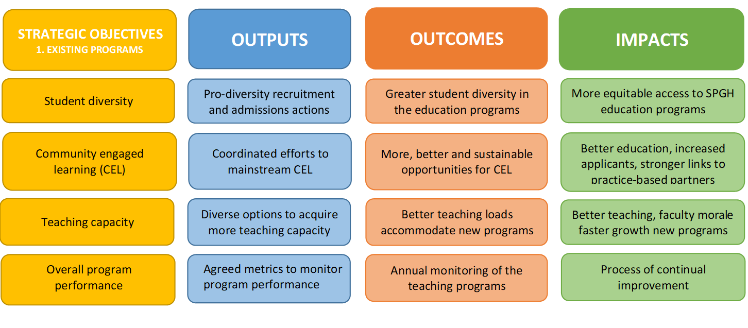
5. Metrics to Monitor Performance
Time to bring more evidence to bear on our educational endeavours!
Indicative results framework related to the objective of improving existing education programs

Slide 25
“You can’t solve a problem on the
same level that it was created.
You have to rise above it to
the next level.”
–Albert Einstein

Slide 26
Thank You!
Questions?

