Slide 1
Projections of climate impact on child undernutrition in Burkina Faso:
The importance of empirical epidemiological studies
60th Jubilee-Symposium
“Climate change and pandemics: the persistent burden for global health systems”
Dr Kristine Belesova
Assistant Professor, London School of Hygiene and Tropical Medicine

Slide 2
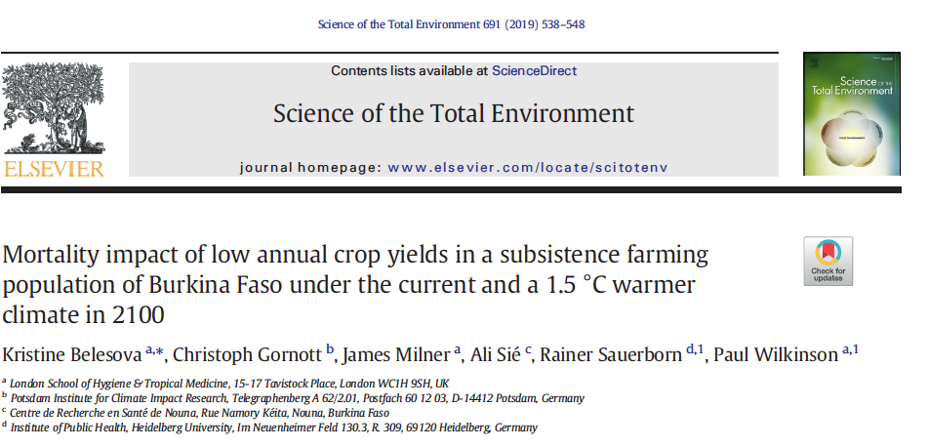
Notes:
The retrospective analyses focused on the development of the exposure-response functions (ERF) from crop yields to child mortality (or survival). In the first project phase, we completed retrospective analyses and developed empirical evidence on the association of child survival with annual crop yield variations in relation to child survival at different stages around early life development. This evidence was essential to inform on the most appropriate way of specifying the Exposure – Response functions. A preliminary version of this ERF had been developed in relation to children’s exposure to crop yield variations in the year of birth (Belesova et al, 2017). These analyses left a set of important questions on: whether this association was a consequence of in utero exposures or of poor nutrition during the first year of life, whether similar associations exist when mothers are exposed to low annual crop yields before conception, and whether similar associations exist when children are exposed to low annual crop yields after the first year of life.

Slide 3

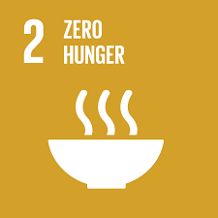

Background
Poor crop yield – a risk factor for child undernutrition and poor survival
1/3 of yield variation related to climate variability
WHO & IPCC recognize undernutrition as one of the greatest health impacts of climate change
By 2050 climate change estimated to result in
  45% increase child stunting in West Africa
  16,105 additional child deaths in West Africa
But these estimates
  not empirically-grounded
  global/regional – may reflect impacts on subsistence farmers
Notes:
there is concern that climate change may increase the frequency and severity of yield losses

Slide 4
Aim
To quantify the impact of low crop yields on child mortality in a subsistence farming population of Burkina Faso
To attribute such impacts to unfavourable growing-season weather conditions, observed past and projected future
Notes:
quantifying the impact of low crop yields on child mortality in a subsistence farming population of Burkina Faso using some of the first available empirical evidence

Slide 5
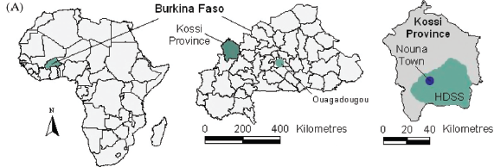
Setting, inputs
  Nouna HDSS population, Kossi province
  Subsistence farmers
  Rainfed agriculture
  Single agricultural production season: June to October
  Cereals: 72% of daily kcal intake
Notes:
Cereal crop yield is highly important

Slide 6
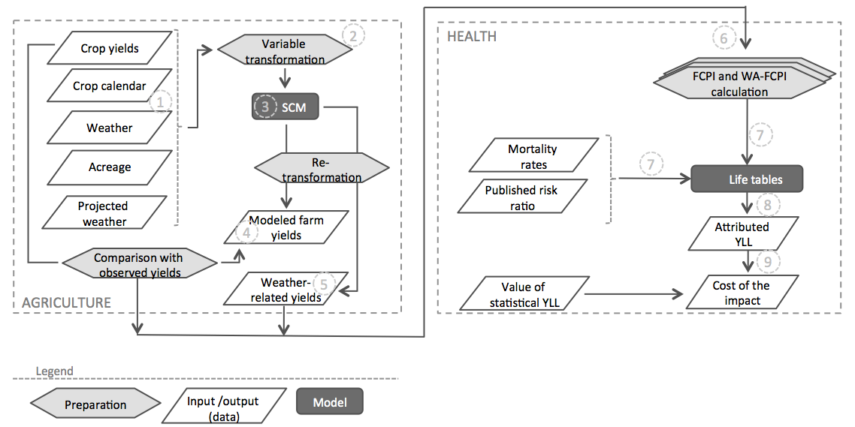
Modelling framework
Notes:
This diag represents our modelling framework – based on agricultural and health models
I will not go into detail of modelling methods. In short, agricultural modelling permitted us identifying the relationship between 5 main staple crop yields and weather as they were observed in the past 30 years and using this relationship to estimate the weather-related component of yield variation as well as project yield variation under 1.5C global warming scenario, as projected by 2 GCMs. For the health modelling part we used the observed yield variation, its weather-attributed part, and the variation projected under the scenario of global warming by 1.5C by the end of 21st c to calculate their corresponding exposure indices, which allowed combining variation across the 5 examined crop types. These exposure indices we then used in lifetables that were constructed using mortality rates of the Nouna HDSS population located in our study area and the mortality risk ratio related to annual crop yield variation in this area that we estimated in our previous study, which I will be presenting in a morning session tomorrow.
The model of mortality impact was based on a life table (a calculation framework for quantitative health impact assessment in relation to differences in hazard levels) [14] constructed for the Nouna population using HDSS data for 1992–2012, to which year-specific relative risks for child mortality were applied based on the year-specific estimates of crop yield. These relative mortality risks were derived from a published relationship between cereal crop yield in the year of birth and survival in children <5 years (further referred to as the exposure-response function) [4]. The relative risk for each calendar year was applied to the population born in that year for the first five years of life (assuming no effect beyond the age of 5 years). The measure of cereal crop yield used was the annual Food Crop Productivity Index (FCPI) [4]. The FCPI for year i reflects the per cent change in the yield across all of the main food crops (millet, sorghum, maize, fonio, rice), relative to the period annual mean yield for 1992–2012 (the same period as that used to derive the exposure-response function [4]). For example, a FCPI of 80% represents a 20% reduction in overall food crop yield in Kossi province relative to the period average. The FCPI was calculated as the sum of crop-specific yield changes – weighted by the annual proportion of the respective crop harvest across all five crops
Corrections: Crop yields – not farm yields
Explain FCPI

Slide 7
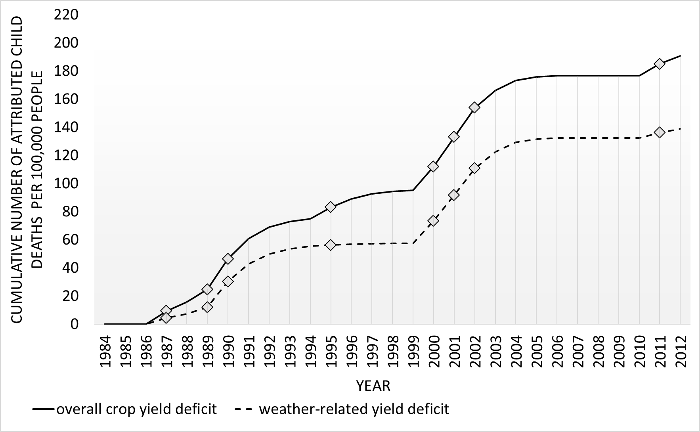
Calculation of a food availability index by the production-weighted crop yields
Food availability
Child mortality (< 5yr) attributable to weather induced food shortages (Food Crop Productivity Index < 90%)
Cum. child death/ 100,000 people
years of impact (FCPI<90%)
Belesova, Gornott, et al. 2019, Science of the Total Environment
7

Slide 8
1.5ºC warming scenario
Projected impact by 2100:
 | IPSL-CM5A-LR |  | MIROC5
 | 2015 (2000-2030) | 2100 (2085-2115) | 2015 (2000-2030) |  | 2100 (2085-2115)
% years with FCPI <100% <90% <80% | 73 37 3 | 70 57 7 | 67 17 0 |  | 70 37 3
Attributable U5 deaths, per 100,000 ppl Annual average Max per year of exposure | 6 14 | 10 19 | 2 9 |  | 6 15
Attributable YLL, per 100,000 people Annual average Max per year of exposure | 364 1,757 | 556 1,571 | 142 1,252 |  | 334 1,607
x2
x3
Notes:
X2-with rounding up
Great uncertainty – with all lower estimates compatible with no impact under our assumptions; upper estimates – YLL los – up to 25x higher

Slide 9
Conclusions
Appreciable impact of low yield on child mortality in Nouna HDSS
  Indicative of the impact in other similar populations in the region
Impacts largely related to weather effects on crop yields
  Interventions targeting crop sensitivity to weather
With weather conditions projected under 1.5ºC global warming impacts may increase 2-3 times (other factors being equal)
  Adds to the case for accelerated climate change mitigation

Slide 10
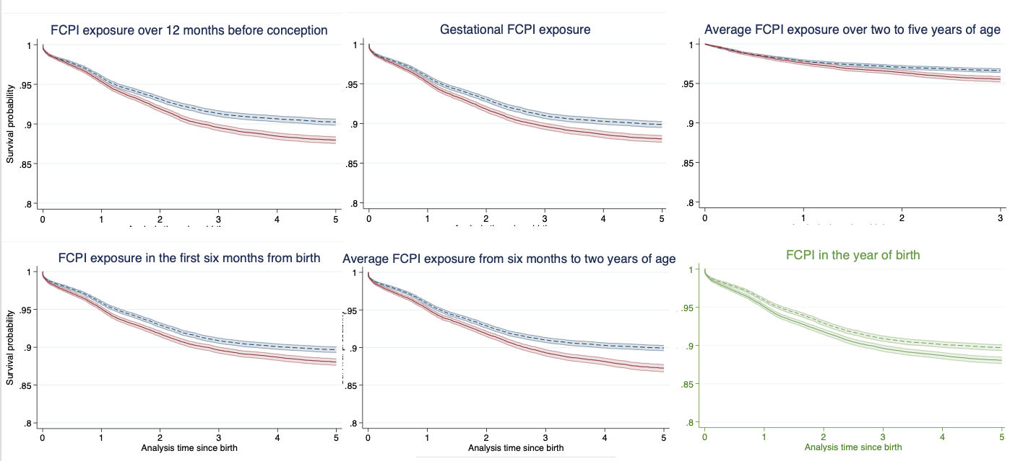
New empirical evidence
Notes:
Our analyses addressed these questions by examining how the ERF function differs in relation to the timing of children’s exposure to crop yield fluctuations at five periods in early child development: 12 months before conception, in utero, birth—6 months, 6 months—2 years, and 2—5 years of age. For these analyses we obtained and processed the latest available Nouna HDSS data capturing records of 57,288 children under 5 years of age followed up over 1994—2016 and yield data for the major five crop yields produced in the Kossi province over the corresponding time period.

Slide 11
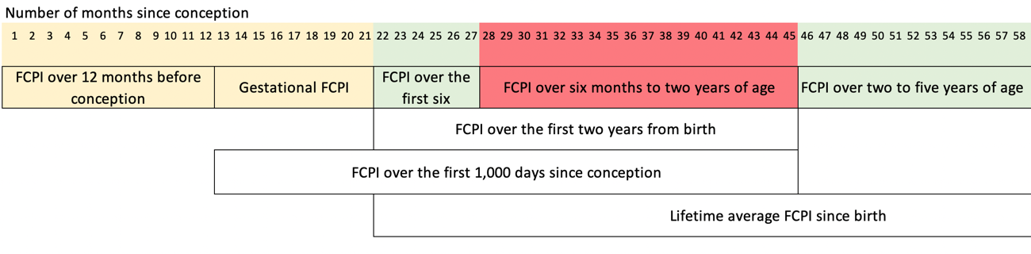
New Exposure-Response Function
Belesova et al 2022, AJE
Notes:
We used shared frailty Cox proportional hazards models adjusted for confounders an even more comprehensive set of confounders than the preliminary analyses. We found the strongest evidence for child survival to be associated with yields during the window of 6 months—2 years of age: adjusted mortality hazard ratio of 1.10 (95% confidence interval 1.03 to 1.19). We found weak to no evidence for associations with crop yield levels in other exposure windows. These findings suggest that child survival in this setting is particularly vulnerable to cereal crop yield reductions during the period of non-exclusive breastfeeding. This new evidence allows us to develop a more comprehensive ERF reflecting the survival risks that weather-related crop failure poses across the entire span of children’s life up to 5 years of age (instead of only the risk posed solely by exposures in the year of birth, as it was identified in our earlier work (Belesova et al, 2017, 2019)). Results of these analyses have been conditionally accepted by the J of Am Epidemi (Belesova et al, 2022).

Slide 12
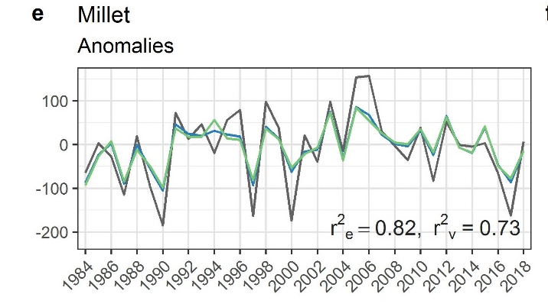
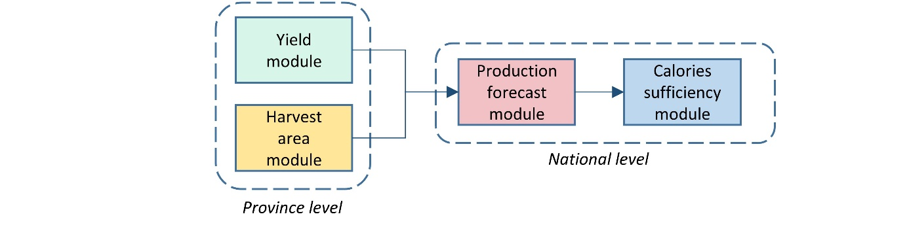
Food availability forecast for Burkina Faso
Laudien, …, Gornott 2022, Scientific Reports

Slide 13
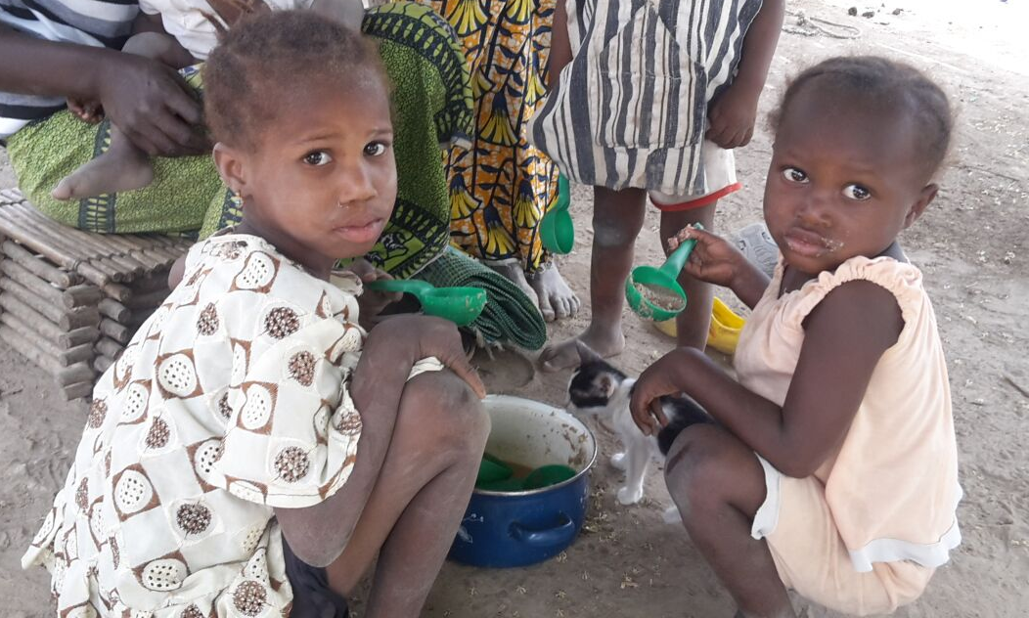
Thank you!
kristine.belesova@lshtm.ac.uk
Twitter: @kbelesova

Slide 14
Modelling future impacts
Population
Underlying health status
Scenarios of the future
Economic development
Nutrition-mortality/morbidity
Climate change
Weather-yield
Yield-nutrition
Local empirical data
Published literature
Local empirical data
Published literature
Local empirical data
Published literature
Sampling of multiple estimates
Sampling of multiple estimates
Sampling of multiple estimates
Sampling of multiple estimates
Health impact
Distribution of integrated impact estimates by Monte Carlo simulation – gives central estimate and joint uncertainty

